Slide 1


Module 3
Back-End Development & Integration
Notes:
In the Trainer would briefly explain the module name, and what are the crucial components of building web applications, software systems, and digital services.

Slide 2
Unit - 2
Back-End Frameworks - Django
Notes:
In this unit, we will study the back end framework – Django, which is a popular and powerful Python web framework that simplifies the process of building complex and dynamic web applications.

Slide 3
Disclaimer
The content is curated from online/offline resources and is used for educational purpose only
Notes:
Trainer would be briefing the students that this content has been prepared for the educational purpose only and is referred from multiple sites which are cited in the last.
---------------------------------------------------
A disclaimer is a statement or notice that is intended to clarify, limit, or provide information about the scope, limitations, or potential risks associated with certain actions, information, products, services, or content.

Slide 4

Learning Objectives
You will learn in this lesson:
Learn how to install Django and set up a development environment to start building web applications
Understand the Model-View-Template (MVT) architectural pattern used by Django and how it differs from traditional Model-View-Controller (MVC).
Learn how to define models in Django and perform database operations using Django's Object-Relational Mapping (ORM) capabilities.
Master the concept of URL routing and how to create views (functions) to handle HTTP requests and generate responses.
Learn how to create and use HTML templates to render dynamic content and serve static files like CSS and JavaScript.
Notes:
In this slide, Trainer would be making understand the students – What are the benefits of the topics, What will be objective. How the topic will be benefitted in order to develop the skill.
---------------------------------------------------
These are the expected knowledge, skills, and abilities that learners should acquire after completing a learning experience, such as a course, training program, workshop, or educational module.

Slide 5
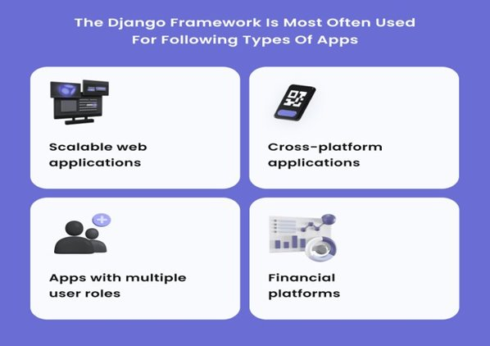
Use Case of Django
Django is a high-level web framework built with Python that enables developers to build web applications rapidly and efficiently.
Click here
Reference link
Notes:
In this slide- Trainer may ask the students some of the use case of the related topic, so that it creates a zeal among the students for the topic. May be students have used the technique before but they are not aware of the application areas. This slide will make them deep dive into the topic.
----------------------------------------------------------------------------------------------------------------
Django is indeed a high-level web framework that is built using the Python programming language. It is designed to empower developers to create web applications quickly and efficiently by providing a set of tools, libraries, and conventions that streamline the development process. With its robust features and well-structured architecture, Django is well-suited for developing complex and feature-rich web applications.

Slide 6

Introduction
Django is a free and open-source web framework written in Python that follows the Model-View-Template (MVT) architectural pattern. It was created to simplify and expedite the process of building web applications by providing a robust set of tools and conventionsDjango provides a high-level and clean design, which allows developers to focus on the application's functionality without getting bogged down by low-level implementation details. It comes with a collection of built-in features that handle common tasks such as URL routing, database management, authentication, security, and more.
Notes:
In this slide, Trainer would be making understand the students about the backend technology and give the brief explain about the framework
---------------------------------------------------------------------
Django is a popular and powerful Python web framework that simplifies the process of building complex and dynamic web applications. It follows the "Don't Repeat Yourself" (DRY) and "Convention over Configuration" (CoC) principles, which encourage developers to write clean, efficient code by providing a set of best practices and tools.
To start working with Django, you'll need to have Python installed on your system.
Django follows the Model-View-Template (MVT) architectural pattern, not the traditional Model-View-Controller (MVC) pattern.
In the MVT pattern:
Model
Agent
Template
In the MVT pattern:

Slide 7
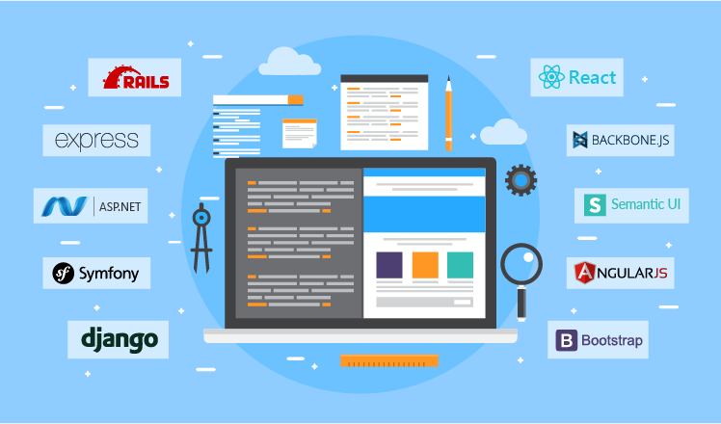
Web Framework
A web framework (WF) or web application framework (WAF) is a software framework that is designed to support the development of web applications including web services, web resources, and web APIs.
Web frameworks provide a standard way to build and deploy web applications on the World Wide Web.
Web frameworks aim to automate the overhead associated with common activities performed in web development.
Click here
Reference link
Notes:
In this slide - Trainer will briefing the students about the web framework
---------------------------------------------------
Web Application Framework or simply “web framework” is a software framework that is designed to support the development of web applications including web services, web resources, and web APIs. Frameworks are, in short, libraries that help you develop your application faster and smarter!
Web frameworks provide a standard way to build and deploy web applications on the World Wide Web.
Web frameworks aim to automate the overhead associated with common activities performed in web development.

Slide 8
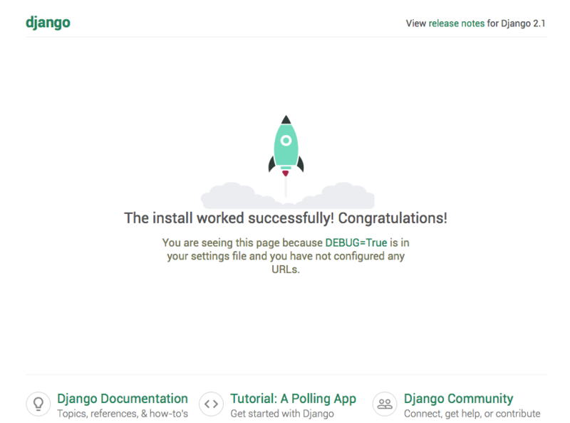
Introduction to Django
Django is a Python-based free and open-source web framework that follows the model–views- template(MVT) architectural pattern.
Django's primary goal is to ease the creation of complex, database-driven websites.
The framework emphasizes reusability and "pluggability" of components, less code, low coupling, rapid development, and the principle of don't repeat yourself.
Click here
Reference link
Notes:
In this slide - Trainer will briefing the students about the Django framework
---------------------------------------------------
Django is a Python-based free and open-source web framework that follows the model–views- template(MVT) architectural pattern.
Django's primary goal is to ease the creation of complex, database-driven websites.
The framework emphasizes reusability and "pluggability" of components, less code, low coupling, rapid development, and the principle of don't repeat yourself.
Django is a high-level, open-source web framework written in Python that makes it easier to build web applications quickly and efficiently. It follows the Model-View-Template (MVT) architectural pattern, which is similar to the more common Model-View-Controller (MVC) pattern. Django provides a wide range of tools and libraries that simplify various aspects of web development, allowing developers to focus on building robust and feature-rich applications.

Slide 9
Django Features
Helps you to define patterns for the URLs in your application
Simple but powerful URL system
Built-in authentication system
Object-oriented programming language database which offers best in class data storage and retrieval
Automatic admin interface feature allows the functionality of adding, editing and deleting items. You can customize the admin panel as per your need.
It is used for Rapid Development
Secure
Open Source
Vast and Supported Community
Notes:
In this slide - Trainer will briefing the students about the Django Features
---------------------------------------------------
Versatility of Django Django can build almost any type of website. It can also work with any client-side framework and can deliver content in any format such as HTML, JSON, XML etc. Some sites which can be built using Django are wikis, social networks, new sites etc.
Security Since Django framework is made for making web development easy, it has been engineered in such a way that it automatically do the right things to protect the website. For example, In the Django framework instead of putting a password in cookies, the hashed password is stored in it so that it can’t be fetched easily by hackers.
Scalability Django web nodes have no stored state, they scale horizontally – just fire up more of them when you need them. Being able to do this is the essence of good scalability. Instagram and Disqus are two Django based products that have millions of active users, this is taken as an example of the scalability of Django.
Portability All the codes of the Django framework are written in Python, which runs on many platforms. Which leads to run Django too in many platforms such as Linux, Windows and Mac OS.
URL Routing and Patterns: Django provides a powerful URL routing system that helps you define patterns for the URLs in your application. This routing system maps URLs to corresponding views or functions, making it easy to organize and structure your application's URLs.
Simplicity and Flexibility: Django's URL system is designed to be simple yet versatile, allowing you to create complex URL patterns while maintaining readability and clarity.
Rapid Development: Django's built-in features and conventions promote rapid development by minimizing the need to write repetitive code and providing solutions for common tasks.

Slide 10
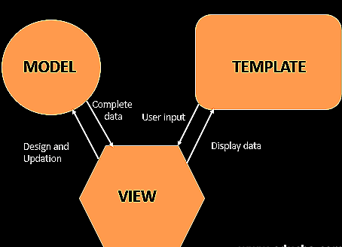
Django Architecture
Model-View-Template (MVT) Architecture
Django is based on MVT (Model-View-Template) architecture. MVT is a software design pattern for developing a web application.
M stands for Model
V stands for View
T stands for Template
Click here
Reference link
Notes:
In this slide - Trainer will briefing and showing the students about the Django Architecture
---------------------------------------------------
Django is based on MVT (Model-View-Template) architecture. MVT is a software design pattern for developing a web application. The MVT (Model-View-Template) architecture is a design pattern used by the Django web framework to structure and organize the components of a web application. It's similar to the more commonly known MVC (Model-View-Controller) pattern, but with a slightly different approach.
Model: Defines data structures and handles interactions with the database.
View: Handles user requests, processes data from the model, and decides how to present it.
Template: Represents the visual presentation of data, separate from the application logic.

Slide 11
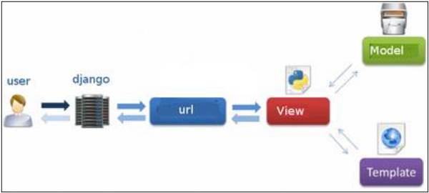
Model-View-Template (MVT) Architecture (Continued)
MVT Structure has the following three parts –
Model: The model is going to act as the interface of your data. It is responsible for maintaining data. It is the logical data structure behind the entire application and is represented by a database (generally relational databases such as MySql, Postgres).
View: The View is the user interface — what you see in your browser when you render a website. It is represented by HTML/CSS/Javascript and Jinja files.
Template: A template consists of static parts of the desired HTML output as well as some special syntax describing how dynamic content will be inserted.
Click here
Reference link
Notes:
In this slide - Trainer will briefing and explain the students about the
Model-View-Template (MVT) Architecture
---------------------------------------------------
Model: The Model component is responsible for managing the data and the business logic of the application. In Django, a model is a Python class that defines the data structure and relationships. Each model class corresponds to a database table, and the attributes of the class represent the fields in the table. The Django ORM (Object-Relational Mapping) facilitates the interaction between models and the underlying database. This component handles tasks like data validation, querying, and representing the data.
View: The View component handles the presentation logic and user interface. It receives requests from the user and communicates with the model to fetch the necessary data. Unlike traditional MVC, where the controller interacts directly with the model, in the MVT pattern, the view serves this role. It processes the data and decides how it should be presented to the user. In Django, views can be functions or classes and return HTTP responses, often by rendering templates.
Template: The Template component is responsible for rendering the user interface and displaying the data to users. Templates are HTML files with placeholders for dynamic content, which are filled in by the view. The template system allows developers to insert variables, conditions, loops, and more directly into the HTML structure. This separation of logic (in the view) and presentation (in the template) ensures cleaner and more maintainable code.

Slide 12
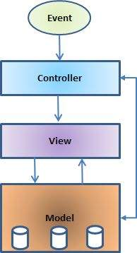
Model-View-Controller (MVC) Architecture
Model View Controller or MVC as it is popularly called, is a software design pattern for developing web applications.
A Model View Controller pattern is made up of the following three parts −
Model − The lowest level of the pattern which is responsible for maintaining data.
View − This is responsible for displaying all or a portion of the data to the user.
Controller − Software Code that controls the interactions between the Model and View.
Click here
Reference link
Notes:
In this slide - Trainer will briefing and explain the students about the
Model-View-Controller (MVC) Architecture
---------------------------------------------------
Model: The Model is responsible for managing the data and the business logic of the application. It represents the application's data structure, handles data storage, retrieval, and manipulation, and defines the rules for how the data should be treated. In the context of web applications, the Model often interacts with a database to store and retrieve data. The Model notifies the View and the Controller when data changes.
View: The View is responsible for presenting the data to the user and handling the user interface. It displays the data retrieved from the Model and provides a visual representation of that data. Views are typically responsible for rendering templates, which define the layout and structure of the user interface. Views are passive components that do not contain business logic; their primary purpose is to ensure a clear separation between data and presentation.
Controller: The Controller acts as an intermediary between the Model and the View. It receives user input and initiates appropriate actions based on that input. The Controller interprets user requests, interacts with the Model to retrieve or modify data, and then updates the View to reflect the changes. It plays a vital role in determining how the application responds to user interactions. The Controller contains the application's logic for handling user actions and orchestrating the flow of data.

Slide 13
Model-View-Controller (MVC) Architecture (Continued)
The Model
The model is responsible for managing the data of the application. It responds to the request from the view and it also responds to instructions from the controller to update itself.
The View
It means presentation of data in a particular format, triggered by a controller's decision to present the data. They are script-based templating systems like JSP, ASP, PHP and very easy to integrate with AJAX technology.
The Controller
The controller is responsible for responding to the user input and perform interactions on the data model objects. The controller receives the input, it validates the input and then performs the business operation that modifies the state of the data model.
Click here
Reference link
Notes:
In this slide - Trainer will briefing and explain the students about the
Model-View-Controller (MVC) Architecture
---------------------------------------------------
MVC is popular as it isolates the application logic from the user interface layer and supports separation of concerns. Here the Controller receives all requests for the application and then works with the Model to prepare any data needed by the View. The View then uses the data prepared by the Controller to generate a final presentable response. The MVC abstraction can be graphically represented as shown in Fig1.
The Model
The model is responsible for managing the data of the application. It responds to the request from the view and it also responds to instructions from the controller to update itself.
The View
It means presentation of data in a particular format, triggered by a controller's decision to present the data. They are script-based templating systems like JSP, ASP, PHP and very easy to integrate with AJAX technology.
The Controller
The controller is responsible for responding to the user input and perform interactions on the data model objects. The controller receives the input, it validates the input and then performs the business operation that modifies the state of the data model.

Slide 14

In this section, Let us work practically. Lets get your hands dirty with code
Installation of Django
Creating the first project with django
Notes:
In this slide - Trainer will briefing and showing the students how to install django
---------------------------------------------------
1. Install Python: Before installing Django, make sure you have Python installed on your system. You can download Python from the official website: https://www.python.org/downloads/
2. Install Django: Once you have Python installed, you can use the package manager pip to install Django.
Open your command prompt or terminal and run: pip install django

Slide 15

Installation of Django
Creating environment for Django project
Install latest version of python
Check installed version
Install pipenev
Install visual studio code editor
Install Django
Create virtual environment
Install django
Notes:
In this slide - Trainer will briefing and showing the students how to install django
---------------------------------------------------
1. Install Python: Before you can install Django, you need to have Python installed on your system. You can download Python from the official website: https://www.python.org/downloads/
2. Install Django: Once Python is installed, you can use the package manager pip to install Django. Follow these steps:
Windows: Open the Command Prompt or PowerShell and run: pip install django
Verify Installation: After the installation is complete, you can verify it by running:

Slide 16
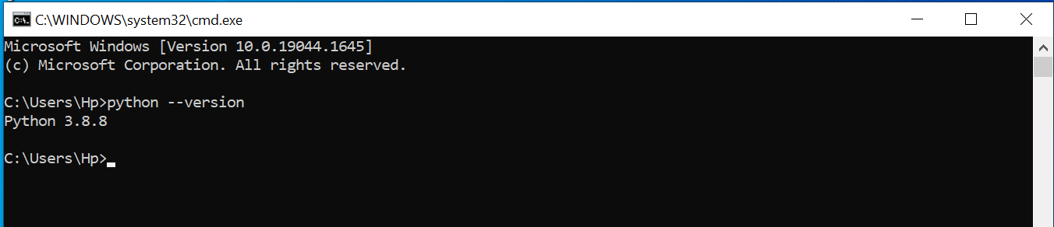
Installation of Django
Step 1) Creating environment for Django project
A) Install latest version of python
Download and install latest version of python from the url https://www.python.org/downloads/
B) Check for installed version of python
Press Window + R to open command prompt
Type cmd in open box and press ok button
Command prompt will open
On command prompt type following command, it will display the current python version installed on your laptop
> python --version
Notes:
In this slide - Trainer will briefing and showing the students how to Installation of Django setting up the environment
https://www.python.org/downloads/
---------------------------------------------------
Step 1) Creating environment for Django project
A) Install latest version of python
Download and install latest version of python from the url https://www.python.org/downloads/
B) Check for installed version of python
Press Window + R to open command prompt
Type cmd in open box and press ok button
Command prompt will open
On command prompt type following command, it will display the current python version installed on your laptop
> python --version

Slide 17
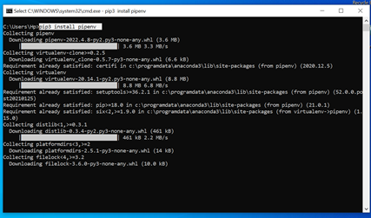
Step 1) Creating environment for Django project (Continued)
C) Install pipenev
> pip3 install pipenv
Notes:
In this slide - Trainer will briefing and showing the students how to Creating environment for Django project
---------------------------------------------------
C) Install pipenev
> pip3 install pipenv

Slide 18
Step 1) Creating environment for Django project (Continued)
D) Install visual studio code editor
Visit URI and download https://code.visualstudio.com/
Notes:
In this slide - Trainer will briefing and showing the students how to
Creating environment for Django Project
---------------------------------------------------
Install visual studio code editor
Visit URI and download https://code.visualstudio.com/

Slide 19
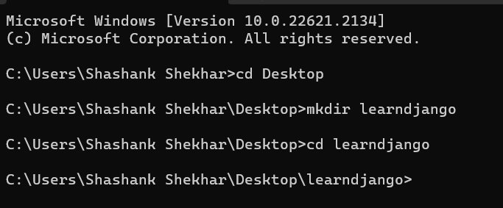
Step 2) Creating the first Project with django
A) Switch to Desktop
> cd Desktop
B) Create Project folder
> mkdir <<projectname_folder>>
> mkdir learndjango
Move to learndjango directory
>cd learndjango
Notes:
In this slide - Trainer will briefing and showing the students how to
Creating the first Project with django
---------------------------------------------------
A) Switch to Desktop
> cd Desktop
B) Create Project folder
> mkdir <<projectname_folder>>
> mkdir learndjango
Move to learndjango directory
>cd learndjango

Slide 20
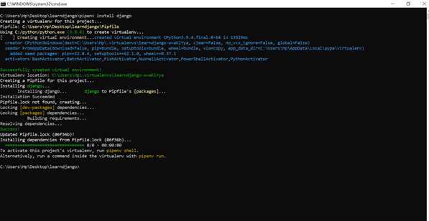
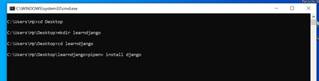
Step 2) Creating the first Project with django
C) Install django
>pipenv install django
Successfully created the virtual environment
Notes:
In this slide - Trainer will briefing and showing the students how to
Creating the first Project with django
---------------------------------------------------
Install django using this command
>pip install django

Slide 21
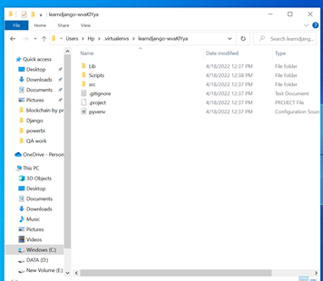
Step 2) Creating the first Project with django
C) Install django (Continued)
Virtual environment location is shown in above image C:\Users\Hp\.virtualenvs\learndjango-wvaKlYya
Notes:
In this slide - Trainer will briefing and showing the students how to
Create Virtual Enviroment
---------------------------------------------------
>py -m venv myproject

Slide 22
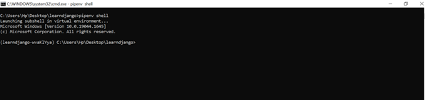
Step 2) Creating the first Project with django
C) Install django (Continued)
Activate python interpreter under this virtual environment
>pipenv shell
Notes:
In this slide - Trainer will briefing and showing the students how to
Activate python interpreter under this virtual environment
---------------------------------------------------
>pipenv shell

Slide 23
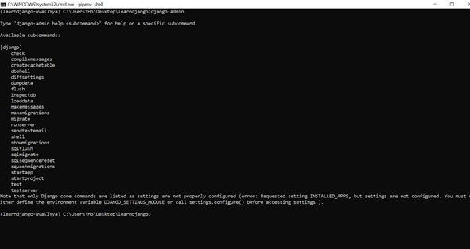
Step 2) Creating the first Project with django
C) Install django (Continued)
Run django-admin to start new project.
django admin is utility comes along with django
>django-admin
Notes:
In this slide - Trainer will briefing and showing the students how to Run django-admin to start new project.
---------------------------------------------------
django admin is utility comes along with django
>django-admin

Slide 24
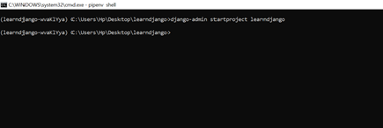
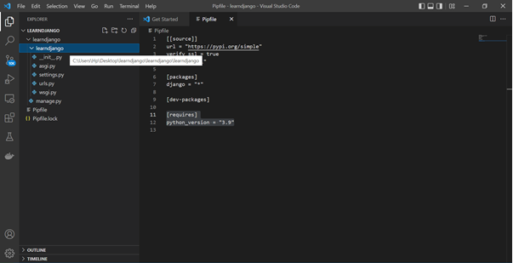
Step 2) Creating the first Project with django
D) start our project learndjango
django-admin startproject <<project_name>>
> django-admin startproject learndjango
It creates the two directories with the same name learndjango
-First directory learndjango is the project directory and second directory learndjango is the django application directory
-delete the first directory learndjango and go to the command prompt
Notes:
In this slide - Trainer will briefing and showing the students how to Run django-admin to start new project.
---------------------------------------------------
start our project learndjango
django-admin startproject <<project_name>>
> django-admin startproject learndjango
It creates the two directories with the same name learndjango
First directory learndjango is the project directory and second directory learndjango is the django application directory
delete the first directory learndjango and go to the command prompt

Slide 25
Step 2) Creating the first Project with django
E) Go Back to the terminal and execute the command
django-admin startproject learndjango .
It will use current directory as our project directory .It will now not going to create the additional directory.
Notes:
In this slide - Trainer will briefing and showing the students how to Go Back to the terminal and execute the command
> django-admin startproject learndjango .
---------------------------------------------------
Go Back to the terminal and execute the command
> django-admin startproject learndjango .
It will use current directory as our project directory .It will now not going to create the additional directory.

Slide 26
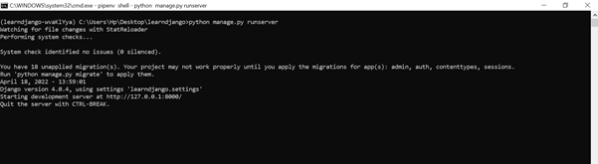
Step 2) Creating the first Project with django
F) Start webserver
Start webserver - Run the command
>python manage.py runserver
It will start server at http://127.0.0.1:8000/
Notes:
In this slide - Trainer will briefing and showing the students how to run the project
---------------------------------------------------
Start the webserver using this command
>python manage.py runserver
It will start server at http://127.0.0.1:8000/

Slide 27
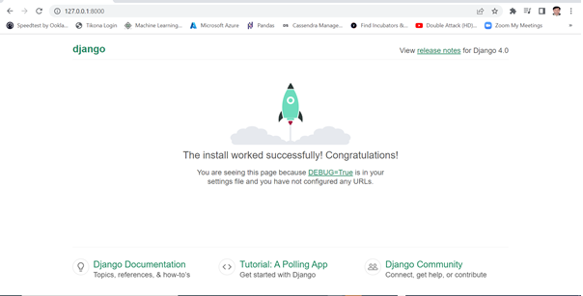
Step 2) Creating the first Project with django
G) Load the landing page/welcome page of Django
Now open browser and type address http://127.0.0.1:8000/ to open home page of our Django project learndjango
Congratulation! You have installed and run the Django home page successfully.
Notes:
In this slide - Trainer will briefing and showing the students the webpage in localhost
---------------------------------------------------
Now open browser and type address http://127.0.0.1:8000/ to open home page of our Django project learndjango
Loading the Landing/Home Page
Finally the message is showing
Congratulation! You have installed and run the Django home page successfully.
Now Successfully run our project

Slide 28
Writing Your First Django App: Basic Poll Application
Throughout this tutorial section, we’ll walk you through the creation of a basic poll application.
It’ll consist of two parts:
A public site that lets people view polls and vote in them.
An admin site that lets you add, change, and delete polls.
We’ll assume you have Django installed already. You can tell Django is installed and which version by running the following command in a command prompt
> python -m django --version
If Django is installed, you should see the version of your installation. If it isn’t, you’ll get an error telling “No module named django”.
This tutorial is written for Django 4.0, which supports Python 3.8 and later.
Notes:
In this slide - Trainer will briefing and showing the students how to Writing Your First Django App: Basic Poll Application
---------------------------------------------------
Now, we’ll walk you through the creation of a basic poll application.
It’ll consist of two parts:
A public site that lets people view polls and vote in them.
An admin site that lets you add, change, and delete polls.
We’ll assume you have Django installed already. You can tell Django is installed and which version by running the following command in a command prompt
> python -m django --version
If Django is installed, you should see the version of your installation. If it isn’t, you’ll get an error telling “No module named django”.
This tutorial is written for Django 4.0, which supports Python 3.8 and later.

Slide 29
Writing Your First Django App: Basic Poll Application
Creating your project
If this is your first time using Django, you’ll have to take care of some initial setup. Namely, you’ll need to auto-generate some code that establishes a Django project – a collection of settings for an instance of Django, including database configuration, Django-specific options and application-specific settings.
From the command line, cd into a directory where you’d like to store your code, then run the following command:
> django-admin startproject mysite
This will create a mysite directory in your current directory.
Notes:
In this slide - Trainer will briefing and showing the students how to Create a basic application
---------------------------------------------------
If this is your first time using Django, you’ll have to take care of some initial setup. Namely, you’ll need to auto-generate some code that establishes a Django project – a collection of settings for an instance of Django, including database configuration, Django-specific options and application-specific settings.
From the command line, cd into a directory where you’d like to store your code, then run the following command:
> django-admin startproject mysite
This will create a mysite directory in your current directory.

Slide 30
Writing Your First Django App: Basic Poll Application
Creating your project (Continued)
Let’s look at what startproject created:
mysite/
manage.py
mysite/
__init__.py
settings.py
urls.py
asgi.py
wsgi.py
We will discuss on these files in next slide.
Notes:
In this slide - Trainer will showing the students the project with Parent and Sub Directories
---------------------------------------------------

Slide 31
Writing Your First Django App: Basic Poll Application
Creating your project (Continued)
Let us discuss on different files created by Django . These files are as follows:
The outer mysite/ root directory is a container for your project. Its name doesn’t matter to Django; you can rename it to anything you like.
manage.py: A command-line utility that lets you interact with this Django project in various ways. You can read all the details about manage.py in django-admin and manage.py.
The inner mysite/ directory is the actual Python package for your project. Its name is the Python package name you’ll need to use to import anything inside it (e.g. mysite.urls).
mysite/__init__.py: An empty file that tells Python that this directory should be considered a Python package.
Notes:
In this slide - Trainer will showing the students Creating your project (Continued)
----------------------------------------------------------------------------------
The outer mysite/ root directory is a container for your project. Its name doesn’t matter to Django; you can rename it to anything you like.
manage.py: A command-line utility that lets you interact with this Django project in various ways. You can read all the details about manage.py in django-admin and manage.py.
The inner mysite/ directory is the actual Python package for your project. Its name is the Python package name you’ll need to use to import anything inside it (e.g. mysite.urls).
mysite/__init__.py: An empty file that tells Python that this directory should be considered a Python package.

Slide 32
Writing Your First Django App: Basic Poll Application
Creating your project (Continued)
Let us discuss on different files created by Django (Continued)
mysite/urls.py: The URL declarations for this Django project; a “table of contents” of your Django-powered site. You can read more about URLs in URL dispatcher.
mysite/asgi.py: An entry-point for ASGI-compatible web servers to serve your project. See How to deploy with ASGI for more details.
mysite/wsgi.py: An entry-point for WSGI-compatible web servers to serve your project. See How to deploy with WSGI for more details.
Notes:
In this slide - Trainer will showing the studentsCreating your project (Continued)
---------------------------------------------------------------
mysite/urls.py: The URL declarations for this Django project; a “table of contents” of your Django-powered site. You can read more about URLs in URL dispatcher.
mysite/asgi.py: An entry-point for ASGI-compatible web servers to serve your project. See How to deploy with ASGI for more details.
mysite/wsgi.py: An entry-point for WSGI-compatible web servers to serve your project. See How to deploy with WSGI for more details.

Slide 33
Writing Your First Django App: Basic Poll Application
The development server : Run the server
Let’s verify your Django project works. Change into the outer mysite directory, if you haven’t already, and run the following commands:
>python manage.py runserver
You’ll see the following output on the command line:
Performing system checks...
System check identified no issues (0 silenced).
You have unapplied migrations; your app may not work properly until they are applied.
Run 'python manage.py migrate' to apply them.
April 20, 2022 - 15:50:53
Django version 4.0, using settings 'mysite.settings'
Starting development server at http://127.0.0.1:8000/
Quit the server with CONTROL-C.
Ignore the warning about unapplied database migrations for now; we’ll deal with the database shortly.
Notes:
In this slide - Trainer will showing the students Poll Application run the Development Server
------------------------------------------------------------------
Let’s verify your Django project works.
Change into the outer mysite directory, if you haven’t already, and run the following commands:
>python manage.py runserver

Slide 34
Writing Your First Django App: Basic Poll Application
The development server : Changing the port :
By default, the runserver command starts the development server on the internal IP at port 8000.
If you want to change the server’s port, pass it as a command-line argument. For instance, this command starts the server on port 8080:
>python manage.py runserver 8080
If you want to change the server’s IP, pass it along with the port. For example, to listen on all available public IPs (which is useful if you are running Vagrant or want to show off your work on other computers on the network), use:
>python manage.py runserver 0:8000
0 is a shortcut for 0.0.0.0.
Automatic reloading of runserver
Notes:
In this slide - Trainer will showing the students Changing the port :
--------------------------------------------------------------
By default, the runserver command starts the development server on the internal IP at port 8000.
If you want to change the server’s port, pass it as a command-line argument. For instance, this command starts the server on port 8080:
>python manage.py runserver 8080
If you want to change the server’s IP, pass it along with the port. For example, to listen on all available public IPs (which is useful if you are running Vagrant or want to show off your work on other computers on the network), use:
>python manage.py runserver 0:8000
0 is a shortcut for 0.0.0.0.
Automatic reloading of runserver

Slide 35
Writing Your First Django App: Basic Poll Application
The development server : Automatic reloading of runserver
The development server automatically reloads Python code for each request as needed. You don’t need to restart the server for code changes to take effect. However, some actions like adding files don’t trigger a restart, so you’ll have to restart the server in these cases.
Notes:
In this slide - Trainer will showing the students Automatic reloading of runserver
---------------------------------------------
The development server automatically reloads Python code for each request as needed. You don’t need to restart the server for code changes to take effect. However, some actions like adding files don’t trigger a restart, so you’ll have to restart the server in these cases.

Slide 36
Writing Your First Django App: Basic Poll Application
Creating the poll app
Projects vs. apps
What’s the difference between a project and an app? An app is a web application that does something – e.g., a blog system, a database of public records or a small poll app. A project is a collection of configuration and apps for a particular website. A project can contain multiple apps. An app can be in multiple projects.
Notes:
In this slide - Trainer will explain the students Projects vs. apps
--------------------------------------------------------------------------
Project: A project in Django represents the entire web application. It's the highest-level container that contains all the configuration settings, URLs, and multiple apps. A project is created using the startproject command, and it typically contains settings, URL routing, and other project-wide configurations.
App: An app in Django is a self-contained module that focuses on a specific functionality or component of the application.
In Django, both projects and apps are fundamental concepts that contribute to the structure and organization of your web application.
An app is a web application that does something – e.g., a blog system, a database of public records or a small poll app.
A project is a collection of configuration and apps for a particular website.
A project can contain multiple apps. An app can be in multiple projects.

Slide 37
Writing Your First Django App: Basic Poll Application
Creating the poll app
Now that your environment – a “project” – is set up, you’re set to start doing work.
Each application you write in Django consists of a Python package that follows a certain convention. Django comes with a utility that automatically generates the basic directory structure of an app, so you can focus on writing code rather than creating directories.
Your apps can live anywhere on your Python path. In this tutorial, we’ll create our poll app in the same directory as your manage.py file so that it can be imported as its own top-level module, rather than a submodule of mysite.
To create your app, make sure you’re in the same directory as manage.py and type this command:
>python manage.py startapp polls
Notes:
In this slide - Trainer will showing the studentsb Creating the poll app
------------------------------------------------
Now that your environment – a “project” – is set up, you’re set to start doing work.
Each application you write in Django consists of a Python package that follows a certain convention. Django comes with a utility that automatically generates the basic directory structure of an app, so you can focus on writing code rather than creating directories.
Your apps can live anywhere on your Python path. In this tutorial, we’ll create our poll app in the same directory as your manage.py file so that it can be imported as its own top-level module, rather than a submodule of mysite.
To create your app, make sure you’re in the same directory as manage.py and type this command:
>python manage.py startapp polls

Slide 38
Writing Your First Django App: Basic Poll Application
Creating the poll app
Now that your environment – a “project” – is set up, you’re set to start doing work.
That’ll create a directory polls, which is laid out like this:
polls/
__init__.py
admin.py
apps.py
migrations/
__init__.py
models.py
tests.py
views.py
This directory structure will house the poll application.
Notes:
In this slide - Trainer will ask the students to create a project
Now that your environment – a “project” – is set up, you’re set to start doing work.
That’ll create a directory polls, which is laid out like this:
Show the image
This directory structure will house the poll application.

Slide 39
Writing Your First Django App: Basic Poll Application
Creating the poll app: Write your first view
Now that your environment – a “project” – is set up, you’re set to start doing work.
Let’s write the first view. Open the file polls/views.py and put the following Python code in it:
from django.http import HttpResponse
def index(request):
return HttpResponse("Hello, world. You're at the polls index.")
This is the simplest view possible in Django. To call the view, we need to map it to a URL - and for this we need a URLconf.
Notes:
In this slide - Trainer will showing the students to write the first view. Open the file polls/views.py and put the following Python code in it:
------------------------------------------------------------------------------
from django.http import HttpResponse
def index(request):
return HttpResponse("Hello, world. You're at the polls index.")
This is the simplest view possible in Django. To call the view, we need to map it to a URL - and for this we need a URLconf.

Slide 40
Writing Your First Django App: Basic Poll Application
Creating the poll app: Write your first view
To create a URLconf in the polls directory, create a file called urls.py. Your app directory should now look like:
polls/
__init__.py
admin.py
apps.py
migrations/
__init__.py
models.py
tests.py
urls.py
views.py
Notes:
In this slide - Trainer will showing the students how your project directory should look like
-----------------------------------------------------------------
To create a URLconf in the polls directory, create a file called urls.py. Your app directory should now look like:
Show the image

Slide 41
Writing Your First Django App: Basic Poll Application
Creating the poll app: Write your first view
In the polls/urls.py file include the following code:
from django.urls import path
from . import views
urlpatterns = [
path('', views.index, name='index'),
]
Notes:
In this slide - Trainer will briefing and showing the students about how to create view
---------------------------------------------------
Creating the poll app: Write your first view
In the polls/urls.py file include the following code:
from django.urls import path
from . import views
urlpatterns = [
path('', views.index, name='index'),
]

Slide 42
Writing Your First Django App: Basic Poll Application
Creating the poll app: Write your first view
The next step is to point the root URLconf at the polls.urls module. In mysite/urls.py, add an import for django.urls.include and insert an include() in the urlpatterns list, so you have
from django.contrib import admin
from django.urls import include, path
urlpatterns = [
path('polls/', include('polls.urls')),
path('admin/', admin.site.urls),
]
The include() function allows referencing other URLconfs. Whenever Django encounters include(), it chops off whatever part of the URL matched up to that point and sends the remaining string to the included URLconf for further processing.
Notes:
In this slide - Trainer will briefing and showing the students about url path
---------------------------------------------------
Creating the poll app: Write your first view
The next step is to point the root URLconf at the polls.urls module. In mysite/urls.py, add an import for django.urls.include and insert an include() in the urlpatterns list, so you have:
from django.contrib import admin
from django.urls import include, path
urlpatterns = [
path('polls/', include('polls.urls')),
path('admin/', admin.site.urls),
]
The include() function allows referencing other URLconfs. Whenever Django encounters include(), it chops off whatever part of the URL matched up to that point and sends the remaining string to the included URLconf for further processing.

Slide 43
Writing Your First Django App: Basic Poll Application
Creating the poll app: Write your first view
The idea behind include() is to make it easy to plug-and-play URLs. Since polls are in their own URLconf (polls/urls.py), they can be placed under “/polls/”, or under “/fun_polls/”, or under “/content/polls/”, or any other path root, and the app will still work.
Note: When to use include()
You should always use include() when you include other URL patterns. admin.site.urls is the only exception to this.
Notes:
In this slide - Trainer will briefing and showing the students about how to Creating the poll app: Write your first view
---------------------------------------------------
The idea behind include() is to make it easy to plug-and-play URLs. Since polls are in their own URLconf (polls/urls.py), they can be placed under “/polls/”, or under “/fun_polls/”, or under “/content/polls/”, or any other path root, and the app will still work.
Note: When to use include()
You should always use include() when you include other URL patterns. admin.site.urls is the only exception to this.

Slide 44
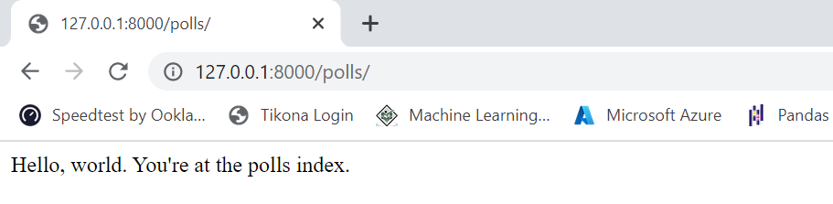
Writing Your First Django App: Basic Poll Application
Creating the poll app: Write your first view
You have now wired an index view into the URLconf. Verify it’s working with the following command:
>python manage.py runserver
Go to http://localhost:8000/polls/ in your browser, and you should see the text “Hello, world. You’re at the polls index.”, which you defined in the index view.
Notes:
In this slide - Trainer will briefing and showing the students about
Creating the poll app: Write your first view
------------------------------------------------------------------
You have now wired an index view into the URLconf. Verify it’s working with the following command:
>python manage.py runserver
Go to http://localhost:8000/polls/ in your browser, and you should see the text “Hello, world. You’re at the polls index.”, which you defined in the index view.

Slide 45
Writing your first Django app: Part 2
Migrating the database
We’ll set up the database, create your first model, and get a quick introduction to Django’s automatically-generated admin site.
Database setup
Now, open up mysite/settings.py. It’s a normal Python module with module-level variables representing Django settings.
By default, the configuration uses SQLite. SQLite is included in Python, so you won’t need to install anything else to support your database.
Notes:
In this slide - Trainer will briefing and showing the students about Creating the poll app: Write your first view
------------------------------------------------------------------------------------------
In the context of Django, migrating the database refers to applying changes to the database schema based on changes you've made to your models. This process keeps the database schema in sync with your code and model definitions.
Setting up a database in Django involves configuring the database connection settings in your project's settings file and then using migrations to create the initial schema.
You have now wired an index view into the URLconf. Verify it’s working with the following command:
>python manage.py runserver
Go to http://localhost:8000/polls/ in your browser, and you should see the text “Hello, world. You’re at the polls index.”, which you defined in the index view.

Slide 46
Writing your first Django app: Part 2
Migrating the database: Database setup (Continued)
If you wish to use another database, install the appropriate database bindings and change the following keys in the DATABASES 'default' item to match your database connection settings:
ENGINE – Either 'django.db.backends.sqlite3', 'django.db.backends.postgresql', 'django.db.backends.mysql', or 'django.db.backends.oracle'. Other backends are also available.
NAME – The name of your database. If you’re using SQLite, the database will be a file on your computer; in that case, NAME should be the full absolute path, including filename, of that file. The default value, BASE_DIR / 'db.sqlite3', will store the file in your project directory.
If you are not using SQLite as your database, additional settings such as USER, PASSWORD, and HOST must be added.
Notes:
In this slide - Trainer will briefing and showing the students about Migrating the database :Database setup (Continued)
---------------------------------------------------------------------------
If you wish to use another database, install the appropriate database bindings and change the following keys in the DATABASES 'default' item to match your database connection settings:
ENGINE – Either 'django.db.backends.sqlite3', 'django.db.backends.postgresql', 'django.db.backends.mysql', or 'django.db.backends.oracle'. Other backends are also available.
NAME – The name of your database. If you’re using SQLite, the database will be a file on your computer; in that case, NAME should be the full absolute path, including filename, of that file. The default value, BASE_DIR / 'db.sqlite3', will store the file in your project directory.
If you are not using SQLite as your database, additional settings such as USER, PASSWORD, and HOST must be added.
1. Make Model Changes: First, make any necessary changes to your models in your Django app. This could involve adding, modifying, or removing fields in your models.
2. Generate Migrations: After making changes to your models, you need to create migration files that capture the changes. Run the following command:
3. Apply Migrations: Once you have the migration files, you need to apply the changes to the actual database.
4. Check Migration Status

Slide 47
Writing your first Django app: Part 2
Setup Timezone , INSTALLED_APPS (Continued)
Some of these applications mentioned in previous slide make use of at least one database table, though, so we need to create the tables in the database before we can use them. To do that, run the following command:
>python manage.py migrate
The migrate command looks at the INSTALLED_APPS setting and creates any necessary database tables according to the database settings in your mysite/settings.py file and the database migrations shipped with the app
You’ll see a message for each migration it applies.
If you’re interested, run the command-line client for your database and type \dt (PostgreSQL), SHOW TABLES; (MariaDB, MySQL), .tables (SQLite), or SELECT TABLE_NAME FROM USER_TABLES; (Oracle) to display the tables Django created.
Notes:
Setup Timezone , INSTALLED_APPS (Continued)
Some of these applications mentioned in previous slide make use of at least one database table, though, so we need to create the tables in the database before we can use them. To do that, run the following command:
>python manage.py migrate
The migrate command looks at the INSTALLED_APPS setting and creates any necessary database tables according to the database settings in your mysite/settings.py file and the database migrations shipped with the app
You’ll see a message for each migration it applies.
If you’re interested, run the command-line client for your database and type \dt (PostgreSQL), SHOW TABLES; (MariaDB, MySQL), .tables (SQLite), or SELECT TABLE_NAME FROM USER_TABLES; (Oracle) to display the tables Django created.

Slide 48
Writing your first Django app: Part 2
Setup Timezone , INSTALLED_APPS
While you’re editing mysite/settings.py, set TIME_ZONE to your time zone.
Also, note the INSTALLED_APPS setting at the top of the file. That holds the names of all Django applications that are activated in this Django instance. Apps can be used in multiple projects, and you can package and distribute them for use by others in their projects.
By default, INSTALLED_APPS contains the following apps, all of which come with Django:
django.contrib.admin – The admin site. You’ll use it shortly.
django.contrib.auth – An authentication system.
django.contrib.contenttypes – A framework for content types.
django.contrib.sessions – A session framework.
django.contrib.messages – A messaging framework.
django.contrib.staticfiles – A framework for managing static files.
These applications are included by default as a convenience for the common case.
Notes:
In this slide - Trainer will briefing and showing the students about 1. Setting Timezone: 2. Configuring INSTALLED_APPS:
-----------------------------------------------------------------
1. Setting Timezone:
Open your project's settings.py file and locate the TIME_ZONE setting. Set the appropriate timezone according to your project's geographic location. Django uses the IANA Time Zone database to handle timezones.
Configuring INSTALLED_APPS:
The INSTALLED_APPS setting in your settings.py file lists all the Django apps that are part of your project. It includes both built-in apps provided by Django and any custom apps you create.
Add the names of the apps you want to include in your project. Each app's name should be in the format 'app_name'.
Make sure to include 'django.contrib.admin' for the Django admin interface and 'django.contrib.auth' for user authentication, as they are commonly used in most projects.
Adding an app to INSTALLED_APPS allows Django to recognize and use its components, such as models, views, templates, and URLs.

Slide 49
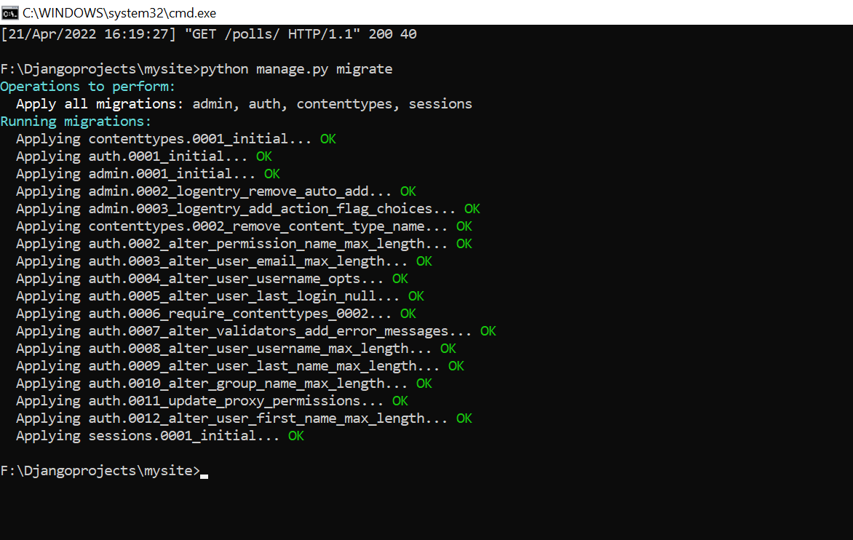
Writing your first Django app: Part 2
INSTALLED_APPS (Continued): Applying Migration
After Output after executing the command
> python manage.py migrate
Notes:
In this slide - Trainer will briefing and showing the students about INSTALLED_APPS (Continued): Applying Migration
-----------------------------------------------------------------------------------------------
After Output after executing the command
> python manage.py migrate

Slide 50
Writing your first Django app: Part 2
Creating models
Now we’ll define your models – essentially, your database layout, with additional metadata.
Overview-
A model is the single, definitive source of information about your data. It contains the essential fields and behaviors of the data you’re storing. Django follows the DRY Principle. The goal is to define your data model in one place and automatically derive things from it.
This includes the migrations - unlike in Ruby On Rails, for example, migrations are entirely derived from your models file, and are essentially a history that Django can roll through to update your database schema to match your current models.
Notes:
In this slide - Trainer will briefing and showing the students about Creating models
-------------------------------------------------------------------------------------
Now we’ll define your models – essentially, your database layout, with additional metadata.
Overview-
A model is the single, definitive source of information about your data. It contains the essential fields and behaviors of the data you’re storing. Django follows the DRY Principle. The goal is to define your data model in one place and automatically derive things from it.
This includes the migrations - unlike in Ruby On Rails, for example, migrations are entirely derived from your models file, and are essentially a history that Django can roll through to update your database schema to match your current models.

Slide 51
Writing your first Django app: Part 2
Creating models (Continued)
In our poll app, we’ll create two models: Question and Choice.
A Question has a question and a publication date.
A Choice has two fields: the text of the choice and a vote tally.
Each Choice is associated with a Question.
These concepts are represented by Python classes. Edit the polls/models.py file so it looks like this:
Notes:
In this slide - Trainer will briefing and showing the students about Creating models (Continued)
--------------------------------------------------------------------------------
In our poll app, we’ll create two models: Question and Choice.
A Question has a question and a publication date.
A Choice has two fields: the text of the choice and a vote tally.
Each Choice is associated with a Question.
These concepts are represented by Python classes. Edit the polls/models.py file so it looks like this:

Slide 52
Writing your first Django app: Part 2
Creating models (Continued)
These concepts are represented by Python classes. Edit the polls/models.py file so it looks like this:
from django.db import models
class Question(models.Model):
question_text = models.CharField(max_length=200)
pub_date = models.DateTimeField('date published')
class Choice(models.Model):
question = models.ForeignKey(Question, on_delete=models.CASCADE)
choice_text = models.CharField(max_length=200)
votes = models.IntegerField(default=0)
Notes:
In this slide - Trainer will briefing and showing the students about Creating models (Continued)
------------------------------------------------------------------
These concepts are represented by Python classes. Edit the polls/models.py file so it looks like this:
from django.db import models
class Question(models.Model):
question_text = models.CharField(max_length=200)
pub_date = models.DateTimeField('date published')
class Choice(models.Model):
question = models.ForeignKey(Question, on_delete=models.CASCADE)
choice_text = models.CharField(max_length=200)
votes = models.IntegerField(default=0)

Slide 53
Writing your first Django app: Part 2
Models explanation :
Here, each model is represented by a class that subclasses django.db.models.Model. Each model has a number of class variables, each of which represents a database field in the model.
Each field is represented by an instance of a Field class – e.g., CharField for character fields and DateTimeField for datetimes. This tells Django what type of data each field holds.
The name of each Field instance (e.g. question_text or pub_date) is the field’s name, in machine-friendly format. You’ll use this value in your Python code, and your database will use it as the column name.
You can use an optional first positional argument to a Field to designate a human-readable name. That’s used in a couple of introspective parts of Django, and it doubles as documentation. If this field isn’t provided, Django will use the machine-readable name. In this example, we’ve only defined a human-readable name for Question.pub_date. For all other fields in this model, the field’s machine-readable name will suffice as its human-readable name.
Notes:
In this slide - Trainer will briefing and showing the students about Models explanation :
-------------------------------------------------------------------------------
Models are a foundational aspect of Django's design, enabling you to define your data structures using Python code and providing a seamless interface for interacting with databases. They make it easier to manage your application's data and maintain data consistency.
Here, each model is represented by a class that subclasses django.db.models.Model. Each model has a number of class variables, each of which represents a database field in the model.
Each field is represented by an instance of a Field class – e.g., CharField for character fields and DateTimeField for datetimes. This tells Django what type of data each field holds.
The name of each Field instance (e.g. question_text or pub_date) is the field’s name, in machine-friendly format. You’ll use this value in your Python code, and your database will use it as the column name.
You can use an optional first positional argument to a Field to designate a human-readable name. That’s used in a couple of introspective parts of Django, and it doubles as documentation. If this field isn’t provided, Django will use the machine-readable name. In this example, we’ve only defined a human-readable name for Question.pub_date. For all other fields in this model, the field’s machine-readable name will suffice as its human-readable name.

Slide 54
Writing your first Django app: Part 2
Models explanation : (Continued )
Some Field classes have required arguments. CharField, for example, requires that you give it a max_length. That’s used not only in the database schema, but in validation, as we’ll soon see.
A Field can also have various optional arguments; in this case, we’ve set the default value of votes to 0.
Finally, note a relationship is defined, using ForeignKey. That tells Django each Choice is related to a single Question. Django supports all the common database relationships: many-to-one, many-to-many, and one-to-one.
Notes:
In this slide - Trainer will briefing and showing the students about Models explanation : (Continued )
-------------------------------------------------------------------
CharField: The CharField is used to define a field for storing character strings. It requires the max_length argument, which specifies the maximum length of the string that can be stored in that field. This max_length value is used for both creating the corresponding database column and for validating data before it's saved to the database.
Some Field classes have required arguments. CharField, for example, requires that you give it a max_length. That’s used not only in the database schema, but in validation, as we’ll soon see.
Django uses the max_length information in several ways:
To create the appropriate column size in the database table.
To validate the length of data before saving it to the database.
To render forms with appropriate input field sizes in the admin interface and templates.
To provide a clear understanding of the data constraints for developers and other team members.
A Field can also have various optional arguments; in this case, we’ve set the default value of votes to 0.
Finally, note a relationship is defined, using ForeignKey. That tells Django each Choice is related to a single Question. Django supports all the common database relationships: many-to-one, many-to-many, and one-to-one.

Slide 55
Writing your first Django app: Part 2
Activating models-
That small bit of model code gives Django a lot of information. With it, Django is able to:
Create a database schema (CREATE TABLE statements) for this app.
Create a Python database-access API for accessing Question and Choice objects.
Notes:
In this slide - Trainer will briefing and showing the students about Creating Models, Creating Migrations, Applying Migrations
-----------------------------------------------------------------------------------
Creating Models: Define your models by creating classes in your Django app's models.py file. Each class should inherit from django.db.models.Model. Define fields and relationships within these classes.
Creating Migrations: After defining your models, you need to create migrations that capture the changes in your models and generate the necessary SQL commands to update the database schema.
Applying Migrations: Apply the migrations to update the database schema based on your model changes
Using Models: Once your models are activated, you can start using them in your application. This includes creating, querying, updating, and deleting data using Django's ORM (Object-Relational Mapping) system.

Slide 56
Writing your first Django app: Part 2
Activating models-
First we need to tell our project that the polls app is installed
To include the app in our project, we need to add a reference to its configuration class in the INSTALLED_APPS setting. The PollsConfig class is in the polls/apps.py file, so its dotted path is 'polls.apps.PollsConfig'. Edit the mysite/settings.py file and add that dotted path to the INSTALLED_APPS setting. It’ll look like this:
INSTALLED_APPS = [
'polls.apps.PollsConfig',
'django.contrib.admin',
'django.contrib.auth',
'django.contrib.contenttypes',
'django.contrib.sessions',
'django.contrib.messages',
'django.contrib.staticfiles',
]
Notes:
In this slide - Trainer will briefing and showing the students about Activating models(Continued)
-------------------------------------------------------------------
First we need to tell our project that the polls app is installed
To include the app in our project, we need to add a reference to its configuration class in the INSTALLED_APPS setting.
The PollsConfig class is in the polls/apps.py file, so its dotted path is 'polls.apps.PollsConfig'. Edit the mysite/settings.py file and add that dotted path to the INSTALLED_APPS setting. It’ll look like this:
INSTALLED_APPS = [
'polls.apps.PollsConfig',
'django.contrib.admin',
'django.contrib.auth',
'django.contrib.contenttypes',
'django.contrib.sessions',
'django.contrib.messages',
'django.contrib.staticfiles',
]

Slide 57
Writing your first Django app: Part 2
Activating models-
Now Django knows to include the polls app. Let’s run another command:
>python manage.py makemigrations polls
You should see something similar to the following:
Migrations for 'polls':
polls/migrations/0001_initial.py
- Create model Question
- Create model Choice
By running makemigrations, you’re telling Django that you’ve made some changes to your models (in this case, you’ve made new ones) and that you’d like the changes to be stored as a migration.
Notes:
In this slide - Trainer will briefing and showing the students about Activating models(Continued)
------------------------------------------------------------
Now Django knows to include the polls app. Let’s run another command:
>python manage.py makemigrations polls
You should see something similar to the following:
Migrations for 'polls':
polls/migrations/0001_initial.py
- Create model Question
- Create model Choice
By running makemigrations, you’re telling Django that you’ve made some changes to your models (in this case, you’ve made new ones) and that you’d like the changes to be stored as a migration.

Slide 58
Writing your first Django app: Part 2
Activating models-
Migrations are how Django stores changes to your models (and thus your database schema) - they’re files on disk. You can read the migration for your new model if you like; it’s the file polls/migrations/0001_initial.py. Don’t worry, you’re not expected to read them every time Django makes one, but they’re designed to be human-editable in case you want to manually tweak how Django changes things.
There’s a command that will run the migrations for you and manage your database schema automatically - that’s called migrate, and we’ll come to it in a moment - but first, let’s see what SQL that migration would run. The sqlmigrate command takes migration names and returns their SQL:
>python manage.py sqlmigrate polls 0001
Notes:
In this slide - Trainer will briefing and showing the students about Activating models(Continued)
-----------------------------------------------------------------
Migrations are how Django stores changes to your models (and thus your database schema) - they’re files on disk. You can read the migration for your new model if you like; it’s the file polls/migrations/0001_initial.py. Don’t worry, you’re not expected to read them every time Django makes one, but they’re designed to be human-editable in case you want to manually tweak how Django changes things.
There’s a command that will run the migrations for you and manage your database schema automatically - that’s called migrate, and we’ll come to it in a moment - but first, let’s see what SQL that migration would run. The sqlmigrate command takes migration names and returns their SQL:
>python manage.py sqlmigrate polls 0001

Slide 59
Writing your first Django app: Part 2
Activating models-
You should see something similar to the following (we’ve reformatted it for readability):
BEGIN;
-- Create model Question
-CREATE TABLE "polls_question" (
"id" serial NOT NULL PRIMARY KEY,
"question_text" varchar(200) NOT NULL,
"pub_date" timestamp with time zone NOT NULL
);
-- Create model Choice
CREATE TABLE "polls_choice" (
"id" serial NOT NULL PRIMARY KEY,
"choice_text" varchar(200) NOT NULL,
"votes" integer NOT NULL,
"question_id" integer NOT NULL
);
Notes:
In this slide - Trainer will briefing and showing the students about Activating models(Continued)
---------------------------------------------------------------------------------
Create model Question & choice
You should see something similar to the following (we’ve reformatted it for readability):
BEGIN;
-- Create model Question
-CREATE TABLE "polls_question" (
"id" serial NOT NULL PRIMARY KEY,
"question_text" varchar(200) NOT NULL,
"pub_date" timestamp with time zone NOT NULL
);
-- Create model Choice
CREATE TABLE "polls_choice" (
"id" serial NOT NULL PRIMARY KEY,
"choice_text" varchar(200) NOT NULL,
"votes" integer NOT NULL,
"question_id" integer NOT NULL
);

Slide 60
Writing your first Django app: Part 2
Activating models- (Continued)
ALTER TABLE "polls_choice"
ADD CONSTRAINT "polls_choice_question_id_c5b4b260_fk_polls_question_id"
FOREIGN KEY ("question_id")
REFERENCES "polls_question" ("id")
DEFERRABLE INITIALLY DEFERRED;
CREATE INDEX "polls_choice_question_id_c5b4b260" ON "polls_choice" ("question_id");
COMMIT;
Notes:
In this slide - Trainer will briefing and showing the students about Activating models(Continued)
------------------------------------------------------------------------------------------
Alter the table polls_choice
ALTER TABLE "polls_choice"
ADD CONSTRAINT "polls_choice_question_id_c5b4b260_fk_polls_question_id"
FOREIGN KEY ("question_id")
REFERENCES "polls_question" ("id")
DEFERRABLE INITIALLY DEFERRED;
CREATE INDEX "polls_choice_question_id_c5b4b260" ON "polls_choice" ("question_id");
COMMIT;

Slide 61
Writing your first Django app: Part 2
Activating models- (Continued)
Note the following:
The exact output will vary depending on the database you are using. The example above is generated for PostgreSQL.
Table names are automatically generated by combining the name of the app (polls) and the lowercase name of the model – question and choice. (You can override this behavior.)
Primary keys (IDs) are added automatically. (You can override this, too.)
By convention, Django appends "_id" to the foreign key field name. (Yes, you can override this, as well.)
The foreign key relationship is made explicit by a FOREIGN KEY constraint. Don’t worry about the DEFERRABLE parts; it’s telling PostgreSQL to not enforce the foreign key until the end of the transaction.
Notes:
In this slide - Trainer will briefing and showing the students about Activating models(Continued)
-------------------------------------------------------------------------
Table names are automatically generated by combining the name of the app (polls) and the lowercase name of the model – question and choice. (You can override this behavior.)
Primary keys (IDs) are added automatically. (You can override this, too.)
By convention, Django appends "_id" to the foreign key field name. (Yes, you can override this, as well.)
The foreign key relationship is made explicit by a FOREIGN KEY constraint. Don’t worry about the DEFERRABLE parts; it’s telling PostgreSQL to not enforce the foreign key until the end of the transaction.
It’s tailored to the database you’re using, so database-specific field types such as auto_increment (MySQL), serial (PostgreSQL), or integer primary key autoincrement (SQLite) are handled for you automatically. Same goes for the quoting of field names – e.g., using double quotes or single quotes.
The sqlmigrate command doesn’t actually run the migration on your database - instead, it prints it to the screen so that you can see what SQL Django thinks is required. It’s useful for checking what Django is going to do or if you have database administrators who require SQL scripts for changes.

Slide 62
Writing your first Django app: Part 2
Migrating the models
Now, run migrate again to create those model tables in your database:
> python manage.py migrate
It will show output like
perations to perform:
Apply all migrations: admin, auth, contenttypes, polls, sessions
Running migrations:
Rendering model states... DONE
Applying polls.0001_initial... OK
The migrate command takes all the migrations that haven’t been applied (Django tracks which ones are applied using a special table in your database called django_migrations) and runs them against your database - essentially, synchronizing the changes you made to your models with the schema in the database.
Notes:
In this slide - Trainer will briefing and showing the students about Migrating the models
-----------------------------------------------------------------------
Now, run migrate again to create those model tables in your database:
> python manage.py migrate
It will show output like
Now, run migrate again to create those model tables in your database:
> python manage.py migrate
It will show output like
Operations to perform:
Apply all migrations: admin, auth, contenttypes, polls, sessions
Running migrations:
Rendering model states... DONE
Applying polls.0001_initial... OK
The migrate command takes all the migrations that haven’t been applied (Django tracks which ones are applied using a special table in your database called django_migrations) and runs them against your database - essentially, synchronizing the changes you made to your models with the schema in the database.
Migrations are very powerful and let you change your models over time, as you develop your project, without the need to delete your database or tables and make new ones - it specializes in upgrading your database live, without losing data.

Slide 63
Writing your first Django app: Part 2
Playing with the API
Now, let’s hop into the interactive Python shell and play around with the free API Django gives you. To invoke the Python shell, use this command:
>python manage.py shell
We’re using this instead of simply typing “python”, because manage.py sets the DJANGO_SETTINGS_MODULE environment variable, which gives Django the Python import path to your mysite/settings.py file.
Once you’re in the shell, explore the database API:
>>> from polls.models import Choice, Question # Import the model classes we just wrote.
# No questions are in the system yet.
>>> Question.objects.all()
<QuerySet []>
Notes:
In this slide - Trainer will briefing and showing the students about how Playing with the API
------------------------------------------------------------------------------------
Now, let’s hop into the interactive Python shell and play around with the free API Django gives you. To invoke the Python shell, use this command:
>python manage.py shell
We’re using this instead of simply typing “python”, because manage.py sets the DJANGO_SETTINGS_MODULE environment variable, which gives Django the Python import path to your mysite/settings.py file.
Once you’re in the shell, explore the database API:
>>> from polls.models import Choice, Question # Import the model classes we just wrote.
# No questions are in the system yet.
>>> Question.objects.all()
<QuerySet []>

Slide 64
Writing your first Django app: Part 2
Playing with the API(Continued)
Once you’re in the shell, explore the database API:
Create a new Question.
# Support for time zones is enabled in the default settings file, so
# Django expects a datetime with tzinfo for pub_date. Use timezone.now()
# instead of datetime.datetime.now() and it will do the right thing.
>>> from django.utils import timezone
>>> q = Question(question_text="What's new?", pub_date=timezone.now())
# Save the object into the database. You have to call save() explicitly.
>>> q.save()
# Now it has an ID.
>>> q.id
1
Notes:
In this slide - Trainer will briefing and showing the students about Playing with the API(Continued)
----------------------------------------------------------------------------------------
Once you’re in the shell, explore the database API:
Create a new Question.
# Support for time zones is enabled in the default settings file, so
# Django expects a datetime with tzinfo for pub_date. Use timezone.now()
# instead of datetime.datetime.now() and it will do the right thing.
>>> from django.utils import timezone
>>> q = Question(question_text="What's new?", pub_date=timezone.now())
# Save the object into the database. You have to call save() explicitly.
>>> q.save()
# Now it has an ID.
>>> q.id
1

Slide 65
Writing your first Django app: Part 2
Playing with the API(Continued)
Once you’re in the shell, explore the database API:
# Access model field values via Python attributes.
>>> q.question_text
"What's new?"
>>> q.pub_date
datetime.datetime(2012, 2, 26, 13, 0, 0, 775217, tzinfo=<UTC>)
# Change values by changing the attributes, then calling save().
>>> q.question_text = "What's up?"
>>> q.save()
# objects.all() displays all the questions in the database.
>>> Question.objects.all()
<QuerySet [<Question: Question object (1)>]>
Notes:
In this slide - Trainer will briefing and showing the students about Playing with the API(Continued)
----------------------------------------------
Once you’re in the shell, explore the database API:
# Access model field values via Python attributes.
>>> q.question_text
"What's new?"
>>> q.pub_date
datetime.datetime(2012, 2, 26, 13, 0, 0, 775217, tzinfo=<UTC>)
# Change values by changing the attributes, then calling save().
>>> q.question_text = "What's up?"
>>> q.save()
# objects.all() displays all the questions in the database.
>>> Question.objects.all()
<QuerySet [<Question: Question object (1)>]>
To explore more click here

Slide 66
Writing your first Django app: Part 2
Playing with the API(Continued)
Wait a minute. <Question: Question object (1)> isn’t a helpful representation of this object. Let’s fix that by editing the Question model (in the polls/models.py file) and adding a __str__() method to both Question and Choice:
from django.db import models
class Question(models.Model):
# ...
def __str__(self):
return self.question_text
class Choice(models.Model):
# ...
def __str__(self):
return self.choice_text
Notes:
In this slide - Trainer will briefing and showing the students aboutPlaying with the API(Continued)
--------------------------------------------------
Wait a minute. <Question: Question object (1)> isn’t a helpful representation of this object. Let’s fix that by editing the Question model (in the polls/models.py file) and adding a __str__() method to both Question and Choice:
from django.db import models
class Question(models.Model):
# ...
def __str__(self):
return self.question_text
class Choice(models.Model):
# ...
def __str__(self):
return self.choice_text

Slide 67
Writing your first Django app: Part 2
Playing with the API(Continued)
It’s important to add __str__() methods to your models, not only for your own convenience when dealing with the interactive prompt, but also because objects’ representations are used throughout Django’s automatically-generated admin.
Let’s also add a custom method to this model: polls/models.py –
import datetime
from django.db import models
from django.utils import timezone
class Question(models.Model):
# ...
def was_published_recently(self):
return self.pub_date >= timezone.now() - datetime.timedelta(days=1)
Notes:
Playing with the API(Continued)
It’s important to add __str__() methods to your models, not only for your own convenience when dealing with the interactive prompt, but also because objects’ representations are used throughout Django’s automatically-generated admin.
Let’s also add a custom method to this model: polls/models.py
import datetime
from django.db import models
from django.utils import timezone
class Question(models.Model):
# ...
def was_published_recently(self):
return self.pub_date >= timezone.now() - datetime.timedelta(days=1)

Slide 68
Writing your first Django app: Part 2
Playing with the API(Continued)
Note the addition of import datetime and from django.utils import timezone, to reference Python’s standard datetime module and Django’s time-zone-related utilities in django.utils.timezone, respectively. If you aren’t familiar with time zone handling in Python, you can learn more in the time zone support docs.
Save these changes and start a new Python interactive shell by running python manage.py shell again:
>>> from polls.models import Choice, Question
# Make sure our __str__() addition worked.
>>> Question.objects.all()
<QuerySet [<Question: What's up?>]>
# Django provides a rich database lookup API that's entirely driven by
# keyword arguments.
Notes:
In this slide - Trainer will briefing and showing the students aboutPlaying with the API(Continued)
---------------------------------------------------------------------------------------------
Note the addition of import datetime and from django.utils import timezone, to reference Python’s standard datetime module and Django’s time-zone-related utilities in django.utils.timezone, respectively. If you aren’t familiar with time zone handling in Python, you can learn more in the time zone support docs.
Save these changes and start a new Python interactive shell by running python manage.py shell again:
>>> from polls.models import Choice, Question
# Make sure our __str__() addition worked.
>>> Question.objects.all()
<QuerySet [<Question: What's up?>]>
# Django provides a rich database lookup API that's entirely driven by
# keyword arguments.

Slide 69
Writing your first Django app: Part 2
Playing with the API(Continued)
Save these changes and start a new Python interactive shell by running python manage.py shell again:
# keyword arguments.
>>> Question.objects.filter(id=1)
<QuerySet [<Question: What's up?>]>
>>> Question.objects.filter(question_text__startswith='What')
<QuerySet [<Question: What's up?>]>
# Get the question that was published this year.
>>> from django.utils import timezone
>>> current_year = timezone.now().year
>>> Question.objects.get(pub_date__year=current_year)
<Question: What's up?>
Notes:
In this slide - Trainer will briefing and showing the students about Playing with the API(Continued)
-----------------------------------------------------------------------------
Save these changes and start a new Python interactive shell by running python manage.py shell again:
# keyword arguments.
>>> Question.objects.filter(id=1)
<QuerySet [<Question: What's up?>]>
>>> Question.objects.filter(question_text__startswith='What')
<QuerySet [<Question: What's up?>]>
# Get the question that was published this year.
>>> from django.utils import timezone
>>> current_year = timezone.now().year
>>> Question.objects.get(pub_date__year=current_year)
<Question: What's up?>

Slide 70
Writing your first Django app: Part 2
Playing with the API(Continued)
Save these changes and start a new Python interactive shell by running python manage.py shell again:
# Make sure our custom method worked.
>>> q = Question.objects.get(pk=1)
>>> q.was_published_recently()
True
# Give the Question a couple of Choices. The create call constructs a new
# Choice object, does the INSERT statement, adds the choice to the set
# of available choices and returns the new Choice object. Django creates
# a set to hold the "other side" of a ForeignKey relation
# (e.g. a question's choice) which can be accessed via the API.
>>> q = Question.objects.get(pk=1)
Notes:
In this slide - Trainer will briefing and showing the students aboutPlaying with the API(Continued)
------------------------------------------------------------------------------
Save these changes and start a new Python interactive shell by running python manage.py shell again:
# Make sure our custom method worked.
>>> q = Question.objects.get(pk=1)
>>> q.was_published_recently()
True
# Give the Question a couple of Choices. The create call constructs a new
# Choice object, does the INSERT statement, adds the choice to the set
# of available choices and returns the new Choice object. Django creates
# a set to hold the "other side" of a ForeignKey relation
# (e.g. a question's choice) which can be accessed via the API.
>>> q = Question.objects.get(pk=1)

Slide 71
Writing your first Django app: Part 2
Playing with the API(Continued)
Save these changes and start a new Python interactive shell by running python manage.py shell again:
# Display any choices from the related object set -- none so far.
>>> q.choice_set.all()
<QuerySet []>
# Create three choices.
>>> q.choice_set.create(choice_text='Not much', votes=0)
<Choice: Not much>
>>> q.choice_set.create(choice_text='The sky', votes=0)
<Choice: The sky>
>>> c = q.choice_set.create(choice_text='Just hacking again', votes=0)
Notes:
In this slide - Trainer will briefing and showing the students aboutPlaying with the API(Continued)
----------------------------------------------------------------------------------------
Save these changes and start a new Python interactive shell by running python manage.py shell again:
# Display any choices from the related object set -- none so far.
>>> q.choice_set.all()
<QuerySet []>
# Create three choices.
>>> q.choice_set.create(choice_text='Not much', votes=0)
<Choice: Not much>
>>> q.choice_set.create(choice_text='The sky', votes=0)
<Choice: The sky>
>>> c = q.choice_set.create(choice_text='Just hacking again', votes=0)

Slide 72
Writing your first Django app: Part 2
Playing with the API(Continued)
Save these changes and start a new Python interactive shell by running python manage.py shell again:
# Choice objects have API access to their related Question objects.
>>> c.question
<Question: What's up?>
# And vice versa: Question objects get access to Choice objects.
>>> q.choice_set.all()
<QuerySet [<Choice: Not much>, <Choice: The sky>, <Choice: Just hacking again>]>
>>> q.choice_set.count()
3
Notes:
In this slide - Trainer will briefing and showing the students about Playing with the API(Continued)
-----------------------------------------------------------------------------
Save these changes and start a new Python interactive shell by running python manage.py shell again:
# Choice objects have API access to their related Question objects.
>>> c.question
<Question: What's up?>
# And vice versa: Question objects get access to Choice objects.
>>> q.choice_set.all()
<QuerySet [<Choice: Not much>, <Choice: The sky>, <Choice: Just hacking again>]>
>>> q.choice_set.count()
3

Slide 73
Writing your first Django app: Part 2
Playing with the API(Continued)
Save these changes and start a new Python interactive shell by running python manage.py shell again:
# The API automatically follows relationships as far as you need.
# Use double underscores to separate relationships.
# This works as many levels deep as you want; there's no limit.
# Find all Choices for any question whose pub_date is in this year
# (reusing the 'current_year' variable we created above).
>>> Choice.objects.filter(question__pub_date__year=current_year)
<QuerySet [<Choice: Not much>, <Choice: The sky>, <Choice: Just hacking again>]>
# Let's delete one of the choices. Use delete() for that.
>>> c = q.choice_set.filter(choice_text__startswith='Just hacking')
>>> c.delete()
Notes:
In this slide - Trainer will briefing and showing the students about Playing with the API(Continued)
--------------------------------------------------------------------------------
Save these changes and start a new Python interactive shell by running python manage.py shell again:
# The API automatically follows relationships as far as you need.
# Use double underscores to separate relationships.
# This works as many levels deep as you want; there's no limit.
# Find all Choices for any question whose pub_date is in this year
# (reusing the 'current_year' variable we created above).
>>> Choice.objects.filter(question__pub_date__year=current_year)
<QuerySet [<Choice: Not much>, <Choice: The sky>, <Choice: Just hacking again>]>
# Let's delete one of the choices. Use delete() for that.
>>> c = q.choice_set.filter(choice_text__startswith='Just hacking')
>>> c.delete()

Slide 74
Introducing the Django Admin
Overview:
Overview:
Generating admin sites for your staff or clients to add, change, and delete content is tedious work that doesn’t require much creativity. For that reason, Django entirely automates creation of admin interfaces for models.
The admin isn’t intended to be used by site visitors. It’s for site managers.
Creating an admin user-
First we’ll need to create a user who can login to the admin site. Run the following command:
>python manage.py createsuperuser
Enter your desired username and press enter.
Username: admin
You will then be prompted for your desired email address:
Notes:
In this slide - Trainer will briefing the students about Django Admin
---------------------------------------------------------------------
The Django Admin is a powerful feature provided by the Django framework that allows you to create a web-based administrative interface for managing your application's data. It offers a user-friendly way to perform tasks such as creating, reading, updating, and deleting (CRUD operations) data stored in your database. The Django Admin is automatically generated based on your models and their configurations.
Using the Django Admin:
Register Models: To make your models accessible through the admin interface, you need to register them in your app's admin.py file. Import your models and use the admin.site.register() function.
Superuser Access: To access the admin panel, you need to have superuser privileges. Create a superuser account using the createsuperuser management command.
Access the Admin Panel: Once your superuser account is created, you can access the admin panel by going to the /admin/ URL of your development server.
Perform CRUD Operations: In the admin panel, you can add new objects, edit existing ones, and delete records. You can also view lists of records and filter them based on different criteria.

Slide 75
Introducing the Django Admin
Creating an admin user-(Continued)
Email address: admin@example.com
The final step is to enter your password. You will be asked to enter your password twice, the second time as a confirmation of the first.
Password: **********
Password (again): *********
Superuser created successfully.
Notes:
In this slide - Trainer will briefing and showing the students about Creating an admin user(Continued)
----------------------------------------------------------
Email address: admin@example.com
The final step is to enter your password. You will be asked to enter your password twice, the second time as a confirmation of the first.
Password: **********
Password (again): *********
Superuser created successfully

Slide 76
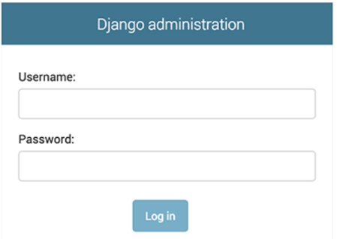
Introducing the Django Admin
Start the development server
The Django admin site is activated by default. Let’s start the development server and explore it.
If the server is not running start it like so:
>python manage.py runserver
Now, open a web browser and go to “/admin/” on your local domain – e.g., http://127.0.0.1:8000/admin/. You should see the admin’s login screen:
Since translation is turned on by default, if you set LANGUAGE_CODE, the login screen will be displayed in the given language (if Django has appropriate translations).
Notes:
In this slide - Trainer will briefing the students aboutIntroducing the Django Admin
--------------------------------------------------------------------
Start the development server
The Django admin site is activated by default. Let’s start the development server and explore it.
If the server is not running start it like so:
>python manage.py runserver
Now, open a web browser and go to “/admin/” on your local domain – e.g., http://127.0.0.1:8000/admin/. You should see the admin’s login screen:
Since translation is turned on by default, if you set LANGUAGE_CODE, the login screen will be displayed in the given language (if Django has appropriate translations).

Slide 77
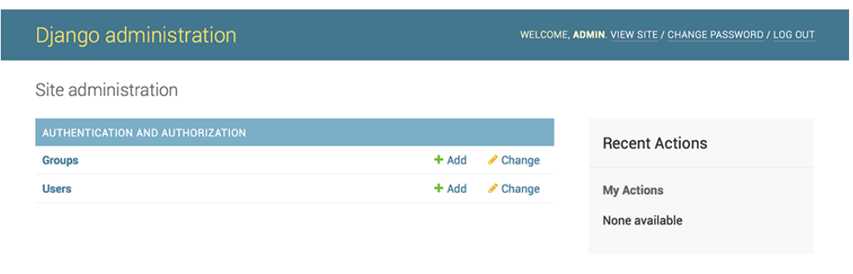
Introducing the Django Admin
Enter the admin site:
Enter the admin site:
Now, try logging in with the superuser account you created in the previous step. You should see the Django admin index page:
You should see a few types of editable content: groups and users. They are provided by django.contrib.auth, the authentication framework shipped by Django.
Notes:
In this slide - Trainer will briefing and showing the students about Introducing the Django Admin
---------------------------------------------------------------------
Enter the admin site:
Now, try logging in with the superuser account you created in the previous step. You should see the Django admin index page:
You should see a few types of editable content: groups and users. They are provided by django.contrib.auth, the authentication framework shipped by Django.

Slide 78
Introducing the Django Admin
Make the poll app modifiable in the admin:
But where’s our poll app? It’s not displayed on the admin index page.
Only one more thing to do: we need to tell the admin that Question objects have an admin interface. To do this, open the polls/admin.py file, and edit it to look like this:
from django.contrib import admin
from .models import Question
admin.site.register(Question)
Notes:
In this slide - Trainer will briefing the students aboutIntroducing the Django Admin
---------------------------------------------------------------
Make the poll app modifiable in the admin:
But where’s our poll app? It’s not displayed on the admin index page.
Only one more thing to do: we need to tell the admin that Question objects have an admin interface. To do this, open the polls/admin.py file, and edit it to look like this:
from django.contrib import admin
from .models import Question
admin.site.register(Question)

Slide 79
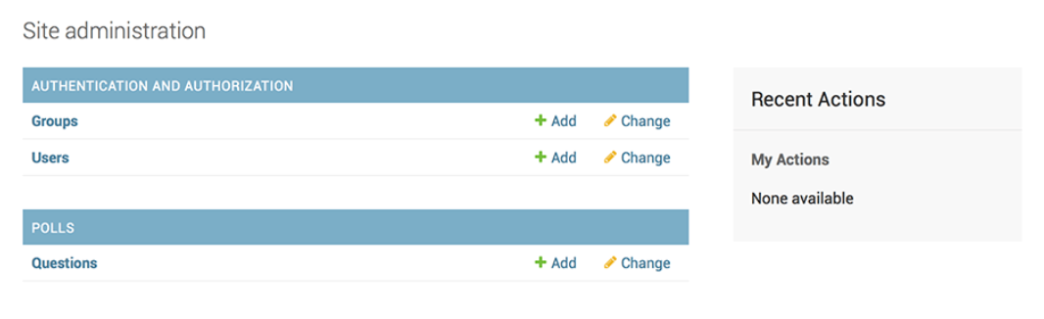
Introducing the Django Admin
Explore the free admin functionality
Now that we’ve registered Question, Django knows that it should be displayed on the admin index page:
Click “Questions”. Now you’re at the “change list” page for questions.
Notes:
In this slide - Trainer will briefing the students about Introducing the Django Admin
---------------------------------------------------------------
! The free admin functionality in Django refers to the built-in administrative interface that Django provides out of the box. This interface allows you to perform various administrative tasks related to managing data stored in your application's database.
1. Authentication and Access:
Model Listing and Filtering:
Adding New Records:
Viewing and Editing Records:
Inline Editing (Inline Forms):
Bulk Actions:
Model Relationships:

Slide 80
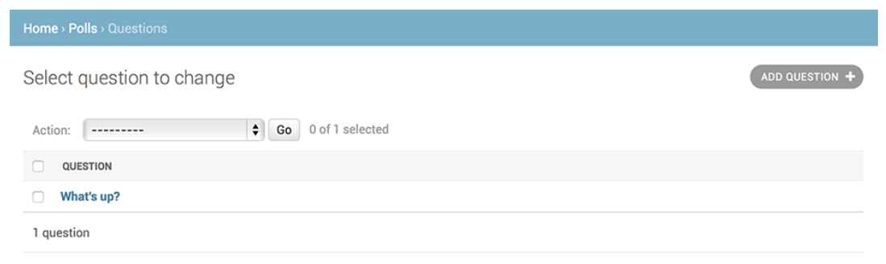
Introducing the Django Admin
Explore the free admin functionality
This page displays all the questions in the database and lets you choose one to change it. There’s the “What’s up?” question we created earlier:
Click the “What’s up?” question to edit it:
Notes:
In this slide - Trainer will briefing the students about Explore the free admin functionality
---------------------------------------------------------------------
This page displays all the questions in the database and lets you choose one to change it. There’s the “What’s up?” question we created earlier:
Click the “What’s up?” question to edit it:

Slide 81
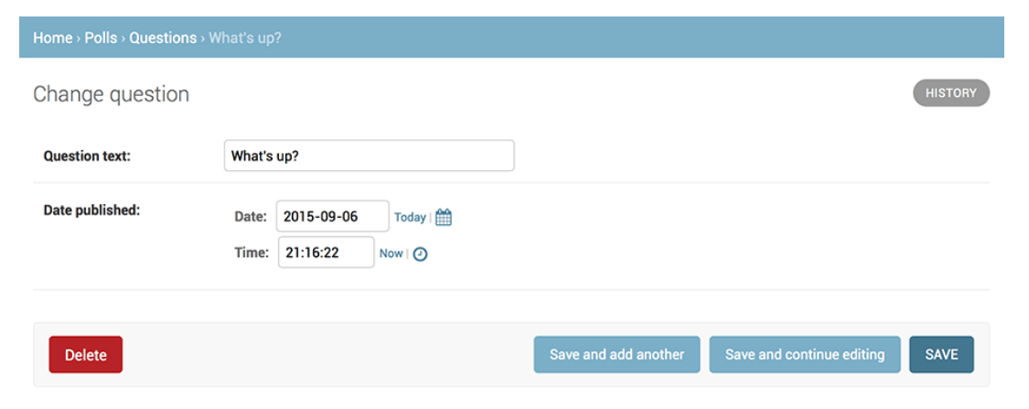
Introducing the Django Admin
Explore the free admin functionality
Edit question :
Notes:
In this slide - Trainer will briefing the students about Explore the free admin functionality
---------------------------------------------------------------------
Editing questions using the Django Admin functionality is straightforward and follows the general CRUD (Create, Read, Update, Delete) pattern. Let's assume you have a Django app named polls and you want to edit questions using the Django Admin.

Slide 82
Introducing the Django Admin
Things to note here:
The form is automatically generated from the Question model.
The different model field types (DateTimeField, CharField) correspond to the appropriate HTML input widget. Each type of field knows how to display itself in the Django admin.
Each DateTimeField gets free JavaScript shortcuts. Dates get a “Today” shortcut and calendar popup, and times get a “Now” shortcut and a convenient popup that lists commonly entered times.
Notes:
In this slide - Trainer will briefing the students about Explore the free admin functionality
---------------------------------------------------------------------
Things to note here:
The form is automatically generated from the Question model.
The different model field types (DateTimeField, CharField) correspond to the appropriate HTML input widget. Each type of field knows how to display itself in the Django admin.
Each DateTimeField gets free JavaScript shortcuts. Dates get a “Today” shortcut and calendar popup, and times get a “Now” shortcut and a convenient popup that lists commonly entered times.

Slide 83
Introducing the Django Admin
things to note here (Continued)-
The bottom part of the page gives you a couple of options:
Save – Saves changes and returns to the change-list page for this type of object.
Save and continue editing – Saves changes and reloads the admin page for this object.
Save and add another – Saves changes and loads a new, blank form for this type of object.
Delete – Displays a delete confirmation page.
Notes:
In this slide - Trainer will briefing the students about Introducing the Django Admin
---------------------------------------------------------------------
Introducing the Django Admin
Things to note here (Continued)-
The bottom part of the page gives you a couple of options:
Save – Saves changes and returns to the change-list page for this type of object.
Save and continue editing – Saves changes and reloads the admin page for this object.
Save and add another – Saves changes and loads a new, blank form for this type of object.
Delete – Displays a delete confirmation page.

Slide 84
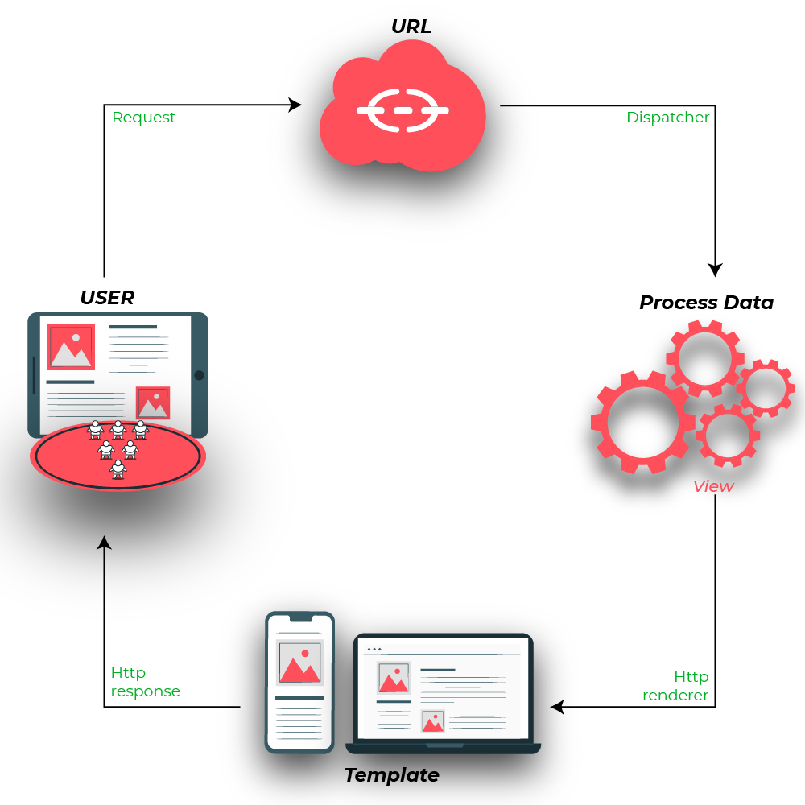
Views
A view function, or view for short, is a Python function that takes a web request and returns a web response.
This response can be the HTML contents of a web page, or a redirect, or a 404 error, or an XML document, or an image , or anything that a web browser can display.
The convention is to put views in a file called views.py file in your project or application directory.
Click here
Reference link
Notes:
In this slide - Trainer will briefing the students about Views
-------------------------------------------------------------------
Views: Views in Django are Python functions or classes that handle incoming HTTP requests and return appropriate responses. A view receives a request, processes the necessary data, and returns an HttpResponse or another type of response (e.g., redirect, JSON). Views are the logic behind your web application's behavior.
A view function, or view for short, is a Python function that takes a web request and returns a web response.
This response can be the HTML contents of a web page, or a redirect, or a 404 error, or an XML document, or an image , or anything that a web browser can display.
The convention is to put views in a file called views.py file in your project or application directory.
For example, many web frameworks provide libraries for database access, templating frameworks, and session management, and they often promote code reuse. Although they often target development of dynamic web sites, they are also applicable to static websites.

Slide 85
Creating simple View : Example
Here’s a view that returns the current date and time, as an HTML document: learndjango/ views.py
# import Http Response from django
from django.http import HttpResponse
# get datetime
import datetime
# create a function
def date_view(request):
# fetch date and time
now = datetime.datetime.now()
# convert to string
html = "Time is {}".format(now)
# return response
return HttpResponse(html)
Notes:
In this slide - Trainer will briefing the students about Views
-------------------------------------------------------------------
Here’s a view that returns the current date and time, as an HTML document: learndjango/ views.py
# import Http Response from django
from django.http import HttpResponse
# get datetime
import datetime
# create a function
def date_view(request):
# fetch date and time
now = datetime.datetime.now()
# convert to string
html = "Time is {}".format(now)
# return response
return HttpResponse(html)

Slide 86
Creating simple View: Example Explanation
First, we import the class HttpResponse from the django.http module, along with Python’s datetime library.
Next, we define a function called date_view. This is the view function. Each view function takes an HttpRequest object as its first parameter, which is typically named request.
The view returns an HttpResponse object that contains the generated response. Each view function is responsible for returning an HttpResponse object.
Notes:
In this slide - Trainer will briefing the students about Creating simple View: Example Explanation
-------------------------------------------------------------------
First, we import the class HttpResponse from the django.http module, along with Python’s datetime library.
Next, we define a function called date_view. This is the view function. Each view function takes an HttpRequest object as its first parameter, which is typically named request.
The view returns an HttpResponse object that contains the generated response. Each view function is responsible for returning an HttpResponse object.

Slide 87
URL Mapping : Example
Let’s get this view to working, in learndjango/urls.py
from django.contrib import admin
from django.urls import path,include
from .views import date_view
urlpatterns = [
#path('admin/', admin.site.urls),
path('', date_view),
]
Notes:
In this slide - Trainer will briefing the students about URL Mapping : Example
-------------------------------------------------------------------------------
URL Mapping: URL mapping (routing) is the process of associating URLs with specific views in your application. In Django, you define URL patterns using regular expressions or path converters to map URLs to corresponding views.
Let’s get this view to working, in learndjango/urls.py
Refer above program.

Slide 88
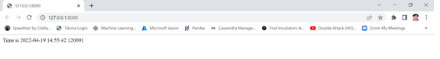
Output for DateTime example
Now, visit http://127.0.0.1:8000/
Notes:
In this slide - Trainer will briefing the students about Output for DateTime example
-----------------------------------------------------------------------------
Now, visit http://127.0.0.1:8000/
For the result see the image on slide.

Slide 89
HttpRequest & HttpResponse
HttpRequest & HttpResponse
Django uses request and response objects to pass state through the system.
When a page is requested, Django creates an HttpRequest object that contains metadata about the request. Then Django loads the appropriate view, passing the HttpRequest as the first argument to the view function. Each view is responsible for returning an HttpResponse object.
Notes:
In this slide - Trainer will briefing the students about HttpRequest & HttpResponse
-----------------------------------------------------------------------
Request and response objects : Overview
Django uses request and response objects to pass state through the system.
When a page is requested, Django creates an HttpRequest object that contains metadata about the request. Then Django loads the appropriate view, passing the HttpRequest as the first argument to the view function. Each view is responsible for returning an HttpResponse object.

Slide 90
HttpRequest
HttpRequest objects
class HttpRequest
Attributes
All attributes should be considered read-only, unless stated otherwise.
HttpRequest.scheme
A string representing the scheme of the request (http or https usually).
Notes:
In this slide - Trainer will briefing the students about HttpRequest
-----------------------------------------------------------------------------------
he HttpRequest object contains various attributes that provide information about the incoming HTTP request from a client's browser. These attributes allow you to access details such as headers, parameters, cookies, and more. Here are some important attributes of the HttpRequest object:
HttpRequest objects
class HttpRequest
Attributes
All attributes should be considered read-only, unless stated otherwise.
The HttpRequest.scheme attribute is used to retrieve the scheme (protocol) of the URL that was used to make the HTTP request. It provides information about whether the request was made using HTTP or HTTPS.

Slide 91
HttpRequest
HttpRequest objects (Continued)
HttpRequest.body
The raw HTTP request body as a bytestring. This is useful for processing data in different ways than conventional HTML forms: binary images, XML payload etc. For processing conventional form data, use HttpRequest.POST.
You can also read from an HttpRequest using a file-like interface with HttpRequest.read() or HttpRequest.readline(). Accessing the body attribute after reading the request with either of these I/O stream methods will produce a RawPostDataException.
HttpRequest.path
A string representing the full path to the requested page, not including the scheme, domain, or query string.
Example: "/music/bands/the_beatles/"
Notes:
In this slide - Trainer will briefing the students about HttpRequest
-----------------------------------------------------------------------------------
HttpRequest objects (Continued)
HttpRequest.body
The raw HTTP request body as a bytestring. This is useful for processing data in different ways than conventional HTML forms: binary images, XML payload etc. For processing conventional form data, use HttpRequest.POST.
You can also read from an HttpRequest using a file-like interface with HttpRequest.read() or HttpRequest.readline(). Accessing the body attribute after reading the request with either of these I/O stream methods will produce a RawPostDataException.
HttpRequest.path
A string representing the full path to the requested page, not including the scheme, domain, or query string.
Example: "/music/bands/the_beatles/"

Slide 92
HttpRequest
HttpRequest objects (Continued)
HttpRequest.path_info
Under some web server configurations, the portion of the URL after the host name is split up into a script prefix portion and a path info portion. The path_info attribute always contains the path info portion of the path, no matter what web server is being used. Using this instead of path can make your code easier to move between test and deployment servers.
For example, if the WSGIScriptAlias for your application is set to "/minfo", then path might be "/minfo/music/bands/the_beatles/" and path_info would be "/music/bands/the_beatles/".
Notes:
In this slide - Trainer will briefing the students about HttpRequest
--------------------------------------------------------------------------
HttpRequest objects (Continued)
HttpRequest.path_info
Under some web server configurations, the portion of the URL after the host name is split up into a script prefix portion and a path info portion. The path_info attribute always contains the path info portion of the path, no matter what web server is being used. Using this instead of path can make your code easier to move between test and deployment servers.
For example, if the WSGIScriptAlias for your application is set to "/minfo", then path might be "/minfo/music/bands/the_beatles/" and path_info would be "/music/bands/the_beatles/".

Slide 93
HttpRequest
HttpRequest objects (Continued)
HttpRequest.method
A string representing the HTTP method used in the request. This is guaranteed to be uppercase. For example:
if request.method == 'GET':
do_something()
elif request.method == 'POST':
do_something_else()
Notes:
In this slide - Trainer will briefing the students about HttpRequest
--------------------------------------------------------------------------
HttpRequest objects (Continued)
The HttpRequest.method attribute in Django represents the HTTP method used in the request. It indicates the type of action the client wants to perform on a resource. Common HTTP methods include GET, POST, PUT, DELETE, and more. In Django views, you can access this attribute to determine how to handle the incoming request.
HttpRequest.method
A string representing the HTTP method used in the request. This is guaranteed to be uppercase. For example:
if request.method == 'GET':
do_something()
elif request.method == 'POST':
do_something_else()

Slide 94
HttpRequest
HttpRequest objects (Continued)
HttpRequest.encoding
A string representing the current encoding used to decode form submission data (or None, which means the DEFAULT_CHARSET setting is used). You can write to this attribute to change the encoding used when accessing the form data. Any subsequent attribute accesses (such as reading from GET or POST) will use the new encoding value. Useful if you know the form data is not in the DEFAULT_CHARSET encoding.
HttpRequest.content_type
A string representing the MIME type of the request, parsed from the CONTENT_TYPE header.
Notes:
In this slide - Trainer will briefing the students about HttpRequest
--------------------------------------------------------------------------
HttpRequest.encoding: The HttpRequest.encoding attribute represents the character encoding used in the request's content. This is especially relevant when the request's content contains text data, such as form submissions. If the request contains no explicit encoding, this attribute will default to 'utf-8'.
HttpRequest.content_type: The HttpRequest.content_type attribute indicates the media type (MIME type) of the request's content. This is relevant when you're handling different types of data in your views, such as JSON, form data, or file uploads.

Slide 95
HttpRequest
HttpRequest objects (Continued)
HttpRequest.POST
A dictionary-like object containing all given HTTP POST parameters, providing that the request contains form data. See the QueryDict documentation below. If you need to access raw or non-form data posted in the request, access this through the HttpRequest.body attribute instead.
It’s possible that a request can come in via POST with an empty POST dictionary – if, say, a form is requested via the POST HTTP method but does not include form data. Therefore, you shouldn’t use if request.POST to check for use of the POST method; instead, use if request.method == "POST" (see HttpRequest.method).
POST does not include file-upload information. See FILES.
Notes:
In this slide - Trainer will briefing the students about HttpRequest
--------------------------------------------------------------------------
The HttpRequest.POST attribute in Django is a dictionary-like object that contains the data sent in the body of a POST request. It is used to access form data submitted by the user. When a user submits a form via a POST request, the form data is sent in the body of the request, and you can access this data using the HttpRequest.POST attribute.

Slide 96
HttpRequest
HttpRequest objects (Continued)
HttpRequest.content_params
A dictionary of key/value parameters included in the CONTENT_TYPE header.
HttpRequest.GET
A dictionary-like object containing all given HTTP GET parameters. See the QueryDict documentation below.
HttpRequest.COOKIES
A dictionary containing all cookies. Keys and values are strings.
Notes:
In this slide - Trainer will briefing the students about HttpRequest
--------------------------------------------------------------------------
HttpRequest.content_params: The HttpRequest.content_params attribute is not a standard attribute in Django's HttpRequest object. Instead, you would typically access parameters included in the CONTENT_TYPE header using the request.META dictionary.
HttpRequest.GET: The HttpRequest.GET attribute is a dictionary-like object that contains all the HTTP GET parameters sent with the request. You can access these parameters by using the .get() method on the GET attribute.
HttpRequest.COOKIES: The HttpRequest.COOKIES attribute is a dictionary that contains all the cookies sent by the client's browser.

Slide 97
HttpRequest
HttpRequest objects (Continued)
HttpRequest.FILES
A dictionary-like object containing all uploaded files. Each key in FILES is the name from the <input type="file" name="">. Each value in FILES is an UploadedFile.
See Managing files for more information.
FILES will only contain data if the request method was POST and the <form> that posted to the request had enctype="multipart/form-data". Otherwise, FILES will be a blank dictionary-like object.
Notes:
In this slide - Trainer will briefing the students about HttpRequest
--------------------------------------------------------------------------
The HttpRequest.FILES attribute in Django is a dictionary-like object that contains all the uploaded files that are part of a POST request. When a user submits a form that includes file input fields (<input type="file">), the uploaded files are accessible through the HttpRequest.FILES attribute.

Slide 98
HttpRequest
HttpRequest objects (Continued)
HttpRequest.META
A dictionary containing all available HTTP headers. Available headers depend on the client and server, but here are some examples:
CONTENT_LENGTH – The length of the request body (as a string).
CONTENT_TYPE – The MIME type of the request body.
HTTP_ACCEPT – Acceptable content types for the response.
HTTP_ACCEPT_ENCODING – Acceptable encodings for the response.
HTTP_ACCEPT_LANGUAGE – Acceptable languages for the response.
HTTP_HOST – The HTTP Host header sent by the client.
HTTP_REFERER – The referring page, if any.
HTTP_USER_AGENT – The client’s user-agent string.
QUERY_STRING – The query string, as a single (unparsed) string.
REMOTE_ADDR – The IP address of the client.
REMOTE_HOST – The hostname of the client.
REMOTE_USER – The user authenticated by the web server, if any.
REQUEST_METHOD – A string such as "GET" or "POST".
SERVER_NAME – The hostname of the server.
SERVER_PORT – The port of the server (as a string).
Notes:
In this slide - Trainer will briefing the students about HttpRequest
--------------------------------------------------------------------------
HttpRequest objects (Continued)
HttpRequest.META
A dictionary containing all available HTTP headers. Available headers depend on the client and server, but here are some examples:
CONTENT_LENGTH – The length of the request body (as a string).
CONTENT_TYPE – The MIME type of the request body.
HTTP_ACCEPT – Acceptable content types for the response.
HTTP_ACCEPT_ENCODING – Acceptable encodings for the response.
HTTP_ACCEPT_LANGUAGE – Acceptable languages for the response.
HTTP_HOST – The HTTP Host header sent by the client.
HTTP_REFERER – The referring page, if any.
HTTP_USER_AGENT – The client’s user-agent string.
QUERY_STRING – The query string, as a single (unparsed) string.
REMOTE_ADDR – The IP address of the client.
REMOTE_HOST – The hostname of the client.
REMOTE_USER – The user authenticated by the web server, if any.
REQUEST_METHOD – A string such as "GET" or "POST".
SERVER_NAME – The hostname of the server.
SERVER_PORT – The port of the server (as a string).

Slide 99
HttpRequest
HttpRequest objects (Continued)
HttpRequest.headers
A case insensitive, dict-like object that provides access to all HTTP-prefixed headers (plus Content-Length and Content-Type) from the request.
HttpRequest.resolver_match
An instance of ResolverMatch representing the resolved URL. This attribute is only set after URL resolving took place, which means it’s available in all views but not in middleware which are executed before URL resolving takes place (you can use it in process_view() though).
Notes:
In this slide - Trainer will briefing the students about HttpRequest
--------------------------------------------------------------------------
In Django, the HttpRequest.headers attribute is used to access the headers sent with the HTTP request. Headers contain additional information about the request, such as user-agent details, content type, and more. The HttpRequest.headers attribute is a dictionary-like object that provides access to these headers.
headers are crucial for various purposes such as identifying the client's browser, handling content negotiation, and passing information about authentication or authorization. Remember that while accessing headers is important, it's equally important to validate and sanitize any data derived from them to prevent security vulnerabilities.

Slide 100
HttpRequest
HttpRequest objects : Attributes set by application code
Django doesn’t set these attributes itself but makes use of them if set by your application.
HttpRequest.current_app
The url template tag will use its value as the current_app argument to reverse().
HttpRequest.urlconf
This will be used as the root URLconf for the current request, overriding the ROOT_URLCONF setting. See How Django processes a request for details.
urlconf can be set to None to revert any changes made by previous middleware and return to using the ROOT_URLCONF.
Notes:
In this slide - Trainer will briefing the students about HttpRequest
--------------------------------------------------------------------------
HttpRequest objects : Attributes set by application code
Django doesn’t set these attributes itself but makes use of them if set by your application.
HttpRequest.current_app
The url template tag will use its value as the current_app argument to reverse().
HttpRequest.urlconf
This will be used as the root URLconf for the current request, overriding the ROOT_URLCONF setting. See How Django processes a request for details.
urlconf can be set to None to revert any changes made by previous middleware and return to using the ROOT_URLCONF.

Slide 101
HttpRequest
HttpRequest objects : Attributes set by application code (Continued)
HttpRequest.exception_reporter_filter
This will be used instead of DEFAULT_EXCEPTION_REPORTER_FILTER for the current request. See Custom error reports for details.
HttpRequest.exception_reporter_class
This will be used instead of DEFAULT_EXCEPTION_REPORTER for the current request. See Custom error reports for details.
Notes:
In this slide - Trainer will briefing the students about HttpRequest
--------------------------------------------------------------------------
HttpRequest objects : Attributes set by application code (Continued)
HttpRequest.exception_reporter_filter
This will be used instead of DEFAULT_EXCEPTION_REPORTER_FILTER for the current request. See Custom error reports for details.
HttpRequest.exception_reporter_class
This will be used instead of DEFAULT_EXCEPTION_REPORTER for the current request. See Custom error reports for details.
HttpRequest.exception_reporter_filter: The HttpRequest.exception_reporter_filter attribute allows you to specify a custom filter that will be used instead of the default filter for generating error reports related to exceptions in the current request. This filter determines which exceptions should be reported and how they should be presented.
HttpRequest.exception_reporter_class: The HttpRequest.exception_reporter_class attribute allows you to specify a custom class that will be used instead of the default class for generating error reports related to exceptions in the current request. This class is responsible for formatting and presenting error reports.
To use these attributes effectively, you would typically need to create your own custom classes or filters that inherit from the relevant default classes provided by Django. You can then configure these attributes in your view or middleware to use your custom implementations for error reporting.

Slide 102
HttpRequest
HttpRequest objects :Methods
HttpRequest.get_host()
Returns the originating host of the request using information from the HTTP_X_FORWARDED_HOST (if USE_X_FORWARDED_HOST is enabled) and HTTP_HOST headers, in that order. If they don’t provide a value, the method uses a combination of SERVER_NAME and SERVER_PORT as detailed in PEP 3333.
Example: "127.0.0.1:8000“
HttpRequest.get_port()
Returns the originating port of the request using information from the HTTP_X_FORWARDED_PORT (if USE_X_FORWARDED_PORT is enabled) and SERVER_PORT META variables, in that order.
Notes:
In this slide - Trainer will briefing the students about HttpRequest
--------------------------------------------------------------------------
HttpRequest objects :Methods
HttpRequest.get_host()
Returns the originating host of the request using information from the HTTP_X_FORWARDED_HOST (if USE_X_FORWARDED_HOST is enabled) and HTTP_HOST headers, in that order. If they don’t provide a value, the method uses a combination of SERVER_NAME and SERVER_PORT as detailed in PEP 3333.
Example: "127.0.0.1:8000“
HttpRequest.get_port()
Returns the originating port of the request using information from the HTTP_X_FORWARDED_PORT (if USE_X_FORWARDED_PORT is enabled) and SERVER_PORT META variables, in that order.
HttpRequest.get_host(): The HttpRequest.get_host() method returns the originating host of the request. It considers the HTTP_X_FORWARDED_HOST header (if USE_X_FORWARDED_HOST setting is enabled) and the HTTP_HOST header to determine the host. If these headers don't provide a value, the method uses a combination of SERVER_NAME and SERVER_PORT as detailed in PEP 3333.
HttpRequest.get_port(): The HttpRequest.get_port() method returns the originating port of the request. It takes into account the HTTP_X_FORWARDED_PORT header (if USE_X_FORWARDED_PORT setting is enabled) and the SERVER_PORT META variable to determine the port.

Slide 103
HttpRequest
HttpRequest objects :Methods (Continued)
HttpRequest.get_full_path()
Returns the path, plus an appended query string, if applicable.
Example: "/music/bands/the_beatles/?print=true"
HttpRequest.get_full_path_info()
Like get_full_path(), but uses path_info instead of path.
Example: "/minfo/music/bands/the_beatles/?print=true"
Notes:
In this slide - Trainer will briefing the students about HttpRequest
--------------------------------------------------------------------------
HttpRequest objects :Methods (Continued)
HttpRequest.get_full_path()
Returns the path, plus an appended query string, if applicable.
Example: "/music/bands/the_beatles/?print=true"
HttpRequest.get_full_path_info()
Like get_full_path(), but uses path_info instead of path.
Example: "/minfo/music/bands/the_beatles/?print=true"
get_full_path() Method: This method returns the complete path of the requested URL, including the query parameters.
get_full_path() Method: The get_full_path() method is available in the HttpRequest object. It returns the complete path of the requested URL, including the query parameters. This method provides a string that represents the full URL path with query parameters.
If you are referring to a method called get_full_path_info(), I recommend checking the official Django documentation or the release notes for the version of Django you are using to verify if such a method exists and to learn more about its usage. Django's documentation is comprehensive and regularly updated, so you'll likely find accurate and up-to-date information there.

Slide 104
HttpRequest
HttpRequest objects :Methods (Continued)
HttpRequest.build_absolute_uri(location=None)
Returns the absolute URI form of location. If no location is provided, the location will be set to request.get_full_path().
If the location is already an absolute URI, it will not be altered. Otherwise the absolute URI is built using the server variables available in this request.
Notes:
In this slide - Trainer will briefing the students about HttpRequest
--------------------------------------------------------------------------
The HttpRequest.build_absolute_uri(location=None) method in Django is used to construct an absolute URI for a given location. It takes an optional location parameter, which, if provided, is combined with the scheme, domain, and port of the current request to create an absolute URI. If location is not provided, the method constructs an absolute URI for the current request's path and query parameters.
Here's how you can use HttpRequest.build_absolute_uri()

Slide 105
HttpRequest
HttpRequest objects :Methods (Continued)
HttpRequest.get_signed_cookie(key, default=RAISE_ERROR, salt='', max_age=None)
Returns a cookie value for a signed cookie, or raises a django.core.signing.BadSignature exception if the signature is no longer valid. If you provide the default argument the exception will be suppressed and that default value will be returned instead.
The optional salt argument can be used to provide extra protection against brute force attacks on your secret key. If supplied, the max_age argument will be checked against the signed timestamp attached to the cookie value to ensure the cookie is not older than max_age seconds.
Notes:
In this slide - Trainer will briefing the students about HttpRequest
--------------------------------------------------------------------------
HttpRequest objects :Methods (Continued)
The HttpRequest.get_signed_cookie(key, default=RAISE_ERROR, salt='', max_age=None) method in Django is used to retrieve the value of a signed cookie while ensuring its integrity. Signed cookies are cookies that include a signature, allowing you to verify that the cookie's value has not been tampered with.

Slide 106
HttpRequest
HttpRequest objects :Methods (Continued)
HttpRequest.is_secure()
Returns True if the request is secure; that is, if it was made with HTTPS.
HttpRequest.accepts(mime_type)
Returns True if the request Accept header matches the mime_type argument
Notes:
In this slide - Trainer will briefing the students about HttpRequest
--------------------------------------------------------------------------
HttpRequest.is_secure(): The is_secure() method returns True if the request is secure, meaning it was made over a secure (HTTPS) connection. This method is particularly useful when you want to distinguish between secure and non-secure requests.
HttpRequest.accepts(mime_type): The accepts(mime_type) method checks if the request's Accept header matches the specified mime_type. This is useful when you want to determine whether the client can handle a specific content type.

Slide 107
HttpResponse
HttpResponse objects
class HttpResponse
In contrast to HttpRequest objects, which are created automatically by Django, HttpResponse objects are your responsibility. Each view you write is responsible for instantiating, populating, and returning an HttpResponse.
The HttpResponse class lives in the django.http module.
Notes:
In this slide - Trainer will briefing the students about HttpResponse
--------------------------------------------------------------------------
The HttpResponse class is used to construct and return HTTP responses from your views. Unlike HttpRequest objects, which are automatically created by Django to represent incoming HTTP requests, HttpResponse objects are created by you, the developer, to construct and send appropriate responses back to the client's browser.
Creating an HttpResponse Object: To create an HttpResponse object, you typically instantiate it and pass the content you want to send back to the client as an argument. This content can be plain text, HTML, JSON, or any other data that the client expects in response to its request.

Slide 108
HttpResponse
HttpResponse objects
Usage
Passing iterators
Finally, you can pass HttpResponse an iterator rather than strings. HttpResponse will consume the iterator immediately, store its content as a string, and discard it. Objects with a close() method such as files and generators are immediately closed.
If you need the response to be streamed from the iterator to the client, you must use the StreamingHttpResponse class instead.
Notes:
In this slide - Trainer will briefing the students about HttpResponse
--------------------------------------------------------------------------
The HttpResponse class is quite versatile, and one of its features is the ability to handle iterators for constructing responses. This is particularly useful when you're dealing with large amounts of data that you want to serve to the client progressively, or when you want to generate content on the fly without storing it in memory.
Passing Iterators to HttpResponse: You can pass an iterator as the content of an HttpResponse. The response will consume the iterator, immediately convert its content to a string, and then discard it. This is useful for cases where you have data-generating iterators, like files or generators.

Slide 109
HttpResponse
Http Response objects
Setting header fields
To set or remove a header field in your response, use HttpResponse.headers:
>>> response = HttpResponse()
>>> response.headers['Age'] = 120
>>> del response.headers['Age’]
You can also manipulate headers by treating your response like a dictionary:
>>> response = HttpResponse()
>>> response['Age'] = 120
>>> del response['Age’]
This proxies to HttpResponse.headers, and is the original interface offered by HttpResponse.
Notes:
In this slide - Trainer will briefing the students about HttpResponse
--------------------------------------------------------------------------
HttpResponse objects
Setting header fields
To set or remove a header field in your response, use HttpResponse.headers:
>>> response = HttpResponse()
>>> response.headers['Age'] = 120
>>> del response.headers['Age’]
You can also manipulate headers by treating your response like a dictionary:
>>> response = HttpResponse()
>>> response['Age'] = 120
>>> del response['Age’]
This proxies to HttpResponse.headers, and is the original interface offered by HttpResponse.

Slide 110
HttpResponse
HttpResponse objects
Setting header fields (continued )
When using this interface, unlike a dictionary, del doesn’t raise KeyError if the header field doesn’t exist.
You can also set headers on instantiation:
>>> response = HttpResponse(headers={'Age': 120})
Notes:
In this slide - Trainer will briefing the students about HttpResponse
--------------------------------------------------------------------------
HttpResponse objects
Setting header fields (continued )
When using this interface, unlike a dictionary, del doesn’t raise KeyError if the header field doesn’t exist.
You can also set headers on instantiation:
>>> response = HttpResponse(headers={'Age': 120})

Slide 111
HttpResponse
HttpResponse objects
Telling the browser to treat the response as a file attachment
To tell the browser to treat the response as a file attachment, set the Content-Type and Content-Disposition headers. For example, this is how you might return a Microsoft Excel spreadsheet:
>>> response = HttpResponse(my_data, headers={
... 'Content-Type': 'application/vnd.ms-excel',
... 'Content-Disposition': 'attachment; filename="foo.xls"',
... })
Notes:
In this slide - Trainer will briefing the students about HttpResponse
--------------------------------------------------------------------------
HttpResponse objects
Telling the browser to treat the response as a file attachment
To tell the browser to treat the response as a file attachment, set the Content-Type and Content-Disposition headers. For example, this is how you might return a Microsoft Excel spreadsheet:
>>> response = HttpResponse(my_data, headers={
... 'Content-Type': 'application/vnd.ms-excel',
... 'Content-Disposition': 'attachment; filename="foo.xls"',
... })

Slide 112
HttpResponse
HttpResponse objects : Attributes
HttpResponse.content
A bytestring representing the content, encoded from a string if necessary.
HttpResponse.headers
New in Django 3.2.
A case insensitive, dict-like object that provides an interface to all HTTP headers on the response. See Setting header fields.
HttpResponse.charset
A string denoting the charset in which the response will be encoded. If not given at HttpResponse instantiation time, it will be extracted from content_type and if that is unsuccessful, the DEFAULT_CHARSET setting will be used.
Notes:
In this slide - Trainer will briefing the students about HttpResponse
--------------------------------------------------------------------------
HttpResponse.content: The content attribute of an HttpResponse object represents the response content as a bytestring. It holds the actual data that will be sent to the client. The content is encoded from a string if necessary, based on the specified or default charset.
HttpResponse.headers: This attribute, introduced in Django 3.2, is a case-insensitive dictionary-like object that provides an interface to access and modify HTTP headers on the response. You can use it to set various response headers, such as Content-Disposition, Cache-Control, and more.
HttpResponse.charset: The charset attribute of an HttpResponse object represents the charset in which the response content will be encoded. If not explicitly provided at the time of instantiation, Django will try to extract it from the content_type parameter. If that extraction fails, it will use the DEFAULT_CHARSET setting.
python

Slide 113
HttpResponse
HttpResponse objects : Attributes
HttpResponse.status_code
The HTTP status code for the response.
HttpResponse.reason_phrase
The HTTP reason phrase for the response. It uses the HTTP standard’s default reason phrases.
HttpResponse.streaming
This is always False.
HttpResponse.closed
True if the response has been closed.
Notes:
In this slide - Trainer will briefing the students about HttpResponse
--------------------------------------------------------------------------
HttpResponse.status_code: The status_code attribute of an HttpResponse object represents the HTTP status code for the response. It indicates the outcome of the request processing, such as success, redirection, client error, or server error. You can set this attribute when creating the response, and it should be an integer representing the HTTP status code.
HttpResponse.reason_phrase: The reason_phrase attribute of an HttpResponse object represents the HTTP reason phrase for the response. It uses the HTTP standard's default reason phrases associated with each status code. This attribute provides additional information about the status code but is typically not used directly in application code.
HttpResponse.streaming: The streaming attribute of an HttpResponse object is always False. It indicates that the response is not being streamed directly from an iterator or generator, as would be the case with a StreamingHttpResponse. The streaming attribute helps distinguish between regular and streaming responses.
HttpResponse.closed: The closed attribute of an HttpResponse object is True if the response has been fully closed. This attribute can be useful when dealing with responses that require special handling upon closure.

Slide 114
HttpResponse
HttpResponse objects : Attributes
HttpResponse.__setitem__(header, value)
Sets the given header name to the given value. Both header and value should be strings.
HttpResponse.__delitem__(header)
Deletes the header with the given name. Fails silently if the header doesn’t exist. Case-insensitive.
HttpResponse.__getitem__(header)
Returns the value for the given header name. Case-insensitive.
HttpResponse.get(header, alternate=None)
Returns the value for the given header, or an alternate if the header doesn’t exist.
Notes:
In this slide - Trainer will briefing the students about HttpResponse
--------------------------------------------------------------------------
HttpResponse objects:Attributes
HttpResponse.__setitem__(header, value)
Sets the given header name to the given value. Both header and value should be strings.
HttpResponse.__delitem__(header)
Deletes the header with the given name. Fails silently if the header doesn’t exist. Case-insensitive.
HttpResponse.__getitem__(header)
Returns the value for the given header name. Case-insensitive.
HttpResponse.get(header, alternate=None)
Returns the value for the given header, or an alternate if the header doesn’t exist.

Slide 115
HttpResponse
HttpResponse objects : Attributes
HttpResponse.has_header(header)
Returns True or False based on a case-insensitive check for a header with the given name.
HttpResponse.items()
Acts like dict.items() for HTTP headers on the response.
HttpResponse.setdefault(header, value)
Sets a header unless it has already been set.
Notes:
In this slide - Trainer will briefing the students about HttpResponse
--------------------------------------------------------------------------
HttpResponse objects:Attributes
HttpResponse.has_header(header)
Returns True or False based on a case-insensitive check for a header with the given name.
HttpResponse.items()
Acts like dict.items() for HTTP headers on the response.
HttpResponse.setdefault(header, value)
Sets a header unless it has already been set.

Slide 116
HttpResponse
HttpResponse objects : Attributes
HttpResponse.set_cookie(key, value='', max_age=None, expires=None, path='/', domain=None, secure=False, httponly=False, samesite=None)¶
Sets a cookie.
max_age should be an integer number of seconds, or None (default) if the cookie should last only as long as the client’s browser session. If expires is not specified, it will be calculated.
expires should either be a string in the format "Wdy, DD-Mon-YY HH:MM:SS GMT" or a datetime.datetime object in UTC. If expires is a datetime object, the max_age will be calculated.
efense in depth measure.
Notes:
In this slide - Trainer will briefing the students about HttpResponse
--------------------------------------------------------------------------
HttpResponse objects:Attributes
HttpResponse.set_cookie(key, value='', max_age=None, expires=None, path='/', domain=None, secure=False, httponly=False, samesite=None)¶
Sets a cookie.
max_age should be an integer number of seconds, or None (default) if the cookie should last only as long as the client’s browser session. If expires is not specified, it will be calculated.
expires should either be a string in the format "Wdy, DD-Mon-YY HH:MM:SS GMT" or a datetime.datetime object in UTC. If expires is a datetime object, the max_age will be calculated.
Use domain if you want to set a cross-domain cookie. For example, domain="example.com" will set a cookie that is readable by the domains www.example.com, blog.example.com, etc. Otherwise, a cookie will only be readable by the domain that set it.
Use secure=True if you want the cookie to be only sent to the server when a request is made with the https scheme.
Use httponly=True if you want to prevent client-side JavaScript from having access to the cookie.
HttpOnly is a flag included in a Set-Cookie HTTP response header. It’s part of the RFC 6265 standard for cookies and can be a useful way to mitigate the risk of a client-side script accessing the protected cookie data.
Use samesite='Strict' or samesite='Lax' to tell the browser not to send this cookie when performing a cross-origin request. SameSite isn’t supported by all browsers, so it’s not a replacement for Django’s CSRF protection, but rather a defense in depth measure.

Slide 117
HttpResponse
HttpResponse objects : Attributes
HttpResponse.delete_cookie(key, path='/', domain=None, samesite=None)
Deletes the cookie with the given key. Fails silently if the key doesn’t exist.
Due to the way cookies work, path and domain should be the same values you used in set_cookie() – otherwise the cookie may not be deleted.
HttpResponse.close()
This method is called at the end of the request directly by the WSGI server.
t.
Notes:
In this slide - Trainer will briefing the students about HttpResponse
--------------------------------------------------------------------------
HttpResponse.delete_cookie(key, path='/', domain=None, samesite=None): The delete_cookie() method of an HttpResponse object allows you to delete a specific cookie by providing its key. This method is used to remove a cookie from the client's browser. The path and domain parameters should match the same values used when setting the cookie originally.
HttpResponse.close(): The close() method is called automatically by the WSGI server at the end of the request cycle. It's not meant to be called directly by your application code. This method is responsible for cleaning up resources and finalizing the response.

Slide 118
HttpResponse
HttpResponse objects : Attributes
HttpResponse.tell()
This method makes an HttpResponse instance a file-like object.
HttpResponse.getvalue()
Returns the value of HttpResponse.content. This method makes an HttpResponse instance a stream-like object.
HttpResponse.readable()
Always False. This method makes an HttpResponse instance a stream-like object.
HttpResponse.seekable()
Always False. This method makes an HttpResponse instance a stream-like object.
HttpResponse.writable()
Always True. This method makes an HttpResponse instance a stream-like object.
Notes:
In this slide - Trainer will briefing the students about HttpResponse
--------------------------------------------------------------------------
1. HttpResponse.tell(): The tell() method of an HttpResponse instance is used to retrieve the current position within the response content. However, it's important to note that HttpResponse objects are not meant to be directly manipulated in the same way as file-like objects, so the usage of this method might be limited.
2. HttpResponse.getvalue(): The getvalue() method returns the content of the HttpResponse as a bytestring. This is similar to how you'd read the contents of a stream or file. It's particularly useful if you need to access the content as a single unit.
3. HttpResponse.readable(): The readable() method always returns False. This method is used to indicate whether the response is considered readable. In this case, False indicates that you can't directly read from an HttpResponse instance like you would from a stream or file.
4. HttpResponse.seekable(): The seekable() method always returns False. Similar to readable(), it's used to indicate whether seeking (changing the position) is supported. In the context of HttpResponse, seeking is generally not applicable.
5. HttpResponse.writable(): The writable() method always returns True. This method indicates that you can write to an HttpResponse instance. However, in practice, HttpResponse instances are usually used to send responses to clients, not to receive data.

Slide 119
HttpResponse
HttpResponse subclasses
Django includes a number of HttpResponse subclasses that handle different types of HTTP responses. Like HttpResponse, these subclasses live in django.http.
class HttpResponseRedirect
The first argument to the constructor is required – the path to redirect to. This can be a fully qualified URL (e.g. 'https://www.yahoo.com/search/'), an absolute path with no domain (e.g. '/search/'), or even a relative path (e.g. 'search/'). In that last case, the client browser will reconstruct the full URL itself according to the current path. See HttpResponse for other optional constructor arguments. Note that this returns an HTTP status code 302.
url
This read-only attribute represents the URL the response will redirect to (equivalent to the Location response header).
Notes:
In this slide - Trainer will briefing the students about HttpResponse
--------------------------------------------------------------------------
HttpResponse subclasses
Django includes a number of HttpResponse subclasses that handle different types of HTTP responses. Like HttpResponse, these subclasses live in django.http.
class HttpResponseRedirect
The first argument to the constructor is required – the path to redirect to. This can be a fully qualified URL (e.g. 'https://www.yahoo.com/search/'), an absolute path with no domain (e.g. '/search/'), or even a relative path (e.g. 'search/'). In that last case, the client browser will reconstruct the full URL itself according to the current path. See HttpResponse for other optional constructor arguments. Note that this returns an HTTP status code 302.
url
This read-only attribute represents the URL the response will redirect to (equivalent to the Location response header).

Slide 120
HttpResponse
HttpResponse subclasses
class HttpResponsePermanentRedirect
Like HttpResponseRedirect, but it returns a permanent redirect (HTTP status code 301) instead of a “found” redirect (status code 302).
class HttpResponseNotModified
The constructor doesn’t take any arguments and no content should be added to this response. Use this to designate that a page hasn’t been modified since the user’s last request (status code 304).
class HttpResponseBadRequest
Acts just like HttpResponse but uses a 400 status code.
Notes:
In this slide - Trainer will briefing the students about HttpResponse
--------------------------------------------------------------------------
HttpResponse subclasses
class HttpResponsePermanentRedirect
Like HttpResponseRedirect, but it returns a permanent redirect (HTTP status code 301) instead of a “found” redirect (status code 302).
class HttpResponseNotModified
The constructor doesn’t take any arguments and no content should be added to this response. Use this to designate that a page hasn’t been modified since the user’s last request (status code 304).
class HttpResponseBadRequest
Acts just like HttpResponse but uses a 400 status code.

Slide 121
HttpResponse
HttpResponse subclasses
class HttpResponseNotFound
Acts just like HttpResponse but uses a 404 status code.
class HttpResponseForbidden
Acts just like HttpResponse but uses a 403 status code.
class HttpResponseNotAllowed
Like HttpResponse, but uses a 405 status code. The first argument to the constructor is required: a list of permitted methods (e.g. ['GET', 'POST']).
Notes:
In this slide - Trainer will briefing the students about HttpResponse
--------------------------------------------------------------------------
HttpResponse subclasses
class HttpResponseNotFound
Acts just like HttpResponse but uses a 404 status code.
class HttpResponseForbidden
Acts just like HttpResponse but uses a 403 status code.
class HttpResponseNotAllowed
Like HttpResponse, but uses a 405 status code. The first argument to the constructor is required: a list of permitted methods (e.g. ['GET', 'POST']).

Slide 122
HttpResponse
HttpResponse subclasses
class HttpResponseGone
Acts just like HttpResponse but uses a 410 status code.
class HttpResponseServerError
Acts just like HttpResponse but uses a 500 status code.
Notes:
In this slide - Trainer will briefing the students about HttpResponse
--------------------------------------------------------------------------
HttpResponse subclasses
class HttpResponseGone
Acts just like HttpResponse but uses a 410 status code.
class HttpResponseServerError
Acts just like HttpResponse but uses a 500 status code.

Slide 123
Get and Post Method
GET and POST
Django’s login form is returned using the POST method, in which the browser bundles up the form data, encodes it for transmission, sends it to the server, and then receives back its response.
GET, by contrast, bundles the submitted data into a string, and uses this to compose a URL. The URL contains the address where the data must be sent, as well as the data keys and values. You can see this in action if you do a search in the Django documentation, which will produce a URL of the form https://docs.djangoproject.com/search/?q=forms&release=1.
GET and POST are typically used for different purposes.
Notes:
In this slide - Trainer will briefing the students about GET Method
--------------------------------------------------------------------------
GET Method: The "GET" method is used to request data from a server. When a user enters a URL in their browser, clicks on a link, or submits a form with a "GET" method, the data is appended to the URL as query parameters. In Django, you can access the "GET" data using the request.GET attribute, which returns a dictionary-like object containing the query parameters.
POST Method: The "POST" method is used to send data to a server, often when submitting forms. Unlike "GET," the data sent using "POST" is not visible in the URL. In Django, you can access the "POST" data using the request.POST attribute, which returns a dictionary-like object containing the submitted form data.

Slide 124
Get and Post Method
GET and POST
Any request that could be used to change the state of the system - for example, a request that makes changes in the database - should use POST. GET should be used only for requests that do not affect the state of the system.
GET would also be unsuitable for a password form, because the password would appear in the URL, and thus, also in browser history and server logs, all in plain text. Neither would it be suitable for large quantities of data, or for binary data, such as an image. A web application that uses GET requests for admin forms is a security risk: it can be easy for an attacker to mimic a form’s request to gain access to sensitive parts of the system. POST, coupled with other protections like Django’s CSRF protection offers more control over access.
Notes:
In this slide - Trainer will briefing the students aboutGet and Post Method
------------------------------------------------------------------------------------
GET and POST
Any request that could be used to change the state of the system - for example, a request that makes changes in the database - should use POST. GET should be used only for requests that do not affect the state of the system.
GET would also be unsuitable for a password form, because the password would appear in the URL, and thus, also in browser history and server logs, all in plain text. Neither would it be suitable for large quantities of data, or for binary data, such as an image. A web application that uses GET requests for admin forms is a security risk: it can be easy for an attacker to mimic a form’s request to gain access to sensitive parts of the system. POST, coupled with other protections like Django’s CSRF protection offers more control over access.

Slide 125
Get and Post Method
HTML Form
In HTML, a form is a collection of elements inside <form>...</form> that allow a visitor to do things like enter text, select options, manipulate objects or controls, and so on, and then send that information back to the server.
Some of these form interface elements - text input or checkboxes - are built into HTML itself. Others are much more complex; an interface that pops up a date picker or allows you to move a slider or manipulate controls will typically use JavaScript and CSS as well as HTML form <input> elements to achieve these effects.
As well as its <input> elements, a form must specify two things:
where: the URL to which the data corresponding to the user’s input should be returned
how: the HTTP method the data should be returned by
Notes:
In this slide - Trainer will briefing the students about HTML Form with "GET" Method
---------------------------------------------------------------------------------
In this example, we'll create an HTML form that uses the "GET" method to submit data to the server. The form contains a text input field where the user can enter a value. When the form is submitted, the value will be appended to the URL as query parameters.
Sure, I can provide you with an example of an HTML form that uses both the "GET" and "POST" methods. This will give you a practical understanding of how to create forms in HTML and how to handle the form data in Django views using these methods.
HTML Form with "GET" Method: In this example, we'll create an HTML form that uses the "GET" method to submit data to the server. The form contains a text input field where the user can enter a value. When the form is submitted, the value will be appended to the URL as query parameters.
htmlCopy code
<!DOCTYPE html> <html> <head> <title>GET Method Form</title> </head> <body> <form action="{% url 'get_view' %}" method="get"> <label for="param_name">Enter a value:</label> <input type="text" id="param_name" name="param_name"> <button type="submit">Submit</button> </form> </body> </html>
HTML Form with "POST" Method: Here's an example of an HTML form that uses the "POST" method to submit data. The form contains a text input field where the user can enter a value. When the form is submitted, the value will be sent to the server using the "POST" method.

Slide 126
Get and Post Method
HTML Form (Continued)
As an example, the login form for the Django admin contains several <input> elements: one of type="text" for the username, one of type="password" for the password, and one of type="submit" for the “Log in” button. It also contains some hidden text fields that the user doesn’t see, which Django uses to determine what to do next.
It also tells the browser that the form data should be sent to the URL specified in the <form>’s action attribute - /admin/ - and that it should be sent using the HTTP mechanism specified by the method attribute - post.
When the <input type="submit" value="Log in"> element is triggered, the data is returned to /admin/.
Notes:
In this slide - Trainer will briefing the students about Get and Post Method HTML Form(Continued)
------------------------------------------------------------------------------------------------------
As an example, the login form for the Django admin contains several <input> elements: one of type="text" for the username, one of type="password" for the password, and one of type="submit" for the “Log in” button. It also contains some hidden text fields that the user doesn’t see, which Django uses to determine what to do next.
It also tells the browser that the form data should be sent to the URL specified in the <form>’s action attribute - /admin/ - and that it should be sent using the HTTP mechanism specified by the method attribute - post.
When the <input type="submit" value="Log in"> element is triggered, the data is returned to /admin/.

Slide 127
Get and Post Method
Django’s role in forms-
Handling forms is a complex business. Consider Django’s admin, where numerous items of data of several different types may need to be prepared for display in a form, rendered as HTML, edited using a convenient interface, returned to the server, validated and cleaned up, and then saved or passed on for further processing.
Django’s form functionality can simplify and automate vast portions of this work, and can also do it more securely than most programmers would be able to do in code they wrote themselves.
Django handles three distinct parts of the work involved in forms:
Notes:
In this slide - Trainer will briefing the students about HTML Form(Continued) handling
------------------------------------------------------------------------------------------------------
Form Handling: Django provides a Form class that allows you to define the structure of a form and its fields using Python classes. This abstraction simplifies the process of creating HTML forms and handling the data submitted through them.
Form Classes: Django's forms.Form class allows you to define the fields you want in your form as class attributes. Each field corresponds to an HTML form element. This includes text fields, checkboxes, radio buttons, dropdowns, and more.
Form Validation: Django's form classes include built-in validation capabilities. You can specify required fields, data types, minimum and maximum values, and more. When a form is submitted, Django automatically validates the data and provides error messages if validation fails.

Slide 128
Get and Post Method
Django’s role in forms-
preparing and restructuring data to make it ready for rendering
creating HTML forms for the data
receiving and processing submitted forms and data from the client
It is possible to write code that does all of this manually, but Django can take care of it all for you.
Notes:
In this slide - Trainer will briefing the students about Get and Post Method HTML Form(Continued)
------------------------------------------------------------------------------------------------------
Django provides a comprehensive framework for handling forms in web applications. Its form handling capabilities streamline the process of creating, rendering, validating, and processing HTML forms.
Form Class: Django's form handling starts with creating a form class using forms.Form or forms.ModelForm (for model forms). Form classes allow you to define the fields, validation rules, labels, and more for your forms using Python code.
Form Fields: You define form fields as attributes of the form class. Django provides various field types like CharField, EmailField, IntegerField, DateField, and more. These fields automatically generate corresponding HTML form elements when rendered.
Form Validation: Django automates form validation. When a form is submitted, the form's validation methods are triggered. You can specify required fields, data types, maximum and minimum values, and custom validation logic. Errors are automatically associated with fields and can be accessed in the template.

Slide 129
Get and Post Method
Forms in Django-
We’ve described HTML forms briefly, but an HTML <form> is just one part of the machinery required.
In the context of a web application, ‘form’ might refer to that HTML <form>, or to the Django Form that produces it, or to the structured data returned when it is submitted, or to the end-to-end working collection of these parts.
Notes:
In this slide - Trainer will briefing the students about Get and Post Method Forms in Django-
------------------------------------------------------------------------------------------------------
Get and Post Method
Forms in Django-
We’ve described HTML forms briefly, but an HTML <form> is just one part of the machinery required.
In the context of a web application, ‘form’ might refer to that HTML <form>, or to the Django Form that produces it, or to the structured data returned when it is submitted, or to the end-to-end working collection of these parts.

Slide 130
Get and Post Method
The Django Form class
At the heart of this system of components is Django’s Form class. In much the same way that a Django model describes the logical structure of an object, its behavior, and the way its parts are represented to us, a Form class describes a form and determines how it works and appears.
In a similar way that a model class’s fields map to database fields, a form class’s fields map to HTML form <input> elements. (A ModelForm maps a model class’s fields to HTML form <input> elements via a Form; this is what the Django admin is based upon.)
Notes:
In this slide - Trainer will briefing the students about Get and Post Method Forms in Django-
------------------------------------------------------------------------------------------------------
The Django Form class
At the heart of this system of components is Django’s Form class. In much the same way that a Django model describes the logical structure of an object, its behavior, and the way its parts are represented to us, a Form class describes a form and determines how it works and appears.
In a similar way that a model class’s fields map to database fields, a form class’s fields map to HTML form <input> elements. (A ModelForm maps a model class’s fields to HTML form <input> elements via a Form; this is what the Django admin is based upon.)
A form’s fields are themselves classes; they manage form data and perform validation when a form is submitted. A DateField and a FileField handle very different kinds of data and have to do different things with it.
A form field is represented to a user in the browser as an HTML “widget” - a piece of user interface machinery. Each field type has an appropriate default Widget class, but these can be overridden as required.

Slide 131
Get and Post Method
Instantiating, processing, and rendering forms
When rendering an object in Django, we generally:
get hold of it in the view (fetch it from the database, for example)
pass it to the template context
expand it to HTML markup using template variables
Rendering a form in a template involves nearly the same work as rendering any other kind of object, but there are some key differences.
Notes:
In this slide - Trainer will briefing the students about Get and Post Method Forms in Django-
------------------------------------------------------------------------------------------------------
Get the Form Object in the View: In your Django view, you need to create an instance of the form class. This typically involves fetching data from the database, initializing the form with initial data, or creating a new form instance.
Pass the Form to the Template Context: In the view, you pass the form instance to the template context. This makes the form available for rendering in the template. You usually use a dictionary to pass data to the template, including the form.
Expand the Form to HTML Markup in the Template: In the template, you can use template tags and variables to render the form fields as HTML elements. The form's fields and their associated labels, input fields, error messages, and other attributes are rendered according to the form's definition.

Slide 132
Get and Post Method
Building a form
The work that needs to be done
Suppose you want to create a simple form on your website, in order to obtain the user’s name. You’d need something like this in your template:
<form action="/your-name/" method="post">
<label for="your_name">Your name: </label>
<input id="your_name" type="text" name="your_name" value="{{ current_name }}">
<input type="submit" value="OK">
</form>
This tells the browser to return the form data to the URL /your-name/, using the POST method. It will display a text field, labeled “Your name:”, and a button marked “OK”. If the template context contains a current_name variable, that will be used to pre-fill the your_name field.
Notes:
In this slide - Trainer will briefing the students about Get and Post Method Building a form
------------------------------------------------------------------------------------------------------
Building a form
The work that needs to be done
Suppose you want to create a simple form on your website, in order to obtain the user’s name. You’d need something like this in your template:
<form action="/your-name/" method="post">
<label for="your_name">Your name: </label>
<input id="your_name" type="text" name="your_name" value="{{ current_name }}">
<input type="submit" value="OK">
</form>
This tells the browser to return the form data to the URL /your-name/, using the POST method. It will display a text field, labeled “Your name:”, and a button marked “OK”. If the template context contains a current_name variable, that will be used to pre-fill the your_name field.

Slide 133
Get and Post Method
Instantiating, processing, and rendering forms (Continued)
When we instantiate a form, we can opt to leave it empty or pre-populate it, for example with:
data from a saved model instance (as in the case of admin forms for editing)
data that we have collated from other sources
data received from a previous HTML form submission
The last of these cases is the most interesting, because it’s what makes it possible for users not just to read a website, but to send information back to it too.
Notes:
In this slide - Trainer will briefing the students about Get and Post Method Instantiating Forms
------------------------------------------------------------------------------------------------------
Instantiating Forms: To create an instance of a form in your view
Form Rendering in Template: In your template, you can render the form using template tags and variables. The rendering includes labels, input fields, error messages, and any specified widgets:
html
Handling Form Submission: When the form is submitted, you need to handle the submission in your view. You can access the submitted data using request.POST and bind it to the form instance for validation:
Displaying Validation Errors: If the form data is not valid, the form will contain validation errors. You can access these errors in the template and display them next to the corresponding fields:

Slide 134
Get and Post Method
Building a form (Continued)
You’ll need a view that renders the template containing the HTML form, and that can supply the current_name field as appropriate.
When the form is submitted, the POST request which is sent to the server will contain the form data.
Now you’ll also need a view corresponding to that /your-name/ URL which will find the appropriate key/value pairs in the request, and then process them.
This is a very simple form. In practice, a form might contain dozens or hundreds of fields, many of which might need to be pre-populated, and we might expect the user to work through the edit-submit cycle several times before concluding the operation.
Notes:
In this slide - Trainer will briefing the students about Get and Post Method Building a form (Continued)
----------------------------------------------------------------------------------------------------------
You’ll need a view that renders the template containing the HTML form, and that can supply the current_name field as appropriate.
When the form is submitted, the POST request which is sent to the server will contain the form data.
Now you’ll also need a view corresponding to that /your-name/ URL which will find the appropriate key/value pairs in the request, and then process them.
This is a very simple form. In practice, a form might contain dozens or hundreds of fields, many of which might need to be pre-populated, and we might expect the user to work through the edit-submit cycle several times before concluding the operation.
We might require some validation to occur in the browser, even before the form is submitted; we might want to use much more complex fields, that allow the user to do things like pick dates from a calendar and so on.
At this point it’s much easier to get Django to do most of this work for us.

Slide 135
Get and Post Method
Building a form in Django
The Form class
We already know what we want our HTML form to look like. Our starting point for it in Django is this:
forms.py
from django import forms
class NameForm(forms.Form):
your_name = forms.CharField(label='Your name', max_length=100)
This defines a Form class with a single field (your_name). We’ve applied a human-friendly label to the field, which will appear in the <label> when it’s rendered (although in this case, the label we specified is actually the same one that would be generated automatically if we had omitted it).
Notes:
In this slide - Trainer will briefing the students about Get and Post Method Building a form
-----------------------------------------------------------------------------------------------------------
It seems like you're referring to the process of defining a form class in Django. The forms.py file is where you define your form classes using Django's built-in Form class or ModelForm class for database models.
Creating a Form Class in forms.py:
In your Django project, you typically create a forms.py file within the app directory to define your form classes. Here's an example of creating a simple form class that inherits from forms.Form:
Create a file named forms.py within your app's directory.
Import the necessary modules and classes from Django.
Define your form class, inheriting from forms.Form.
Define the form fields as class attributes, using the appropriate field classes from django.forms.

Slide 136
Get and Post Method
Building a form in Django (Continued)
The field’s maximum allowable length is defined by max_length. This does two things. It puts a maxlength="100" on the HTML <input> (so the browser should prevent the user from entering more than that number of characters in the first place). It also means that when Django receives the form back from the browser, it will validate the length of the data.
A Form instance has an is_valid() method, which runs validation routines for all its fields. When this method is called, if all fields contain valid data, it will:
return True
place the form’s data in its cleaned_data attribute.
Notes:
In this slide - Trainer will briefing the students about Handling Form Submission in a View
-------------------------------------------------------------------------------------------------
After rendering the form in your template, you'll need to handle form submissions in your view. This involves validating the submitted data, processing it, and responding accordingly. To handle form submissions, you typically check the request method and validate the form data.
Displaying Form Validation Errors: If the submitted form data is not valid, the form will contain validation errors. You can access these errors in the template and display them alongside the corresponding form fields using {{ form.field_name.errors }}.
Displaying Initial Data and Customizing Form Rendering: You can prepopulate the form with initial data by passing a dictionary to the form's initial parameter when creating the form instance. You can also customize the appearance and behavior of the form fields by using different widgets, labels, help text, and more.

Slide 137
Get and Post Method
Building a form in Django (Continued)
The whole form, when rendered for the first time, will look like:
<label for="your_name">Your name: </label>
<input id="your_name" type="text" name="your_name" maxlength="100" required>
Note: that it does not include the <form> tags, or a submit button. We’ll have to provide those ourselves in the template.
Notes:
In this slide - Trainer will briefing the students about Handling Form Submission in a View
-------------------------------------------------------------------------------------------------
<label for="your_name">Your name: </label>:
The <label> element is used to create a label for an associated form input field.
The for attribute of the <label> specifies which form element the label is associated with. In this case, it's linked to the input with id="your_name".
<input id="your_name" type="text" name="your_name" maxlength="100" required>:
The <input> element is used to create various types of form input fields.
The id attribute uniquely identifies the input field. It matches the for attribute of the associated label.
The type="text" attribute indicates that this is a text input field.
The name attribute defines the name of the input field. This name is used to identify the field when the form is submitted.
The maxlength="100" attribute limits the maximum number of characters that can be entered into the field to 100 characters.
The required attribute makes the field mandatory, ensuring that the user must enter a value before the form can be submitted.

Slide 138
Get and Post Method
Building a form in Django (Continued) : The view
Form data sent back to a Django website is processed by a view, generally the same view which published the form. This allows us to reuse some of the same logic.
To handle the form we need to instantiate it in the view for the URL where we want it to be published:
Notes:
In this slide - Trainer will briefing the students about Handling Form Submission in a View
-------------------------------------------------------------------------------------------------
Form data sent back to a Django website is processed by a view, generally the same view which published the form. This allows us to reuse some of the same logic.
To handle the form we need to instantiate it in the view for the URL where we want it to be published:
Inside of the CreatePost view we need to do the following:
retrieve the data sent to us in the POST request
create a Post in our DB based on that data
tell the client to reload the page to reflect the updated DB

Slide 139
Get and Post Method
Building a form in Django (Continued) : The view
from django.http import HttpResponseRedirect
from django.shortcuts import render
from .forms import NameForm
def get_name(request):
# if this is a POST request we need to process the form data
if request.method == 'POST':
# create a form instance and populate it with data from the request:
form = NameForm(request.POST)
# check whether it's valid:
if form.is_valid():
# process the data in form.cleaned_data as required
# ...
# redirect to a new URL:
return HttpResponseRedirect('/thanks/')
# if a GET (or any other method) we'll create a blank form
else:
form = NameForm()
return render(request, 'name.html', {'form': form})
Notes:
In this slide - Trainer will briefing the students about Django Form Submission in a View
-------------------------------------------------------------------------------------------------
Form data sent back to a Django website is processed by a view, generally the same view which published the form. This allows us to reuse some of the same logic.
To handle the form we need to instantiate it in the view for the URL where we want it to be published:
Inside of the CreatePost view we need to do the following:
retrieve the data sent to us in the POST request
create a Post in our DB based on that data
tell the client to reload the page to reflect the updated DB

Slide 140
Get and Post Method
Building a form in Django : The view (Continued)
If we arrive at this view with a GET request, it will create an empty form instance and place it in the template context to be rendered. This is what we can expect to happen the first time we visit the URL.
If the form is submitted using a POST request, the view will once again create a form instance and populate it with data from the request: form = NameForm(request.POST) This is called “binding data to the form” (it is now a bound form).
Notes:
In this slide - Trainer will briefing the students about GET and POST
-------------------------------------------------------------------------------------------------
If we arrive at this view with a GET request, it will create an empty form instance and place it in the template context to be rendered. This is what we can expect to happen the first time we visit the URL.
If the form is submitted using a POST request, the view will once again create a form instance and populate it with data from the request: form = NameForm(request.POST) This is called “binding data to the form” (it is now a bound form).
We call the form’s is_valid() method; if it’s not True, we go back to the template with the form. This time the form is no longer empty (unbound) so the HTML form will be populated with the data previously submitted, where it can be edited and corrected as required.
If is_valid() is True, we’ll now be able to find all the validated form data in its cleaned_data attribute. We can use this data to update the database or do other processing before sending an HTTP redirect to the browser telling it where to go next.
Form.is_valid()¶
The primary task of a Form object is to validate data. With a bound Form instance, call the is_valid() method to run validation and return a boolean designating whether the data was valid:

Slide 141
Get and Post Method
Building a form in Django (Continued) : The template
We don’t need to do much in our name.html template:
<form action="/your-name/" method="post">
{% csrf_token %}
{{ form }}
<input type="submit" value="Submit">
</form>
All the form’s fields and their attributes will be unpacked into HTML markup from that {{ form }} by Django’s template language.
We now have a working web form, described by a Django Form, processed by a view, and rendered as an HTML <form>.
Notes:
In this slide - Trainer will briefing the students about GET and POST
-------------------------------------------------------------------------------------------------
Templates are the third and most important part of Django’s MVT Structure. A template in Django is basically written in HTML, CSS, and Javascript in a .html file. Django framework efficiently handles and generates dynamically HTML web pages that are visible to the end-user. Django mainly functions with a backend so, in order to provide a frontend and provide a layout to our website, we use templates. There are two methods of adding the template to our website depending on our needs.
Using Django Templates
Illustration of How to use templates in Django using an Example Project. Templates not only show static data but also the data from different databases connected to the application through a context dictionary.

Slide 142
Get and Post Method
Working with form templates
All you need to do to get your form into a template is to place the form instance into the template context. So if your form is called form in the context, {{ form }} will render its <label> and <input> elements appropriately.
Form rendering options:
There are other output options though for the <label>/<input> pairs:
{{ form.as_table }} will render them as table cells wrapped in <tr> tags
{{ form.as_p }} will render them wrapped in <p> tags
{{ form.as_ul }} will render them wrapped in <li> tags
Note: that you’ll have to provide the surrounding <table> or <ul> elements yourself.
Notes:
In this slide - Trainer will briefing the students about GET and POST
-------------------------------------------------------------------------------------------------
Working with form templates in Django involves rendering form fields and handling their display and interactions.
Rendering Form Fields: Django provides template tags to render form fields in your HTML templates. You can render the entire form or individual fields using these tags.
Displaying Labels, Errors, and Help Text: You can use {{ form.field.label }}, {{ form.field.errors }}, and {{ form.field.help_text }} to display labels, error messages, and help text for form fields, respectively.
Styling Form Fields: You can apply CSS classes and styles to form fields using the attrs attribute of the form fields.
Looping Through Form Fields: If you want to loop through all form fields, you can use the form.visible_fields attribute.
Conditional Rendering: You can conditionally render certain parts of your template based on form field values or other conditions:

Slide 143
Templates
Templates are the third and most important part of Django’s MVT Structure. A template in Django is basically written in HTML, CSS, and Javascript in a .html file. Django framework efficiently handles and generates dynamically HTML web pages that are visible to the end-user.
Django mainly functions with a backend so, in order to provide a frontend and provide a layout to our website, we use templates.
There are two methods of adding the template to our website depending on our needs.
We can use a single template directory which will be spread over the entire project.
For each app of our project, we can create a different template directory.
Click here
Reference link
Notes:
In this slide - Trainer will briefing the students about MVT Templates
-------------------------------------------------------------------------------------------------
For example, many web frameworks provide libraries for database access, templating frameworks, and session management, and they often promote code reuse. Although they often target development of dynamic web sites, they are also applicable to static websites.
Django is based on MVT (Model-View-Template) architecture. MVT is a software design pattern for developing a web application.
MVT Structure has the following three parts –
Model
View
Template

Slide 144
The Django Template Language
A Django template is a text document or a Python string marked-up using the Django template language.
Some constructs are recognized and interpreted by the template engine.
The main ones are variables and tags.
The main characteristics of Django Template language are Variables, Tags, Filters, and Comments.
Notes:
In this slide - Trainer will briefing the students about Template Language
-------------------------------------------------------------------------------------------------
Django focuses on making it faster and easier to build a web application. One way it does this is with the Template Language that is used to format and display content.
Django comes with its own template language that is based on the popular Jinja2 template engine and adds some features that make it better suited for web development.
What is Django Template Language?
Most web frameworks have a template system that allows the developer to separate the presentation layer from the application logic.
With Django, this is all handled automatically, and developers are free to write their applications unhindered by concerns that have already been solved.
In the world of web development, one problem comes up over and over again: HTML.
Whenever we develop a new web application, at some point we have to display information from a database or variables from your Django app.
The most simple way to do so is to using a template language, in the case of Django the Django Template Language (DTL).

Slide 145
Let us Discuss Main Characteristics One by One
Variables
Variables output a value from the context, which is a dict-like object mapping keys to values. The context object we sent from the view can be accessed in the template using variables of Django Template.
Syntax
{{ variable_name }}
Example
-Variables are surrounded by {{ and }} like this:
Eg.-My first name is {{ first_name }}. My last name is {{ last_name }}.
With a context of {‘first_name’: ‘Pawan’, ‘last_name’: ‘Kumar’}, this template renders to:
My first name is Pawan. My last name is Kumar.
Notes:
In this slide - Trainer will briefing the students about Template Variables
-------------------------------------------------------------------------------------------------
In Django templates, you can render variables by putting them inside {{ }} brackets:
Create Variables in Template
You can also create variables directly in the template, by using the {% with %} template tag:
A Django template is a text document or a Python string marked-up using the Django template language. Django being a powerful Batteries included framework provides convenience to rendering data in a template. Django templates not only allow passing data from view to template, but also provides some limited features of a programming such as variables, for loops, etc. This article revolves about how to use a variable in Template. A variable outputs a value from the context, which is a dict-like object mapping keys to values.
Syntax:
{{ variable_name }}
Example: Variables are surrounded by {{ and }} like this:
My first name is {{ first_name }}. My last name is {{ last_name }}.
With a context of {‘first_name’: ‘Naveen’, ‘last_name’: ‘Arora’}, this template renders to:
My first name is Naveen. My last name is Arora.

Slide 146
Let us Discuss Main Characteristics One by One (Continued)
Tags -
It provide arbitrary logic in the rendering process
Syntax
{% tag_name %}
Example
Tags are surrounded by {% and %} like this:
{% csrf_token %}
Most tags accept arguments, for example :
{% cycle 'odd' 'even' %}
Notes:
In this slide - Trainer will briefing the students about Template Variables
-------------------------------------------------------------------------------------------------
Django Web Framework ships with dozens of tags used to implement arbitrary logics right in the template. Tags look like this: {% tag %}. Tags are more complex than variables: Some create text in the output, some control flow by performing loops or logic, and some load external information into the template to be used by later variables. Tags provide arbitrary logic in the rendering process. For example, a tag can output content, serve as a control structure e.g. an “if” statement or a “for” loop, grab content from a database, or even enable access to other template tags.
Syntax
{% tag_name %}
Example
Tags are surrounded by {% and %} like this:
{% csrf_token %}
Most tags accept arguments, for example :
{% cycle 'odd' 'even' %}

Slide 147
Let us Discuss Main Characteristics One by One (Continued)
Filters
Django Template Engine provides filters that are used to transform the values of variables and tag arguments.
Tags can’t modify the value of a variable whereas filters can be used for incrementing the value of a variable or modifying it to one’s own need.
Syntax
{{ variable_name | filter_name }}
Filters can be “chained.” The output of one filter is applied to the next.
{{ text|escape|linebreaks }} is a common idiom for escaping text contents, then converting line breaks to <p> tags.
Example
{{ value | length }}
If value is [‘a’, ‘b’, ‘c’, ‘d’], the output will be 4.
Notes:
In this slide - Trainer will briefing the students about Filter a Value
-------------------------------------------------------------------------------------------------
With the pipe | character followed by a filter name, you can run a value through a filter before returning it.
The name of the filter defines what the filter will do with the value.
Example
Return the variable firstname with upper case letters:
<h1>Hello {{ firstname|upper }}, how are you?</h1>
Multiple Filters
You can add more than one filter by adding pipe | characters followed by filter names:
Example
Return the first character of variable firstname, in lower case:
<h1>Hello {{ firstname|first|lower }}, how are you?</h1>

Slide 148
Let us Discuss Main Characteristics One by One (Continued)
Comments
Template ignores everything between {% comment %} and {% end comment %}.
An optional note may be inserted in the first tag.
For example, this is useful when commenting out code for documenting why the code was disabled.
Syntax
{% comment 'comment_name' %}
{% endcomment %}
Example :
{% comment "Optional note" %}
Commented out text with {{ create_date|date:"c" }}
{% endcomment %}
Notes:
In this slide - Trainer will briefing the students about Comments
--------------------------------------------------------------------------------------
Comments allows you to have sections of code that should be ignored.
Example
<h1>Welcome Everyone</h1> {% comment %} <h1>Welcome ladies and gentlemen</h1> {% endcomment %}
Smaller Comments
You can also use the {# ... #} tags when commenting out code, which can be easier when for smaller comments:
Example
Comment out the word Everyone:
<h1>Welcome{# Everyone#}</h1>

Slide 149
Let us Discuss Main Characteristics One by One (Continued)
Template Inheritance
Template inheritance allows you to build a base “skeleton” template that contains all the common elements of your site and defines blocks that child templates can override. extends tag is used for the inheritance of templates in Django. One needs to repeat the same code again and again. Using extends we can inherit templates as well as variables.
Syntax
{% extends 'template_name.html' %}
Notes:
In this slide - Trainer will briefing the students about Template Inheritance
-----------------------------------------------------------------------------------
A Django template is a text document or a Python string marked-up using the Django template language. Django being a powerful Batteries included framework provides convenience to rendering data in a template. Django templates not only allow passing data from view to template, but also provides some limited features of a programming such as variables, for loops, comments, extends etc. This article revolves about how to use extends tag in Templates. extends tag is used for inheritance of templates in django. One needs to repeat the same code again and again. Using extends we can inherit templates as well as variables.
Syntax:
{% extends 'template_name.html' %}

Slide 150
Let us Discuss Main Characteristics One by One (Continued)
Template Inheritance
Example:
assume the following directory structure:
dir1/
template.html
base2.html
my/
base3.html
base1.html
In template.html, the following paths would be valid:
{% extends "./base2.html" %}
{% extends "../base1.html" %}
{% extends "./my/base3.html" %}
Notes:
in this slide - Trainer will briefing the students about According to Django,
-----------------------------------------------------------------------------------
“Template inheritance allows you to build a base “skeleton” template that contains all the common elements of your site and defines blocks that child templates can override.”
Template inheritance is a powerful feature in Django that allows you to create a consistent and modular structure for your HTML templates. It enables you to define a base template with common elements, layout, and structure, and then extend or override specific sections of that template in child templates. This approach helps maintain consistency across your web application's pages while allowing customization where needed.

Slide 151
Example on Django Template : Let us create one template and render it .
Step1) Create view.py
# import Http Response from django
from django.shortcuts import render
# create a function
def learn_view(request):
# create a dictionary to pass
# data to the template
context ={
"data":"Updating from the list",
"list":['Data Science', 'Python', 'Django', 'HTML5','JavaScript']
}
# return response with template and context
return render(request, "learn.html", context)
Notes:
In this slide - Trainer will briefing the students about Talk about steps to create view program
---------------------------------------------------------------------------------------------------------------
A view function, or “view” for short, is simply a Python function that takes a web request and returns a web response. This response can be the HTML contents of a Web page, or a redirect, or a 404 error, or an XML document, or an image, etc. Example: You use view to create web pages, note that you need to associate a view to a URL to see it as a web page.
In Django, views have to be created in the app views.py file.

Slide 152
Example on Django Template : Let us create one template and render it .
Step2) URL Mapping: open urls.py
from django.urls import path
# importing views from views..py
from .views import learn_view
urlpatterns = [
path('', learn_view),
]
Notes:
In this slide - Trainer will briefing and giving example the students about template
-------------------------------------------------------------------------------
Now that we have a working view as explained in the previous chapters. We want to access that view via a URL. Django has his own way for URL mapping and it's done by editing your project url.py file (myproject/url.py).

Slide 153
Example on Django Template : Let us create one template and render it .
Step3) Create template
Create folder named as template and create new file names learn.html
<!DOCTYPE html>
<html lang="en">
<head>
<meta charset="UTF-8">
<meta name="viewport" content="width=device-width, initial-scale=1.0">
<meta http-equiv="X-UA-Compatible" content="ie=edge">
<title>Homepage</title>
</head>
<body>
<h1>Welcome to Learn Django.</h1>
<p> Data is {{ data }}</p>
<h4>List is </h4>
<ul>
{% for i in list %}
<li>{{ i }}</li>
{% endfor %}
</body>
</html>
Notes:
In this slide - Trainer will briefing the students about creating al this
-----------------------------------------------------------------------------
Create the Template: Create a new file named welcome.html in your Django app's templates directory.
Create a View: Create a view function in your Django app's views.py file. This function will render the welcome.html template.
URL Configuration: Add a URL pattern to map a URL to the welcome_view function. In your Django app's urls.py file
Run the Development Server: Start the Django development server and navigate to http://127.0.0.1:8000/welcome/ in your web browser.

Slide 154
Example on Django Template : Let us create one template and render it .
Step4) Open settings.py and Configure TEMPLATES section
-Copy path of your template directory and paste under TEMPLATES section in seetings.py
'DIRS': ['C:\Users\Hp\Desktop\learndjango\learndjango\templates'],
Notes:
In this slide - Trainer will briefing the students about Insights about settings.py file
----------------------------------------------------------------------------------------------------
A Django settings file contains all the configuration of your Django Project. In this article the important points of settings.py file of Django will be discussed. A settings file is just a Python module with module-level variables.

Slide 155
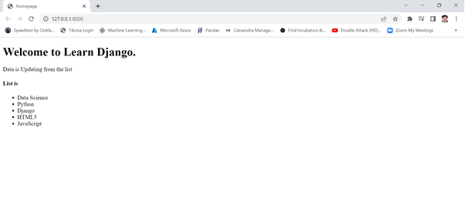
Example on Django Template : Let us create one template and render it .
Step4) check output : Visit http://127.0.0.1:8000/
Notes:
In this slide - Trainer will showing the students the output
------------------------------------------------------------------------------
Page redirection is needed for many reasons in web application. You might want to redirect a user to another page when a specific action occurs, or basically in case of error. For example, when a user logs in to your website, he is often redirected either to the main home page or to his personal dashboard. In Django, redirection is accomplished using the 'redirect' method.
The 'redirect' method takes as argument: The URL you want to be redirected to as string A view's name.

Slide 156
Django Models
A model is the single, definitive source of information about your data. It contains the essential fields and behaviors of the data you’re storing. Generally, each model maps to a single database table.
A Django model is the built-in feature that Django uses to create tables, their fields, and various constraints. In short, Django Models is the SQL of Database one uses with Django.
SQL (Structured Query Language) is complex and involves a lot of different queries for creating, deleting, updating or any other stuff related to database. Django models simplify the tasks and organize tables into models. Generally, each model maps to a single database table.
Django models provide simplicity, consistency, version control and advanced metadata handling.
Basics of a model include –
Each model is a Python class that subclasses django.db.models.Model.
Each attribute of the model represents a database field.
With all of this, Django gives you an automatically-generated database-access API
Notes:
In this slide - Trainer will briefing the students about Django Models
-------------------------------------------------------------------------------
Django provides a high-level Object-Relational Mapping (ORM) framework that abstracts the database layer, allowing you to perform SQL operations using Python code and classes called "models." These models define the structure of your database tables and their relationships, making it easier to work with databases without writing raw SQL queries.
A model is a class that represents table or collection in our DB, and where every attribute of the class is a field of the table or collection. Models are defined in the app/models.py (in our example: myapp/models.py)

Slide 157
Quick Example : Creating Models
This example model defines a Person, which has a first_name and last_name:
from django.db import models
class Person(models.Model):
first_name = models.CharField(max_length=30)
last_name = models.CharField(max_length=30)
first_name and last_name are fields of the model. Each field is specified as a class attribute, and each attribute maps to a database column.
The Person model would create a database table like this:
CREATE TABLE myapp_person (
"id" serial NOT NULL PRIMARY KEY,
"first_name" varchar(30) NOT NULL,
"last_name" varchar(30) NOT NULL
);
Notes:
In this slide - Trainer will briefing the students about how to create Django Models
-------------------------------------------------------------------------------
Some technical notes:
The name of the table, myapp_person, is automatically derived from some model metadata but can be overridden.
An id field is added automatically, but this behavior can be overridden.
The CREATE TABLE SQL in this example is formatted using PostgreSQL syntax, but it’s worth noting Django uses SQL tailored to the database backend specified in your settings file.

Slide 158
Using Models
Once you have defined your models, you need to tell Django you’re going to use those models. Do this by editing your settings file and changing the INSTALLED_APPS setting to add the name of the module that contains your models.py.
For example, if the models for your application live in the module myapp.models (the package structure that is created for an application by the manage.py startapp script), INSTALLED_APPS should read, in part:
INSTALLED_APPS = [
#...
'myapp’,
#...
]
When you add new apps to INSTALLED_APPS, be sure to run following commands for making migrations
> manage.py makemigrations
> manage.py migrate
Notes:
In this slide - Trainer will briefing the students about Django user Models
-------------------------------------------------------------------------------
Benefits of using Django apps –
Django apps are reusable i.e. a Django app can be used with multiple projects.
We have loosely coupled i.e. almost independent components
Multiple developers can work on different components
Debugging and code organization is easy. Django has an excellent debugger tool.
It has in-built features like admin pages etc, which reduces the effort of building the same from stratch

Slide 159
Fields : -creating model Fields
The most important part of a model – and the only required part of a model – is the list of database fields it defines. Fields are specified by class attributes. Be careful not to choose field names that conflict with the models API like clean, save, or delete.
Example:
from django.db import models
class Musician(models.Model):
first_name = models.CharField(max_length=50)
last_name = models.CharField(max_length=50)
instrument = models.CharField(max_length=100)
class Album(models.Model):
artist = models.ForeignKey(Musician, on_delete=models.CASCADE)
name = models.CharField(max_length=100)
release_date = models.DateField()
num_stars = models.IntegerField()
Notes:
In this slide - Trainer will briefing the students about Django Models fields
-------------------------------------------------------------------------------
The most important part of a model and the only required part of a model is the list of database fields it defines. Fields are specified by class attributes. Be careful not to choose field names that conflict with the models API like clean, save, or delete.
Field types
Each field in the model should be an instance of the appropriate Field class. Django uses field class types to determine a few things:
The column type, which tells the database what kind of data to store (e.g. INTEGER, VARCHAR, TEXT).
The default HTML widget to use when rendering a form field (e.g. <input type=”text”>, <select>).
The minimal validation requirements, used in Django’s admin and in automatically-generated forms.

Slide 160
Fields types : - Creating Model Fields
Each field in your model should be an instance of the appropriate Field class. Django uses the field class types to determine a few things:
The column type, which tells the database what kind of data to store (e.g. INTEGER, VARCHAR, TEXT).
The default HTML widget to use when rendering a form field (e.g. <input type="text">, <select>).
The minimal validation requirements, used in Django’s admin and in automatically-generated forms.
Django ships with dozens of built-in field types; you can find the complete list in the model field reference.
Few Filed types are listed below:
AutoField IntegerField
CharField TextField
DateField FileField
ImageField EmailField
DecimalField JSONField
Notes:
In this slide - Trainer will briefing the students about create Models fields
-------------------------------------------------------------------------------
AutoField
It is an IntegerField that automatically increments.
BigAutoField
It is a 64-bit integer, much like an AutoField except that it is guaranteed to fit numbers from 1 to 9223372036854775807.
BigIntegerField
It is a 64-bit integer, much like an IntegerField except that it is guaranteed to fit numbers from -9223372036854775808 to 9223372036854775807.
BinaryField
A field to store raw binary data.
BooleanField
A true/false field. The default form widget for this field is a CheckboxInput.
CharField
A field to store text-based values.
DateField
A date, represented in Python by a datetime.date instance
DateTimeField
It is used for date and time, represented in Python by a datetime.datetime instance.
DecimalField
It is a fixed-precision decimal number, represented in Python by a Decimal instance.
DurationField
A field for storing periods of time.
EmailField
It is a CharField that checks that the value is a valid email address.
FileField
It is a file-upload field.
FloatField
It is a floating-point number represented in Python by a float instance.
ImageField
It inherits all attributes and methods from FileField, but also validates that the uploaded object is a valid image.
IntegerField
It is an integer field. Values from -2147483648 to 2147483647 are safe in all databases supported by Django.
GenericIPAddressField
An IPv4 or IPv6 address, in string format (e.g. 192.0.2.30 or 2a02:42fe::4).
NullBooleanField
Like a BooleanField, but allows NULL as one of the options.
PositiveIntegerField
Like an IntegerField, but must be either positive or zero (0).
PositiveSmallIntegerField
Like a PositiveIntegerField, but only allows values under a certain (database-dependent) point.
SlugField
Slug is a newspaper term. A slug is a short label for something, containing only letters, numbers, underscores or hyphens. They’re generally used in URLs.
SmallIntegerField
It is like an IntegerField, but only allows values under a certain (database-dependent) point.
TextField
A large text field. The default form widget for this field is a Textarea.
TimeField
A time, represented in Python by a datetime.time instance.
URLField
A CharField for a URL, validated by URLValidator.
UUIDField
A field for storing universally unique identifiers. Uses Python’s UUID class. When used on PostgreSQL, this stores in a uuid datatype, otherwise in a char(32).

Slide 161
Fields options : -creating model Fields
Each field takes a certain set of field-specific arguments. For example, CharField (and its subclasses) require a max_length argument which specifies the size of the VARCHAR database field used to store the data.
Here’s a quick summary of the most often-used ones:
null -If True, Django will store empty values as NULL in the database. Default is False.
blank -If True, the field is allowed to be blank. Default is False.
choices- A sequence of 2-tuples to use as choices for this field. If this is given, the default form widget will be a select box instead of the standard text field and will limit choices to the choices given.
A choices list looks like this:
YEAR_IN_SCHOOL_CHOICES = [
('FR', 'Freshman'),
('SO', 'Sophomore'),
('JR', 'Junior'),
('SR', 'Senior'),
('GR', 'Graduate’), ]
Notes:
In this slide - Trainer will briefing the students about Django Models fields options
-------------------------------------------------------------------------------
Django Field Choices. According to documentation Field Choices are a sequence consisting itself of iterables of exactly two items (e.g. [(A, B), (A, B) …]) to use as choices for some field. For example, consider a field semester which can have options as { 1, 2, 3, 4, 5, 6 } only. Choices limits the input from the user to the particular values specified in models.py. If choices are given, they’re enforced by model validation and the default form widget will be a select box with these choices instead of the standard text field.

Slide 162
Making queries :create model
Once you’ve created your data models, Django automatically gives you a database-abstraction API that lets you create, retrieve, update and delete objects. we’ll refer to the following models
from datetime import date
from django.db import models
class Blog(models.Model):
name = models.CharField(max_length=100)
tagline = models.TextField()
def __str__(self):
return self.name
class Author(models.Model):
name = models.CharField(max_length=200)
email = models.EmailField()
def __str__(self):
return self.name
Notes:
In this slide - Trainer will briefing the students about create Models fields
-------------------------------------------------------------------------------
A Django model is the built-in feature that Django uses to create tables, their fields, and various constraints. In short, Django Models is the SQL of Database one uses with Django. SQL (Structured Query Language) is complex and involves a lot of different queries for creating, deleting, updating or any other stuff related to database. Django models simplify the tasks and organize tables into models. Generally, each model maps to a single database table.

Slide 163
Making queries :create model
class Entry(models.Model):
blog = models.ForeignKey(Blog, on_delete=models.CASCADE)
headline = models.CharField(max_length=255)
body_text = models.TextField()
pub_date = models.DateField()
mod_date = models.DateField(default=date.today)
authors = models.ManyToManyField(Author)
number_of_comments = models.IntegerField(default=0)
number_of_pingbacks = models.IntegerField(default=0)
rating = models.IntegerField(default=5)
def __str__(self):
return self.headline
Notes:
In this slide - Trainer will briefing the students about create Models fields
-------------------------------------------------------------------------------
A Django model is the built-in feature that Django uses to create tables, their fields, and various constraints. In short, Django Models is the SQL of Database one uses with Django. SQL (Structured Query Language) is complex and involves a lot of different queries for creating, deleting, updating or any other stuff related to database. Django models simplify the tasks and organize tables into models. Generally, each model maps to a single database table.

Slide 164
Making queries : Creating objects
A model class represents a database table, and an instance of that class represents a particular record in the database table.
To create an object, instantiate it using keyword arguments to the model class, then call save() to save it to the database.
Assuming models live in a file mysite/blog/models.py, here’s an example:
>>> from blog.models import Blog
>>> b = Blog(name='Beatles Blog', tagline='All the latest Beatles news.')
>>> b.save()
This performs an INSERT SQL statement behind the scenes. Django doesn’t hit the database until you explicitly call save().
The save() method has no return value.
To create and save an object in a single step, use the create() method.
Notes:
In this slide - Trainer will briefing the students about create object
-------------------------------------------------------------------------------
Adding objects
To create an object of model Album and save it into the database, we need to write the following command:
>>> a = Album(title = "Divide", artist = "Ed Sheeran", genre = "Pop") >>> a.save()
To create an object of model Song and save it into the database, we need to write the following command:
>>> s = Song(name = "Castle on the Hill", album = a) >>> s.save()

Slide 165
Making queries : Saving changes to objects
To save changes to an object that’s already in the database, use save().
Given a Blog instance b5 that has already been saved to the database, this example changes its name and updates its record in the database:
>>> b5.name = 'New name'
>>> b5.save()
This performs an UPDATE SQL statement behind the scenes. Django doesn’t hit the database until you explicitly call save().
Notes:
In this slide - Trainer will briefing the students about Modifying existing objects
-------------------------------------------------------------------------------
We can modify an existing object as follows:
>>> a = Album.objects.get(pk = 3) >>> a.genre = "Pop" >>> a.save()

Slide 166
Making queries : Retrieving objects
To retrieve objects from your database, construct a QuerySet via a Manager on your model class.
A QuerySet represents a collection of objects from your database. It can have zero, one or many filters. Filters narrow down the query results based on the given parameters. In SQL terms, a QuerySet equates to a SELECT statement, and a filter is a limiting clause such as WHERE or LIMIT.
You get a QuerySet by using your model’s Manager. Each model has at least one Manager, and it’s called objects by default. Access it directly via the model class, like so:
>>> Blog.objects
<django.db.models.manager.Manager object at ...>
>>> b = Blog(name='Foo', tagline='Bar')
>>> b.objects
Traceback:
...
AttributeError: "Manager isn't accessible via Blog instances.“
Notes:
In this slide - Trainer will briefing the students about Making query
-------------------------------------------------------------------------------
The SQL SELECT LIMIT statement is used to retrieve records from one or more tables in a database and limit the number of records returned based on a limit value.

Slide 167
Making queries : Retrieving specific objects with filters
The QuerySet returned by all() describes all objects in the database table. Usually, though, you’ll need to select only a subset of the complete set of objects.
To create such a subset, you refine the initial QuerySet, adding filter conditions. The two most common ways to refine a QuerySet are:
filter(**kwargs)
-Returns a new QuerySet containing objects that match the given lookup parameters.
exclude(**kwargs)
-Returns a new QuerySet containing objects that do not match the given lookup parameters.
The lookup parameters (**kwargs in the above function definitions) should be in the format described in Field lookups below:
For example, to get a QuerySet of blog entries from the year 2006, use filter() like so:
Entry.objects.filter(pub_date__year=2006)
With the default manager class, it is the same as:
Entry.objects.all().filter(pub_date__year=2006)
Notes:
In this slide - Trainer will briefing the students about Making query
-------------------------------------------------------------------------------
Django QuerySet
A QuerySet is a collection of data from a database.
A QuerySet is built up as a list of objects.
QuerySets makes it easier to get the data you actually need, by allowing you to filter and order the data.

Slide 168
Making queries :Retrieving a single object with get()
filter() will always give you a QuerySet, even if only a single object matches the query - in this case, it will be a QuerySet containing a single element.
If you know there is only one object that matches your query, you can use the get() method on a Manager which returns the object directly:
>>> one_entry = Entry.objects.get(pk=1)
Notes:
In this slide - Trainer will briefing the students about filter()
-------------------------------------------------------------------------------
filter() will always give you a QuerySet, even if only a single object matches the query - in this case, it will be a QuerySet containing a single element.

Slide 169
Making queries : Limiting QuerySets
Use a subset of Python’s array-slicing syntax to limit your QuerySet to a certain number of results. This is the equivalent of SQL’s LIMIT and OFFSET clauses.
For example, this returns the first 5 objects (LIMIT 5):
>>> Entry.objects.all()[:5]
This returns the sixth through tenth objects (OFFSET 5 LIMIT 5):
>>> Entry.objects.all()[5:10]
Negative indexing (i.e. Entry.objects.all()[-1]) is not supported
Notes:
In this slide - Trainer will briefing the students about Making query
-------------------------------------------------------------------------------
Django limit query
I am trying to run a Django query that will anycodings_django limit the returned results to 5 items. This anycodings_django is easy, except for the fact that the query anycodings_django will not always return 5 items.
In Django, you can use the QuerySet API to limit the number of records retrieved from the database. The QuerySet is an abstraction over the database table, and it provides various methods to filter, sort, and manipulate data. Here's how you can use the QuerySet to limit the number of records retrieved:

Slide 170
Performing raw SQL queries
Django gives you two ways of performing raw SQL queries: you can use Manager.raw() to perform raw queries and return model instances, or you can avoid the model layer entirely and execute custom SQL directly.
The raw() manager method can be used to perform raw SQL queries that return model instances:
Manager.raw(raw_query, params=(), translations=None)
This method takes a raw SQL query, executes it, and returns a django.db.models.query.RawQuerySet instance. This RawQuerySet instance can be iterated over like a normal QuerySet to provide object instances.
This is best illustrated with an example. Suppose you have the following model:
class Person(models.Model):
first_name = models.CharField(...)
last_name = models.CharField(...)
birth_date = models.DateField(...)
Notes:
In this slide - Trainer will briefing the students about Performing raw queries
-------------------------------------------------------------------------------
Performing raw queries¶
The raw() manager method can be used to perform raw SQL queries that return model instances:
Manager.raw(raw_query, params=(), translations=None)¶
This method takes a raw SQL query, executes it, and returns a django.db.models.query.RawQuerySet instance. This RawQuerySet instance can be iterated over like a normal QuerySet to provide object instances.

Slide 171
Performing raw SQL queries (Continued)
You could then execute custom SQL like so:
>>> for p in Person.objects.raw('SELECT * FROM myapp_person'):
... print(p)
John Smith
Jane Jones
it’s exactly the same as running Person.objects.all().
Index lookups:
raw() supports indexing, so if you need only the first result you can write:
>>> first_person = Person.objects.raw('SELECT * FROM myapp_person')[0]
Notes:
In this slide - Trainer will briefing the students about Index lookups
--------------------------------------------------------------------------------------------
raw() supports indexing, so if you need only the first result you can write:
>>> first_person = Person.objects.raw('SELECT * FROM myapp_person')[0]

Slide 172
Django CRUD (Create, Retrieve, Update, Delete) Function Based Views
Django is a Python-based web framework which allows you to quickly create web application without all of the installation or dependency problems that you normally will find with other frameworks.
Django is based on MVT (Model View Template) architecture and revolves around CRUD (Create, Retrieve, Update, Delete) operations.
CRUD means performing Create, Retrieve, Update and Delete operations on a table in a database.
Notes:
In this slide - Trainer will briefing the students about CRUD
-------------------------------------------------------------------------------
CRUD (Create, Retrieve, Update, Delete) operations are fundamental actions when working with databases and web applications. In Django, you can implement these operations using function-based views. Let's explore how to create CRUD views for a simple model using function-based views:

Slide 173
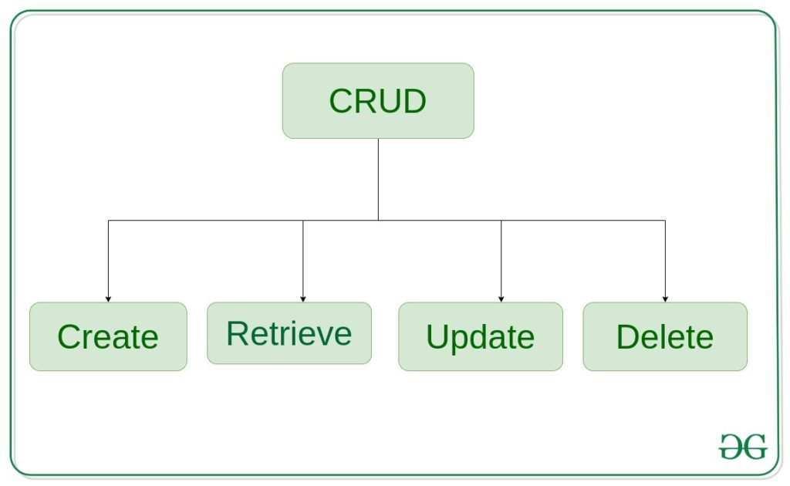
Django CRUD Operations
Create – create or add new entries in a table in the database.
Retrieve – read, retrieve, search, or view existing entries as a list(List View) or retrieve a particular entry in detail (Detail View)
Update – update or edit existing entries in a table in the database
Delete – delete, deactivate, or remove existing entries in a table in the database
Click here
Reference link
Notes:
In this slide - Trainer will briefing the students about CRUD OPERATIONS
-------------------------------------------------------------------------------
Create (Add) View: The create view handles the addition of new records to the database. It typically displays a form to collect user input and then saves the data to the database upon form submission.
Retrieve (List) View: The retrieve view displays a list of records from the database. It fetches data using the model's manager and displays it in a template.
Update View: The update view allows users to modify existing records. It fetches a specific record using its primary key, displays a pre-filled form with the record's data, and then updates the record upon form submission.
Delete View: The delete view allows users to remove records from the database.

Slide 174
Django Lab 23
Click below
Django
Notes:
In this slide, Trainer will ask the students to click on the link given in the slide – Django – Which is a solved question based on a topic. Student may refer the questions, analyze the questions and after the concept is understood. Student may solve another question with the following link.
Practice Question -: https://github.com/edunetnextgen/Student-Development/blob/main/Full%20Stack%20Development%20with%20Cloud/Module%203/Lab%2023%20Ex.2%20Practice%20Question
Practice Question Solution -: https://github.com/edunetnextgen/Student-Development/blob/main/Full%20Stack%20Development%20with%20Cloud/Module%203/Lab%2023%20Ex.2%20Practice%20Question%20Solution

Slide 175
Handling Sessions
Notes:
Handling sessions in Django is crucial for maintaining user state across multiple requests. Sessions allow you to store user-specific data on the server and associate it with a session ID stored in cookies or URLs. Django provides a convenient way to work with sessions using its built-in session framework.

Slide 176
What is session and How to use Sessions:
The session framework lets you store and retrieve arbitrary data on a per-site-visitor basis. It stores data on the server side and abstracts the sending and receiving of cookies. Cookies contain a session ID – not the data itself (unless you’re using the cookie-based backend).
Django provides full support for anonymous sessions.
Enabling sessions
Sessions are implemented via a piece of middleware.
To enable session functionality, do the following:
Edit the MIDDLEWARE setting and make sure it contains 'django.contrib.sessions.middleware.SessionMiddleware'. The default settings.py created by django-admin startproject has SessionMiddleware activated.
Notes:
In this slide - Trainer will briefing the students about What is session and How to use Sessions
-------------------------------------------------------------------------------
A session is a way to store user-specific data on the server between requests in a web application. It allows you to maintain user state and store information that persists across multiple interactions without having to pass the data back and forth between the client (browser) and the server. Sessions are essential for managing user authentication, tracking user activity, and providing personalized experiences.

Slide 177
Configuring the session engine
By default, Django stores sessions in your database (using the model django.contrib.sessions.models.Session). Though this is convenient, in some setups it’s faster to store session data elsewhere, so Django can be configured to store session data on your filesystem or in your cache.
Using database-backed sessions
If you want to use a database-backed session, you need to add 'django.contrib.sessions' to your INSTALLED_APPS setting.
Once you have configured your installation, run manage.py migrate to install the single database table that stores session data.
Notes:
In this slide - Trainer will briefing the students about Configuring the session engine
-------------------------------------------------------------------------------
In Django, the session engine is responsible for managing how session data is stored and retrieved. By default, Django uses a database-backed session engine, but you can also configure other session engines such as cache-based sessions or file-based sessions.
Default Session Engine (Database-Backed Sessions): By default, Django uses database-backed sessions, which store session data in the database. To use the default session engine, you only need to ensure that the SessionMiddleware is included in your MIDDLEWARE setting:
Using Cache-Based Sessions: Cache-based sessions store session data in a cache backend (e.g., Memcached, Redis) instead of the database. To use cache-based sessions, you need to modify the SESSION_ENGINE and SESSION_CACHE_ALIAS settings in your settings.py:

Slide 178
Using file-based Sessions
To use file-based sessions, set the SESSION_ENGINE setting to "django.contrib.sessions.backends.file".
You might also want to set the SESSION_FILE_PATH setting (which defaults to output from tempfile.gettempdir(), most likely /tmp) to control where Django stores session files. Be sure to check that your web server has permissions to read and write to this location.
Using cookie-based sessions
To use cookies-based sessions, set the SESSION_ENGINE setting to "django.contrib.sessions.backends.signed_cookies".
The session data will be stored using Django’s tools for cryptographic signing and the SECRET_KEY setting.
Notes:
In this slide - Trainer will briefing the students about Using file-based Sessions
-------------------------------------------------------------------------------
To test out whether cookies work on your client, you can use some convenience methods provided by Django’s request object (set_test_cookie(), test_cookie_worked(), delete_test_cookie() ). In one view you will need to set a cookie and in another view you’ll need to test it. The reason you need to set the cookie in one view and test it in another is that you need to wait to see if the client has actually accepted the cookie.

Slide 179
Using sessions in views
When SessionMiddleware is activated, each HttpRequest object – the first argument to any Django view function – will have a session attribute, which is a dictionary-like object.
You can read it and write to request.session at any point in your view. You can edit it multiple times.
class backends.base.SessionBase
This is the base class for all session objects. It has the following standard dictionary methods:
__getitem__(key)
Example: fav_color = request.session['fav_color']
__setitem__(key, value)
Example: request.session['fav_color'] = 'blue’
__delitem__(key)¶
Example: del request.session['fav_color']. This raises KeyError if the given key isn’t already in the session.
Notes:
In this slide - Trainer will briefing the students about Using file-based Sessions
-------------------------------------------------------------------------------
Using sessions in Django views is relatively straightforward. Sessions allow you to store and retrieve user-specific data across multiple requests.
Storing Data in Sessions: You can store data in sessions using the request.session dictionary-like attribute.
Retrieving Data from Sessions: To retrieve data from sessions, you can access the request.session dictionary just like a regular Python dictionary.
Clearing Session Data: To clear session data, you can use the clear() method of the request.session

Slide 180
Using Sessions in Views (Continued)
___contains__(key)
Example: 'fav_color' in request.session
get(key, default=None)
Example: fav_color = request.session.get('fav_color', 'red')
pop(key, default=__not_given)
Example: fav_color = request.session.pop('fav_color', 'blue’)
keys()
items()
setdefault()
clear()
Notes:
In this slide - Trainer will briefing the students about Using Sessions in Views (Continued)
-------------------------------------------------------------------------------
__contains__(key) - Checking for a Key in the Session: The __contains__() method allows you to check if a key exists in the session.
get(key, default=None) - Retrieving Data with Default Value: The get() method retrieves the value associated with the specified key from the session. If the key doesn't exist, it returns the provided default value.
pop(key, default=__not_given) - Removing and Returning a Key: The pop() method removes the specified key from the session and returns its value. If the key doesn't exist, it returns the provided default value or raises an exception if not provided.
keys() - Retrieving All Keys in the Session: The keys() method returns a list of all keys stored in the session.
items() - Retrieving All Key-Value Pairs in the Session: The items() method returns a list of tuples containing all key-value pairs stored in the session.

Slide 181
Using Sessions in Views (Continued)
It also has these methods:
flush()
Deletes the current session data from the session and deletes the session cookie. This is used if you want to ensure that the previous session data can’t be accessed again from the user’s browser (for example, the django.contrib.auth.logout() function calls it).
set_test_cookie()
Sets a test cookie to determine whether the user’s browser supports cookies. Due to the way cookies work, you won’t be able to test this until the user’s next page request.
test_cookie_worked()
Returns either True or False, depending on whether the user’s browser accepted the test cookie. Due to the way cookies work, you’ll have to call set_test_cookie() on a previous, separate page request.
Notes:
In this slide - Trainer will briefing the students about Using Sessions in Views (Continued)
-------------------------------------------------------------------------------
flush() - Deleting Session Data and Session Cookie: The flush() method deletes the current session data from the session and also deletes the session cookie. It's often used when you want to ensure that previous session data can't be accessed again from the user's browser.
set_test_cookie() - Setting a Test Cookie for Cookie Support Test: The set_test_cookie() method is used to set a test cookie in the user's browser. This is typically used to determine whether the user's browser supports cookies. Since cookies are set on the user's next page request, you need to check if the test cookie worked on the following request using the test_cookie_worked() method.
test_cookie_worked() - Checking if Test Cookie Worked: The test_cookie_worked() method returns either True or False depending on whether the test cookie was successfully set and received by the user's browser. This is a way to confirm that the user's browser supports cookies.

Slide 182
Using Sessions in Views (Continued)
delete_test_cookie()
Deletes the test cookie. Use this to clean up after yourself.
get_session_cookie_age()
Returns the value of the setting SESSION_COOKIE_AGE. This can be overridden in a custom session backend.
set_expiry(value)
Sets the expiration time for the session. You can pass a number of different values:
If value is an integer, the session will expire after that many seconds of inactivity. For example, calling request.session.set_expiry(300) would make the session expire in 5 minutes.
If value is a datetime or timedelta object, the session will expire at that specific date/time. Note that datetime and timedelta values are only serializable if you are using the PickleSerializer.
If value is 0, the user’s session cookie will expire when the user’s web browser is closed.
If value is None, the session reverts to using the global session expiry policy.
Reading a session is not considered activity for expiration purposes. Session expiration is computed from the last time the session was modified.
Notes:
In this slide - Trainer will briefing the students about Using Sessions in Views (Continued)
-------------------------------------------------------------------------------
delete_test_cookie() - Deleting the Test Cookie: The delete_test_cookie() method is used to delete the test cookie that was previously set using set_test_cookie(). This method is used to clean up after performing the test cookie check.
get_session_cookie_age() - Retrieving the Session Cookie Age: The get_session_cookie_age() method returns the value of the SESSION_COOKIE_AGE setting, which specifies the expiration time for the session cookie. This value can be overridden in a custom session backend.
set_expiry(value) - Setting the Expiration Time for the Session: The set_expiry() method is used to set the expiration time for the session.

Slide 183
Using sessions in views (Continued)
get_expiry_age()
Returns the number of seconds until this session expires. For sessions with no custom expiration (or those set to expire at browser close), this will equal SESSION_COOKIE_AGE.
This function accepts two optional keyword arguments:
modification: last modification of the session, as a datetime object. Defaults to the current time.
expiry: expiry information for the session, as a datetime object, an int (in seconds), or None. Defaults to the value stored in the session by set_expiry(), if there is one, or None.
get_expiry_date()
Returns the date this session will expire. For sessions with no custom expiration (or those set to expire at browser close), this will equal the date SESSION_COOKIE_AGE seconds from now.
This function accepts the same keyword arguments as get_expiry_age(), and similar notes on usage apply.
Notes:
In this slide - Trainer will briefing the students about Using Sessions in Views (Continued)
-------------------------------------------------------------------------------
get_expiry_age(modification=None, expiry=None) - Retrieving Seconds Until Expiry: The get_expiry_age() method returns the number of seconds until the session expires. This function accepts two optional keyword arguments:
get_expiry_date(modification=None, expiry=None) - Retrieving Expiry Date: The get_expiry_date() method returns the date when the session will expire. For sessions with no custom expiration (or those set to expire at browser close), this will equal the date SESSION_COOKIE_AGE seconds from now. This function also accepts the same keyword arguments as get_expiry_age().

Slide 184
Using Sessions in Views (Continued)
get_expire_at_browser_close()
Returns either True or False, depending on whether the user’s session cookie will expire when the user’s web browser is closed.
clear_expired()
Removes expired sessions from the session store. This class method is called by clearsessions.
cycle_key()
Creates a new session key while retaining the current session data. django.contrib.auth.login() calls this method to mitigate against session fixation.
Notes:
In this slide - Trainer will briefing the students about Using Sessions in Views (Continued)
-------------------------------------------------------------------------------
get_expire_at_browser_close() - Checking if Session Expires at Browser Close: The get_expire_at_browser_close() method returns either True or False, depending on whether the user's session cookie will expire when the user's web browser is closed. If the session is set to expire when the browser is closed, this method will return True.
clear_expired() - Removing Expired Sessions: The clear_expired() method removes expired sessions from the session store. This class method is usually called by the clearsessions management command, which you can use to clean up expired sessions.
cycle_key() - Cycling the Session Key: The cycle_key() method creates a new session key while retaining the current session data. This is used as a security measure to mitigate against session fixation attacks. The django.contrib.auth.login() function often calls this method after a successful login.

Slide 185
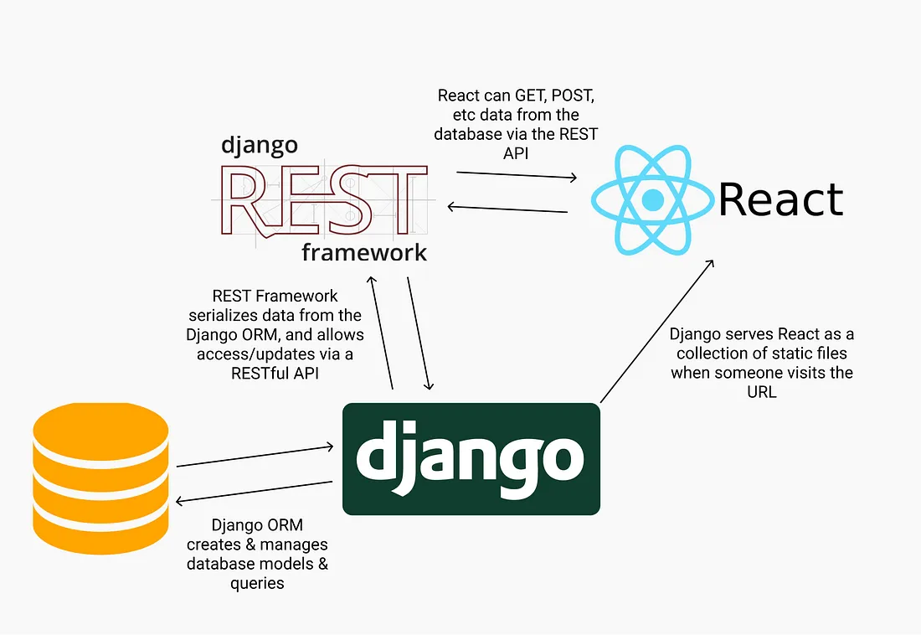
REST API
Click here
Reference link
Notes:
In this slide - Trainer will briefing the students about REST API
-------------------------------------------------------------------------------
REST APIs are so commonplace in software development, it’s an essential skill for a developer to know how they work. APIs are how applications communicate with one another or even within themselves.

Slide 186
Introduction to REST API
A REST API (Representational State Transfer Application Programming Interface) is a type of web API that follows the principles of REST, an architectural style for designing networked applications.
It provides a way for different software systems to communicate and interact with each other over the internet. REST APIs are widely used in web development to allow applications to exchange data and perform actions on remote servers.
Notes:
In this slide - Trainer will briefing the students about REST API
-------------------------------------------------------------------------------
A REST API (Representational State Transfer Application Programming Interface) is a set of rules and conventions that allows different software applications to communicate with each other over the internet. It provides a standardized way for applications to exchange data and perform actions on resources.
REST APIs are commonly used to build web services that allow client applications (such as web browsers, mobile apps, or other servers) to interact with a server and perform CRUD operations (Create, Read, Update, Delete) on resources. These resources could be in the form of data objects, such as user profiles, articles, products, or any other information that can be represented digitally.

Slide 187
Key Concepts of REST API:
Resources: In REST, everything is a resource, which can be a data object, a service, or any other piece of information. Each resource is uniquely identified by a URI (Uniform Resource Identifier).
HTTP Methods: REST APIs use standard HTTP methods to perform actions on resources. The most common methods are:
GET: Retrieve a representation of the resource.
POST: Create a new resource.
PUT: Update an existing resource.
DELETE: Remove a resource.
Notes:
In this slide - Trainer will briefing the students about REST API Key Concepts
-------------------------------------------------------------------------------
Resources: Resources are the fundamental objects that a REST API manages. They can be data objects, such as user profiles, articles, images, or any other type of information that you want to expose to clients. Resources are identified by a unique URI (Uniform Resource Identifier), which is a URL that points to a specific location where the resource can be accessed.
GET: The GET method is used to retrieve a representation of the resource. It's a safe and idempotent method, meaning it should not have any side effects on the resource and can be called multiple times without altering the resource.
POST: The POST method is used to create a new resource. It's typically used when you want to add a new data object to the server. The client sends data in the request body, and the server processes it to create a new resource.
PUT: The PUT method is used to update an existing resource or create it if it doesn't exist. The client sends the updated data in the request body, and the server replaces the resource with the provided data.
DELETE: The DELETE method is used to remove a resource. It deletes the resource identified by the URI, and subsequent GET requests to that URI would result in a "404 Not Found" response.
These HTTP methods, when used in combination with the appropriate URIs, form the basis of how REST APIs allow clients to interact with resources. They provide a standardized way for clients to perform actions on resources, making it easy to develop and consume APIs across different platforms and technologies.

Slide 188
Key Concepts of REST API:
Statelessness: REST APIs are stateless, meaning each request from a client to the server must contain all the necessary information to understand and process the request. The server does not store any information about the client's state between requests.
Representations: Resources in a REST API can have multiple representations, such as JSON, XML, HTML, or others. Clients can specify the desired representation in the HTTP request headers.
Notes:
In this slide - Trainer will briefing the students about REST API Key Concepts
-------------------------------------------------------------------------------
Statelessness: Statelessness is a fundamental principle in RESTful APIs. It means that each individual request from a client to the server must contain all the information needed to understand and process the request. The server doesn't store any client-specific state between requests. This design ensures that each request can be processed independently, which leads to better scalability and reliability.
Representations: Resources in a REST API can have multiple representations, allowing clients to choose the format that best suits their needs. The most common representation formats are JSON (JavaScript Object Notation) and XML (eXtensible Markup Language). These formats are human-readable and easy for machines to parse.

Slide 189
Key Concepts of REST API:
Uniform Interface: REST APIs follow a uniform and consistent interface, which simplifies communication between clients and servers. This allows different clients to interact with the same API easily.
Hypermedia as the Engine of Application State (HATEOAS): HATEOAS is an important principle of REST that suggests including hypermedia links in the API responses. These links guide clients on how to interact with the API and discover available actions dynamically.
Notes:
In this slide - Trainer will briefing the students about REST API Key Concepts
-------------------------------------------------------------------------------
Uniform Interface: The uniform interface is a central principle of REST APIs, emphasizing the importance of a consistent and standardized way to interact with resources.
Hypermedia as the Engine of Application State (HATEOAS): HATEOAS is an advanced concept in RESTful design that takes the concept of uniform interface further. In HATEOAS, API responses include hypermedia links that guide clients on how to interact with the API and discover available actions dynamically.
These hypermedia links provide contextual information about what actions are allowed on a resource. For example, a response might include links to create a new resource, update an existing resource, or navigate to related resources. Clients can follow these links to perform the appropriate actions, reducing the need for prior knowledge of API endpoints.

Slide 190
Working of rest API: Django
The working of a REST API in Django involves building an API using the Django web framework that adheres to the principles of RESTful architecture.
Django provides a powerful framework to create RESTful APIs easily with the help of Django REST Framework (DRF), a popular third-party package.
Notes:
In this slide - Trainer will briefing the students about Working with REST API in Django
-------------------------------------------------------------------------------
Building a REST API in Django involves creating an API that follows the principles of RESTful architecture. Django, being a versatile web framework, provides developers with the tools needed to create powerful and flexible APIs.
However, to make the process even more efficient and feature-rich, many developers turn to Django REST Framework (DRF), a third-party package specifically designed for building RESTful APIs in Django. DRF extends Django's capabilities by providing a set of tools and components that simplify the creation of APIs.

Slide 191
Set up a Django Project and App:
Start by creating a new Django project if you haven't already:
django-admin startproject project_name
Create a Django app within your project:
python manage.py startapp app_name
Notes:
In this slide - Trainer will briefing and show the students about Set up a Django Project and App
-------------------------------------------------------------------------------
Step 1: Creating a New Django Project: To create a new Django project, you can use the django-admin command-line tool. Replace project_name with the desired name for your project.
Step 2: Creating a Django App: After creating the project, you can create a new app within it. An app is a modular component of a Django project that encapsulates a specific functionality.
Navigate to the project's root directory (where the manage.py script is located) and use the following command to create a new app. Replace app_name with the desired name for your app.

Slide 192
Define Models:
In your app, define the data models using Django's ORM (Object-Relational Mapping). Models represent the data that will be exposed through the API.
Configure Serializers:
Serializers in Django REST Framework allow you to convert complex data types, such as Django models, into Python data types that can be rendered into JSON or XML content.
Serializers also handle parsing incoming request data and validating it.
Notes:
In this slide - Trainer will briefing and show the students about Define Models
-----------------------------------------------------------------
Models in Django define the structure of your database tables and how data will be stored. You'll create Python classes that subclass django.db.models.Model. Each attribute of the class represents a field in the database table.
Configure Serializers: Serializers in Django REST Framework allow you to convert complex data types, like models, into a format that can be easily rendered into JSON or XML. They also handle parsing incoming data and validating it.

Slide 193
Create Views and ViewSets:
Views in Django REST Framework are similar to Django views but are tailored for handling API requests.
You can use class-based views or function-based views to define how your API views process incoming requests and return responses. ViewSets are a convenient way to combine the logic for CRUD operations (list, create, retrieve, update, delete) on a resource.
Set up URL Patterns:
In the app's urls.py file, define URL patterns that map to your API views or ViewSets.
These URL patterns determine the API endpoints that clients can use to interact with your API.
Notes:
In this slide - Trainer will briefing and show the students about Create Views and ViewSets
------------------------------------------------------------------------------
In Django REST Framework, views are used to handle incoming API requests and return appropriate responses. You can use class-based views or function-based views to define how your API views process requests and return data. ViewSets are a powerful way to group the logic for CRUD operations on a resource.
Set Up URL Patterns: To map API views or ViewSets to specific URL patterns, you need to define the URL routing in your app's urls.py file.

Slide 194
Test Your API:
Run the Django development server and test your API using tools like cURL, Postman, or any other API client.
Use the API endpoints to perform CRUD operations on resources and verify the responses.
Deploy and Scale (Production):
Once your API is ready for production, you can deploy it to a web server or cloud platform like AWS, Heroku, or DigitalOcean.
Depending on the traffic and usage, you may need to scale your API to handle more requests efficiently.
Notes:
In this slide - Trainer will briefing the students about Test Your API
----------------------------------------------------------------------------------
After setting up your API, it's essential to thoroughly test it to ensure that it works as expected. Here's how you can do it:
Run the Development Server: Start the Django development server by running python manage.py runserver.
API Client: Use tools like cURL, Postman, or any other API client to interact with your API endpoints.
API Endpoints: Use the API endpoints you defined to perform CRUD operations on your resources. For example, you can use the API to create new posts, retrieve existing posts, update posts, and delete posts.
Verify Responses: As you perform operations using the API, verify that the responses are correct, and the data is being processed as expected.
Deploy and Scale (Production): Once you're satisfied with the functionality and testing of your API, you can deploy it to a production environment:

Slide 195
Advantages of REST API:
Scalability: RESTful architecture is scalable and can handle a large number of clients and requests efficiently.
Platform Independence: Clients and servers in a RESTful API can be built using different programming languages and platforms, as long as they adhere to the standard HTTP methods and representations.
Simplicity and Ease of Use: REST APIs are easy to understand and use, making them popular among developers.
Stateless Communication: The stateless nature of REST allows for better performance and easier caching of responses.
Wide Adoption: REST APIs are widely adopted, and there are many tools and libraries available to develop, test, and consume RESTful services.
Notes:
In this slide - Trainer will briefing and show the students about Advantages of REST API
--------------------------------------------------------------------------------------------
Scalability: RESTful architecture's statelessness and uniform interface contribute to its scalability. Each request contains all the necessary information, which allows servers to scale horizontally by adding more servers to handle increased load. This design also helps in load balancing and distributing the traffic efficiently.
Platform Independence: One of the remarkable features of RESTful APIs is their platform independence. Clients and servers can be built using different technologies and programming languages, as long as they adhere to the HTTP methods and representations specified by the REST architecture.
Simplicity and Ease of Use: RESTful APIs follow a clear and simple design, based on standard HTTP methods and status codes.
Stateless Communication: The stateless nature of RESTful communication simplifies the server's job. It doesn't need to maintain client sessions between requests, resulting in better performance and scalability.
Wide Adoption: RESTful APIs have gained widespread adoption across industries and domains. As a result, there's an abundance of resources, tools, libraries, and documentation available to help developers build, test, and consume RESTful services.

Slide 196
Disadvantages of REST API:
1. Increased design complexity.
Although they are easier to use, the design of a REST API can be more complex than other APIs, especially if you are not familiar with web architecture.
The REST API uses architectural principles that you need to be familiar with in order to develop your API.
2. Web connection
All changes to your REST API must be executed on the web and only on the web. It’s impossible to edit the API from your desktop without an internet connection, unlike HTML web files, for example. You must always connect to make the slightest change.
A REST API requires an Internet connection to function, which means it may be less useful in offline environments.
3. Variable performance and flexibility
On the other hand, REST APIs can have slightly lower performance than other APIs, depending on the servers and their internet speed.
Notes:
In this slide - Trainer will briefing and show the students about Disadvantages of REST API
----------------------------------------------------------------------------------------------------------
Increased Design Complexity: While RESTful APIs follow a well-defined architectural style, their design can become more complex, especially if you're new to web architecture. Understanding concepts like resource modeling, URI design, HTTP methods, and status codes is crucial for designing effective and consistent APIs. This complexity can be a challenge for developers who are not familiar with these principles.
Web Connection Dependency: RESTful APIs are dependent on web connections, which means any changes or updates to the API require an internet connection. Unlike editing files on your local machine, you can't make changes to a REST API without being connected to the internet. This dependence on connectivity might limit the API's usability in offline or low-bandwidth environments.
Variable Performance and Flexibility: The performance of a REST API can be influenced by factors such as server responsiveness, network latency, and the complexity of the API's operations. Since RESTful APIs use HTTP, their performance is tied to the underlying web infrastructure. While they are generally efficient for most use cases, variable performance can arise due to differences in server capabilities and internet speeds.

Slide 197
REST API methods
GET: The GET method is used to retrieve data from the server. When a client sends a GET request to a specific URI, the server responds with the representation of the requested resource. GET requests are idempotent, meaning multiple identical requests have the same effect as a single request and do not modify the server's state.
POST: The POST method is used to submit data to be processed to the server. It is typically used to create new resources on the server. When a client sends a POST request to a URI, the server processes the request data and creates a new resource. Unlike GET, POST requests are not idempotent.
PUT: The PUT method is used to update an existing resource on the server. When a client sends a PUT request to a specific URI, the server updates the resource if it exists or creates a new resource if it does not exist. PUT requests are idempotent, so multiple identical PUT requests will not result in additional changes.
Notes:
In this slide - Trainer will briefing and show the students about REST API methods
---------------------------------------------------------------------------------------------------
GET: This method is used to retrieve information from the server. It does not modify the data on the server; it only fetches the requested resource's representation. For example, fetching a list of users or retrieving details of a specific post.
POST: The POST method is used to create a new resource on the server. You send data in the request body, and the server processes it to create a new resource. For instance, adding a new user to the system or creating a new blog post.
PUT: PUT is used to update an existing resource or create a resource if it doesn't exist at the specified URI. When sending a PUT request, you typically send the complete representation of the resource you want to update. For instance, updating the details of a user profile.

Slide 198
REST API methods
DELETE: The DELETE method is used to remove a resource from the server. When a client sends a DELETE request to a specific URI, the server removes the resource. DELETE requests are idempotent, so making multiple identical DELETE requests has the same effect as a single request.
PATCH: The PATCH method is used to partially update an existing resource on the server. It allows clients to send only the changes they want to apply to the resource rather than sending the entire resource. PATCH requests are not always idempotent, depending on how the server handles them.
HEAD: The HEAD method is similar to GET but returns only the response headers without the actual response body. It is often used to check the status or retrieve metadata about a resource without transferring the entire content.
OPTIONS: The OPTIONS method is used to retrieve information about the communication options available for a resource. It is often used to determine the allowed methods, headers, and other information about the resource.
Notes:
In this slide - Trainer will briefing and show the students about REST API methods
---------------------------------------------------------------------------------------------------
PATCH: Similar to PUT, the PATCH method is used to update a resource. However, with PATCH, you send only the fields that need to be updated rather than sending the entire representation. This can be useful for making partial updates to resources.
DELETE: DELETE is used to delete a resource from the server. Sending a DELETE request to a specific URI removes the resource associated with that URI. For example, deleting a user's account or removing a post.
OPTIONS: The OPTIONS method is used to request information about the communication options available for a resource. It returns information about the HTTP methods supported for that resource.
HEAD: Similar to GET, the HEAD method requests the headers of a resource without retrieving its actual content. It's useful for checking resource existence and metadata without transferring the entire payload.

Slide 199
MODEL, SERIALIZER, AND VIEW
Notes:
In this slide - Trainer will tells the students
---------------------------------------------------------------------------------------------------
let's dive into the concepts of Model, Serializer, and View in the context of a Django RESTful API:

Slide 200
Model, Serializer, and view
Django REST Framework (DRF), Model, Serializer, and View are important components used to build RESTful APIs.
Model:
In DRF, the Model represents the data structure and business logic of the resources that you want to expose through your API.
Models are defined using Django's ORM (Object-Relational Mapping) and represent the database tables.
Each model class typically corresponds to a single database table and its fields represent the table's columns.
Notes:
In this slide - Trainer will briefing and show the students about Model
---------------------------------------------------------------------------------------------------
: In Django, a model is a Python class that defines the structure of a database table and the fields it will contain. Models serve as a bridge between your code and the database, allowing you to interact with database data using Python code.
In the context of a RESTful API, a model defines the data structure for the resources you want to expose through your API. For example, if you're building a blog API, you might have a Post model that defines the fields such as title, content, and publication date.

Slide 201
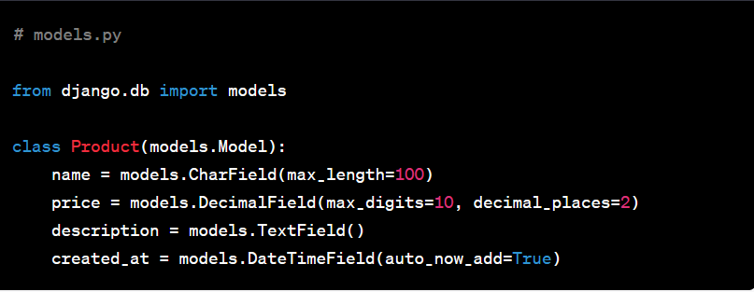
Model:
Notes:
In this slide - Trainer will briefing and show the students about code implementation Model
---------------------------------------------------------------------------------------------------
This is the code to implement the django models

Slide 202
Serializer:
Serializers in DRF are responsible for converting complex data types (like Django models) into JSON or XML data that can be easily rendered and understood by the client.
They also handle parsing incoming request data and validating it before saving it to the database.
DRF provides serializers, such as ModelSerializer, to automate the serialization process based on the model definition.
Notes:
In this slide - Trainer will briefing and show the students about Serializer
------------------------------------------------------------------------------------------------------------
Serializers in Django REST Framework handle the conversion of complex data types, like models, into Python data types that can be easily rendered into JSON, XML, or other formats. Serializers also handle parsing incoming request data and validating it before saving it to the database.
In the context of an API, a serializer defines how data should be converted into a format that can be sent as a response to API requests. It also handles converting incoming data from requests into a format that can be saved to the database.

Slide 203
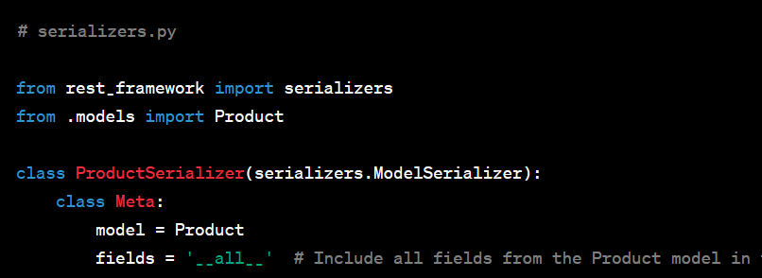
Serializer:
Notes:
In this slide - Trainer will briefing and show the students about code implementation of serializer
---------------------------------------------------------------------------------------------------
This is the code to implement the serializer

Slide 204
View:
In DRF, views handle incoming HTTP requests and return appropriate HTTP responses.
Views can be function-based or class-based and are responsible for processing the data, performing CRUD operations, and returning serialized data as responses.
Notes:
In this slide - Trainer will briefing and show the students about View
-----------------------------------------------------------------
In Django, a view is a Python function or class method that receives an HTTP request, processes it, and returns an HTTP response. Views handle the logic of your application, such as fetching data from the database, processing forms, and rendering templates.
In the context of a RESTful API, views determine how data is presented to clients making API requests. You can use class-based views or function-based views to define how API requests are processed. Views often work with serializers to convert data into a suitable format for response.

Slide 205
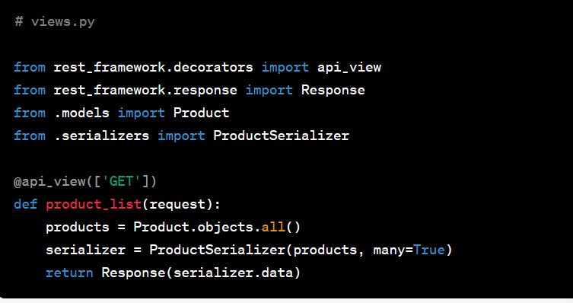
View:
Notes:
Code to implement view

Slide 206
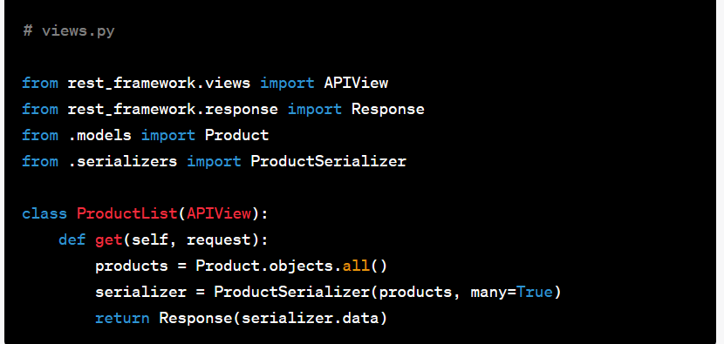
Example View (Class-Based View):
Notes:
In this slide - Trainer will briefing and show the students about code implementation of class based view
---------------------------------------------------------------------------------------------------
Code to implement class based view

Slide 207

Summary
Well done! You have completed this course.
You have learned how to install Django and set up a development environment to start building web applications.
You understand the Model-View-Template (MVT) architectural pattern used by Django and how it helps in organizing code for web applications.
You can create models in Django to define the application's data structure and use Django's Object-Relational Mapping (ORM) to interact with databases
You know how to map URLs to view functions in Django, allowing you to handle HTTP requests and generate appropriate responses.
You have learned how to use Django's template engine to create dynamic HTML templates and how to serve static files like CSS and JavaScript.
Notes:
In this slide - Trainer will go through all the topics cover in this unit and give a summary
---------------------------------------------------------------------------------------------------
Django is a high-level Python web framework that simplifies and expedites the process of building robust web applications. It follows the Model-View-Controller (MVC) architectural pattern, implemented as Model-View-Template (MVT) in Django. This framework empowers developers to focus on business logic rather than low-level technical details. Some notable features include a powerful Object-Relational Mapping (ORM) system for database management, an intuitive URL routing system, and an automatic admin interface for managing application data.
207

Slide 208
Quiz
What does Django's ORM stand for?
Object-Relational Mapping
Object-Rendering Model
Object-Relational Model
Object-Request Mapping ​
Answer : A) Object-Relational Mapping ​
Notes:
In this slide - Trainer will ask quiz to the students and explain about the answer
---------------------------------------------------------------------------------------------------
Django's ORM stands for "Object-Relational Mapping."
208

Slide 209
Quiz
2. In Django, what does the term "View" refer to?
The part of the website that users see
A Python function that processes HTTP requests and returns HTTP responses
The HTML template that renders the webpage
The database schema for storing data
Answer : b) A Python function that processes HTTP requests and returns HTTP responses
Notes:
In this slide - Trainer will ask quiz to the students and explain about the answer
---------------------------------------------------------------------------------------------------
Views are responsible for processing incoming HTTP requests, handling business logic, interacting with models, and returning appropriate HTTP responses. They form the core of the application's logic and determine how data is presented to users.

Slide 210
Quiz
3. Which file is typically used to define Django model classes?
views.py
models.py
settings.py
urls.py
Answer : b) models.py
Notes:
In this slide - Trainer will ask quiz to the students and explain about the answer
---------------------------------------------------------------------------------------------------
Django model classes are typically defined in the models.py file. This file is where you define the structure and behavior of your data models using Python classes, which are then used to interact with the database.

Slide 211
Quiz
4. What is the purpose of Django's admin interface?
To display analytics and user statistics
To manage database migrations
To provide a graphical user interface for managing application data
To automatically generate HTML templates for web pages
Answer : c) To provide a graphical user interface for managing application data
Notes:
In this slide - Trainer will ask quiz to the students and explain about the answer
---------------------------------------------------------------------------------------------------
The admin interface is a powerful feature of Django that allows developers and administrators to manage and interact with application data using a user-friendly interface. It automatically generates forms for adding, editing, and deleting records in the database, making data management tasks more convenient.

Slide 212
Quiz
5. How does Django handle URL routing?
It uses regular expressions to match URLs to view functions
It uses a centralized URL mapping file
It follows a hierarchical folder structure to organize URLs
It uses JavaScript to dynamically map URLs​
Answer : a) It uses regular expressions to match URLs to view functions
Notes:
In this slide - Trainer will ask quiz to the students and explain about the answer
---------------------------------------------------------------------------------------------------
Django uses a single file called urls.py to define the URL patterns and map them to view functions. This approach keeps the URL routing organized and allows for easy maintenance and customization of URL patterns. The urls.py file contains a list of URL patterns along with the corresponding view functions that should be called when a matching URL is accessed.
212

Slide 213
Reference
https://en.wikipedia.org/wiki/Web_framework
https://en.wikipedia.org/wiki/Django_(web_framework)
https://www.tutorialspoint.com/struts_2/basic_mvc_architecture.htm
https://www.geeksforgeeks.org/django-project-mvt-structure/
https://docs.djangoproject.com/en/4.0/topics/http/views/
https://www.geeksforgeeks.org/views-in-django-python/
https://docs.djangoproject.com/en/4.0/topics/db/sql/
https://www.guru99.com/django-tutorial.html#5
https://www.javatpoint.com/django-tutorial
https://docs.djangoproject.com/en/4.0/ref/request-response/
https://docs.djangoproject.com/
https://docs.djangoproject.com/en/4.0/intro/tutorial01/
https://docs.djangoproject.com/en/4.0/intro/tutorial02/
Notes:
In this slide - Trainer will give reference link to the students
---------------------------------------------------------------------------------------------------
By providing references, we attribute ideas, research findings, and creative expressions to their original creators.
213

Slide 214
Thank You!
Notes:
Thank you !
214

